Slide 1
BDCC & Six College Collaborative Internship Program
Kristin Mehalick
Internship Coordinator
BDCC
August 8, 2017

Slide 2
Background

Slide 3
Six College Collaborative

Slide 4
Internship Program – About
Partner college students and recent graduates with local companies and contribute to Vermont’s economic development
Introducing students to the opportunities that exist here in Vermont
Attracts students from across Windham County, the State, and the Country to start their careers in Southern Vermont
Work-based learning experiences to students and qualified labor to Windham County’s growing businesses and nonprofits

Slide 5
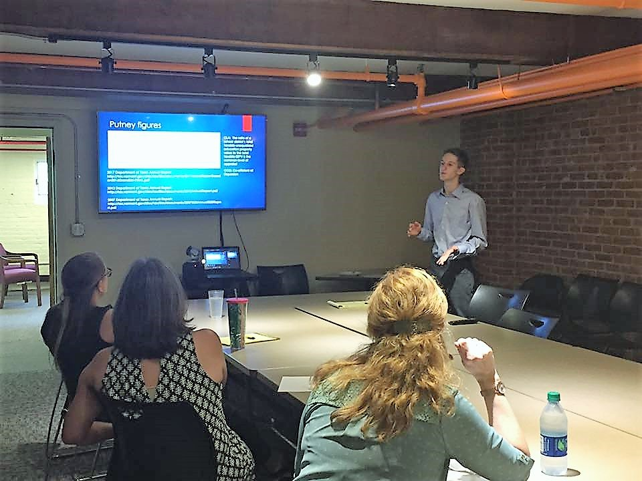
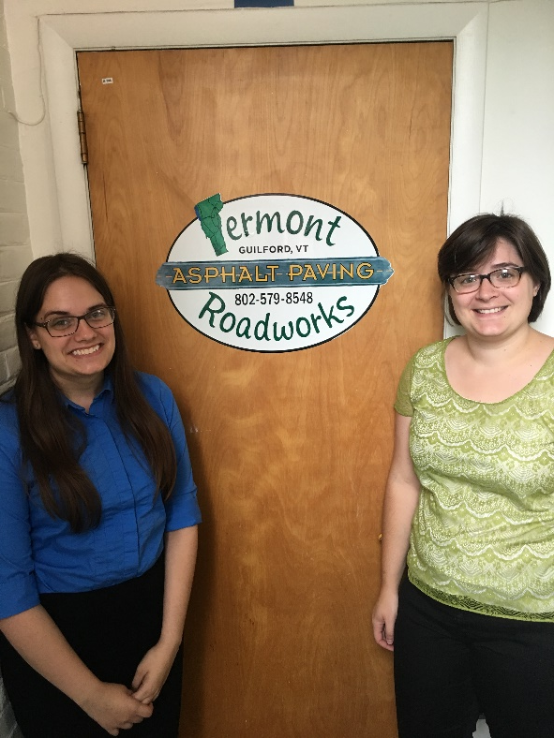
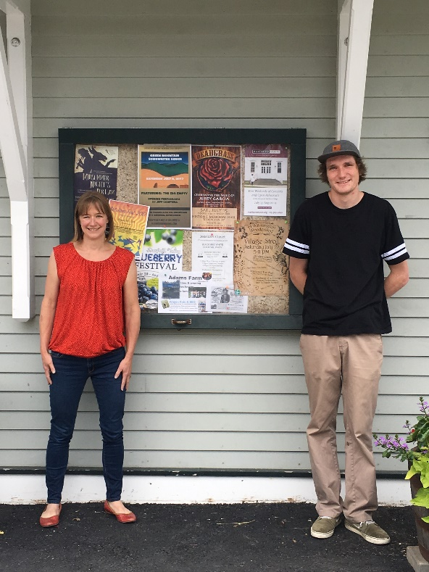
Internship Program Placement
76 interns placed
16 led to full time employment

Slide 6
Current Internship Openings
Marketing Intern – True North Granola
Sales Intern – Aflac Insurance
Tiny House Intern – Jamaica Cottage Shop
Administrative Assistant/Host Intern – Duo Restaurant
Harvesting/Processing Intern – Vermont Elderberry Farm

Slide 7
Interested Businesses & Organizations
If a company or organization is facing a workforce shortage, an intern may be a great opportunity to recruit high quality talent at a competitive cost.
Windham County colleges are attracting highly skilled individuals from across the country, and yet most students are unaware of locally available employment opportunities, forcing them to leave the State, bringing their skills and expertise with them.

Slide 8
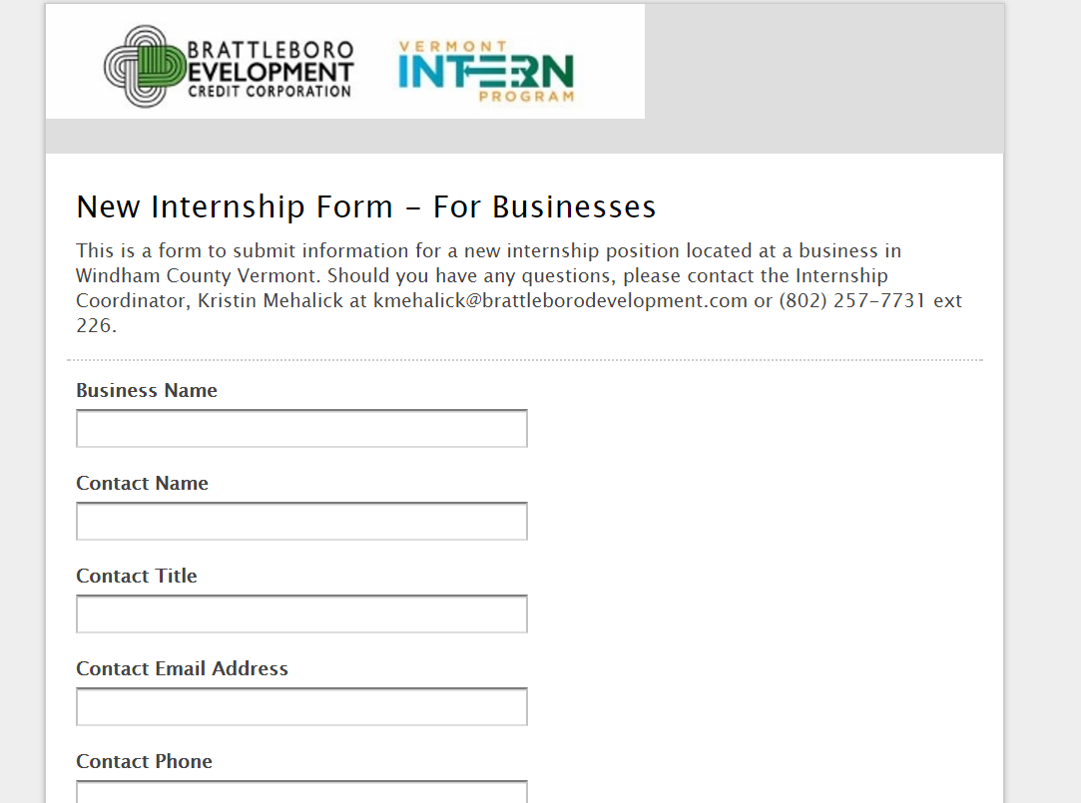
Job Description Form

Slide 9
Testimonials
“As an intern placed through the BDCC's internship program, I've gotten the chance to gain invaluable skills that would not have been possible under normal employment circumstances. Because I'm only 19 and have just completed my first year of college, the employment opportunities available to me are generally limited to manual labor and jobs that require little thought. However, as a intern I've gotten the chance to work with and around highly skilled professionals and gained expertise and advice from them, while also getting to complete projects for their different programs. This experience will surely serve me well going forward, and these professional skills will undoubtedly translate to wherever I work in the future, both next year and after college.” – Caleb Paasche, BDCC Summer Intern
“The BDCC internship program made it easy for us to get help over our busy summer season, when we have lots of events to plan and market. Kristin winnowed through applications so we were easily able to find a just-right candidate quickly. Our intern, Max, was a life-saver and he learned a lot through the design and marketing projects we handed to him. We'll definitely use the program again next summer!” – Meg Staloff, Program Coodrinator, Wilmington Works

Slide 10
Contact Information
Kristin Mehalick
Internship Coordinator
Brattleboro Development Credit Corporation
kmehalick@brattleborodevelopment.com
(802) 257-7731 ext.226

Slide 11
Internship Toolkit
Recruiting and Hiring Resources
Mentorship and Guidance
For questions or to participate in the Bennington Comprehensive Internship Program contact:
Michelle Marrocco
mmarrocco@bcrcvt.org
(802) 442-0713 x9

Slide 12
Questions and Comments

