Slide 1
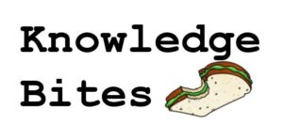
Structured Problem Solving
SVEP Webinar Series
“How do I solve problems quickly and keep them from recurring?”
Jon Bates
September 12, 2017

Slide 2
Jon Bates
Professional Manufacturing and Business Growth Advisor
(802) 345-2062 jbates@vmec.org
Jon joined VMEC in April 2017 as a VMEC Professional Manufacturing & Business Growth Advisor. He has over 20 years of diverse, practical experience in engineering, business management, business marketing, customer relationship building, and project management in manufacturing and the HVAC industry. Immediately prior to joining VMEC, Jon was a Manufacturing Process Engineer at General Electric (GE) Aviation in Rutland, VT. In that role, he drove process improvements and Lean initiatives that in part included successful efforts to decrease delinquency to customers, reduce scrap and rework, and reduce inventory.
Jon holds a BS degree in Mechanical Engineering from the University of Vermont and is also a graduate of the GE Apprentice Program. Jon has since become a valued instructor, through Vermont Technical College (VTC), of the successful GE Apprentice Program at GE Aviation in Rutland.

Slide 3
VMEC is a Vermont resource and trusted advisor to enterprises of all sizes. Since 1995, the VMEC Team has brought world-class expertise through consulting, coaching, hands-on implementation support, and training and education for leaders and workers.
VMEC helps company leaders with the structure, behaviors, and systems, that lead to a culture of continuous improvement and employee engagement. This management philosophy fosters the behaviors needed to be successful in a continuous learning culture, where all employees are engaged in improvement.

Slide 4
Why Do Problems Keep Coming Back?
Are we solving the real problem, or masking symptoms?
By masking symptoms, we are not only turning off the signals but ignoring the real problem.
Focusing on symptoms deviates our attention from solving the root problem. Or, actually, root problems. As, in most cases, symptoms are caused by multiple problems.
Focusing on symptoms rather than on understanding the real problem is ingrained in our culture.
We get caught in the trap of solving short-term symptoms instead of fixing the real problem. Symptoms will show up again driving more anxiety in your team.

Slide 5
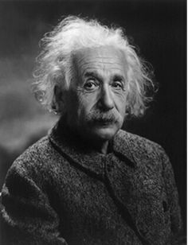
Are We Solving the Right Problem?
“If I were given one hour to save the planet, I would spend 59 minutes defining the problem and one minute resolving it.”
Albert Einstein

Slide 6
ASK 5 PEOPLE WHAT THE PROBLEM IS,
GET 5 DIFFERENT ANSWERS
Each according to their perspective, beliefs & bias
= Observed Problems
This seems important!
This seems interesting
There's always too much to do, and by random choices we get nowhere
We have limited time and resources for problem solving!
Illustration by Teemu Toivonen

Slide 7
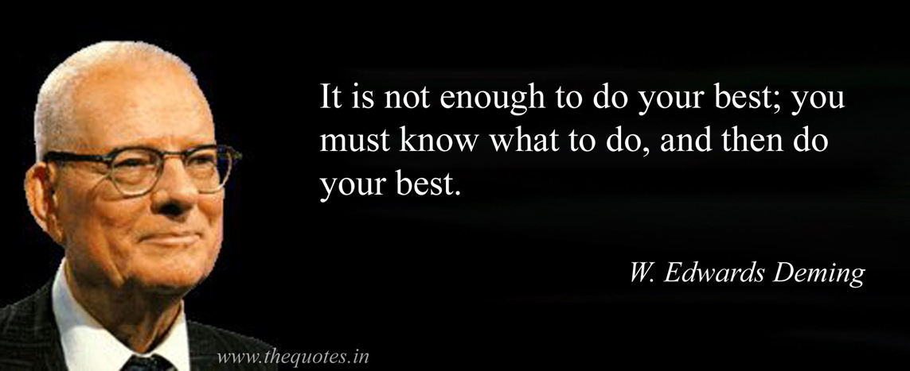
HOW DO WE KNOW WHAT TO WORK ON?
Each according to their perspective, beliefs & bias

Slide 8
WE NEED A TARGET CONDITION
What do you want to achieve?
Things
we HAVE
to do
Things we
CAN do

Slide 9
THAT TAKES SOME ANALYSIS & PLANNING
✓
✓
✓
NEXT TARGET CONDITION

Slide 10
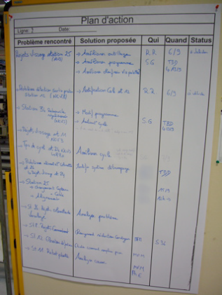
SO NOW WE CAN GET GOING, RIGHT?
We know the overall direction or challenge,
where we are now and our next Target Condition.
It’s time to make a plan for how to get there!
Team's Action Plan

Slide 11
SO NOW WE CAN GET GOING, RIGHT?
We know the overall direction or challenge,
where we are now and our next Target Condition.
It’s time to make a plan for how to get there!
Well, not quite...
Team's Action Plan

Slide 12
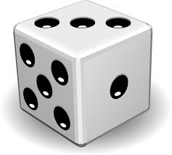
THE DICE EXPERIMENT
I’ll roll a die three (3) times and sum the numbers.
The sum will be a number between 3 and 18.
Before I roll, please write down:
What will be the sum of the 3 rolls?

Slide 14
Those of you who wrote down the incorrect sum...
How do you feel?

Slide 15
Not so bad,
it’s just chance

Slide 16
QUESTION #2
2, 4, 6, 8, 10, 12, ?
What will be the next number in this series?
Please write down your answer

Slide 17
ANSWER
2
2, 4, 6, 8, 10, 12,

Slide 18
ANSWER
2
2, 4, 6, 8, 10, 12,
Those of you who wrote down
the incorrect number...
How do you feel this time?

Slide 19
Hey!

Slide 20
What was different
about these two scenarios?

Slide 21
DIFFERENCE BETWEEN THE SCENARIOS
How easy or hard it is to spot the Current Knowledge Threshold
• In Round 1 with the dice, it was easy to see
that we didn’t know what the outcome would be.
• In Round 2 the knowledge threshold was more
difficult to see. We thought we knew the answer,
so we went over the threshold & answered.
Yet in both rounds the knowledge threshold was the same: There were no facts beyond the initial setup
Predictable Zone
2, 4, 6, 8, 10, 12
Current
Knowledge
Threshold
What would be a good answer in both rounds?
Why don’t we say that?

Slide 22
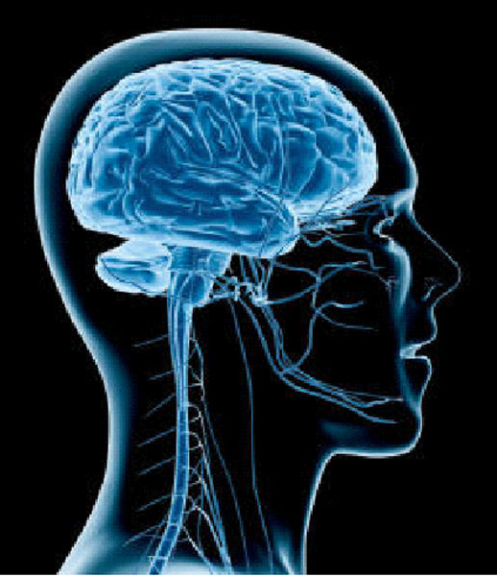
WHY WE GO THROUGH
KNOWLEDGE THRESHOLDS
OUR BRAIN FILLS IN THE BLANKS
(automatically)
Current
Knowledge
Threshold

Slide 23
READ WHAT YOU SEE
IUMRING TQ GQNGIUSIQNS

Slide 24
IUMRING TQ GQNGIUSIQNS

Slide 25
IUMRING TQ GQNGIUSIQNS
We don't notice the Knowledge Threshold because our brain automatically fills in the blanks

Slide 26
WE NEED THIS COGNITIVE MECHANISM
TO GET THROUGH THE DAY
Ca y u rea t is?
But it also causes some problems

Slide 27
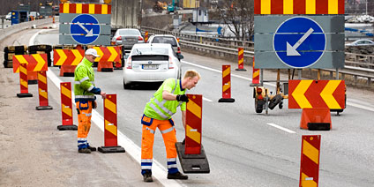
THERE'S ALWAYS A KNOWLEDGE THRESHOLD
What’s over the hill??
The path is unpredictable
Key points about Knowledge Thresholds:
1) They're hard to see (until you practice it)
and we tend to go right through them
2) We actually see farther through experimenting
3) We don’t know in advance what the result
of a step/experiment will be
The Knowledge Threshold is our Learning Edge.
It's where the next experiment should take place.

Slide 28
Signing your name
Using your dominate hand, sign your name 5 times. Time yourself.

Slide 29
Signing your name
Now using your other hand, sign your name 5 times. Time yourself.

Slide 30
Signing your name
How did it FEEL the 2nd time compared to the 1st?
Awkward
Messy
Slow
Unnatural
Difficult
Deliberate
Can’t tell what I’m doing
Had to think about it

Slide 31
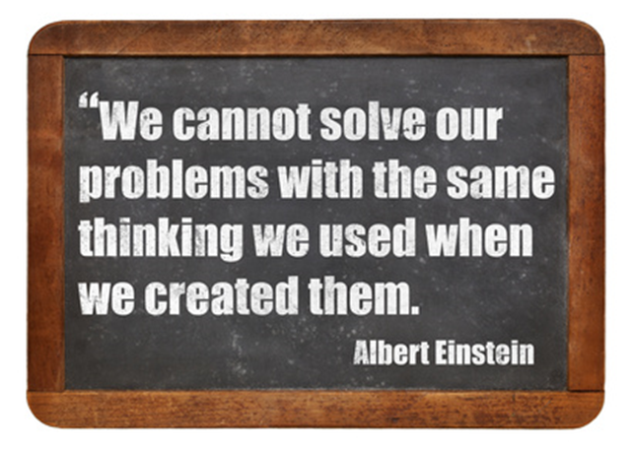
WE NEED TO LEARN NEW BEHAVIORS
Each according to their perspective, beliefs & bias

Slide 32
A COUNTERMEASURE TO EVERYONE’S NATURAL BIAS SCIENTIFIC THINKING
"Let's try it and see"
Scientific thinking is a routine of intentional coordination between what we think will happen (theory), what actually happens (evidence), and adjusting based on what we learn from the difference.
What we
expect
to happen
What
actually
happened
Learning

Slide 33
ADOPTING NEW WAYS
Hoping to create different behavior by explaining or trying to convince people generally doesn't work.
We don't behave a certain way because we lack information. We behave one way or another because it's a habit.
What can work is deliberately practicing a different routine, which over time changes how you think.
But don't try to run 20 miles in your first workout! Begin with some starter practice routines, which help you learn fundamentals and build some initial confidence in the new pattern you are trying to learn.

Slide 34
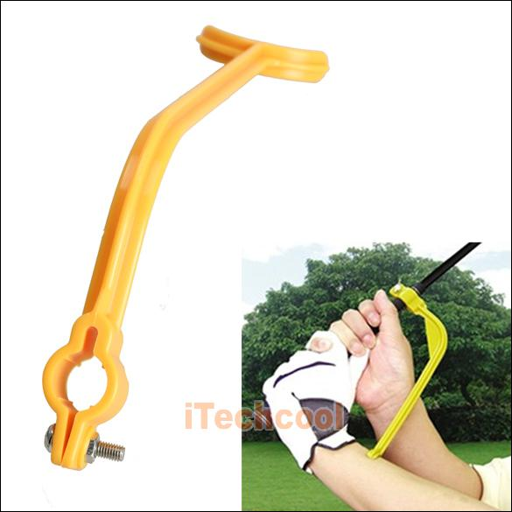
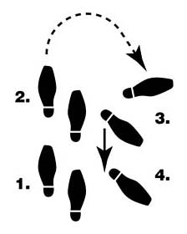
WHAT ARE KATA?
They're practice routines. Kata are structured routines to practice deliberately, especially at the beginning, so their pattern becomes a habit and leaves you with new abilities. Kata are for learning fundamentals that you can build on. Kata are a way of transferring skills and developing shared abilities and mindset in a team or organization.
“Let’s begin by practicing it this way for a while”
Science + Kata = Problem Solving Skill
Combining a scientific pattern with structured practice
routines (Kata) develops effective problem solvers

Slide 35
WHAT KATA ARE FOR
The Routines of the Improvement Kata and Coaching Kata
are Practiced to Develop Scientific Mindset
Kata
Practice
To develop foundational
skill and mindset
Beginners should follow Kata exactly; not deviating from them, so the Learner can internalize the patterns. But with increasing proficiency each Learner can start to (within limits) develop their own style.
Likewise, over time each organization can evolve the Kata it began with to better suit and mesh with its culture. The original Kata evolve into organization-specific practice routines.

Slide 36
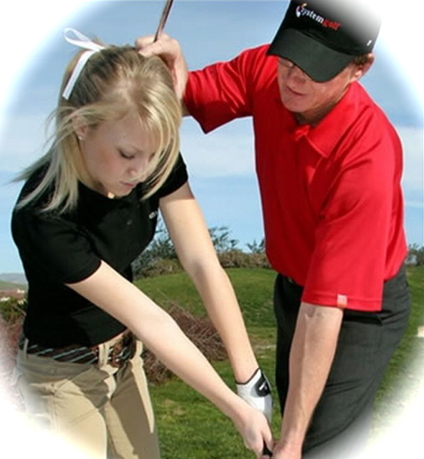
4 INGREDIENTS FOR ACQUIRING NEW SKILLS
Brain research is clear: To develop new habits you should practice new routines and experience a progressive sense of mastering them (which helps generate and maintain enthusiasm). The following ingredients help us rewire our brain (new neural circuits) to acquire new skills & mindset.
k
STARTER
KATA
l
COACHING
Structured routines
for beginners
to practice
fundamentals
Corrective feedback
to ensure the Learner practices the right
patterns
j
m
This is how you do it
FREQUENT
PRACTICE
MASTERY
Growing self efficacy
"I'm getting better at this"
A little every day

Slide 37
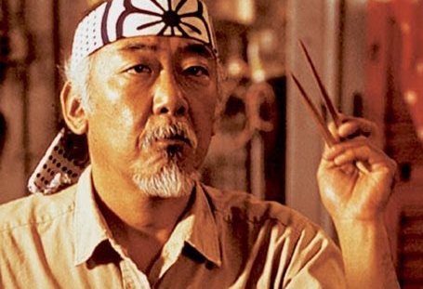
HOW LONG DO YOU PRACTICE RELIGIOUSLY?
Real practice doesn't pass through these discrete stages,
but they are a useful way to depict your progression
(1) FOLLOW: Start by repeating each practice routine without modification, so you can absorb its fundamental pattern.
(2) DETACH: Once the basic patterns get habitual and you understand the 'why' behind them, you'll start to adapt them.
(3) FLUENCY: At this stage your actions become natural. You can create your own approaches to fit different circumstances, while sticking to basic underlying principles.

Slide 38
THE IMPROVEMENT KATA MODEL
Kata¹ (方) – Suffix Meaning "Way of Doing"
We found a common, scientific pattern of thinking and behavior in Toyota managers' approach -- their 'Way of Improving' -- and depicted it with a four-step model we named the “Improvement Kata.”
1
3
Get the Direction or
Challenge
Establish your Next
Target
Condition
2
4
Conduct Experiments
to get there
Grasp the Current
Condition
The Improvement Kata model comes from research into how Toyota manages people, which is summarized in the book “Toyota Kata”

Slide 39
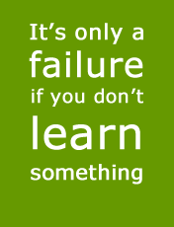
IT IS ALL ABOUT THE JOURNEY AND WHAT WE LEARN ALONG THE WAY?
Each according to their perspective, beliefs & bias

Slide 40
Contact Information
E-mail: jbates@vmec.org
Phone: (802)345-2062
Website: www.vmec.org

