Slide 1
Agenda
Introduction: The Labor Market Information Division
Our Data Products:
  Quarterly Census of Employment & Wages
  Current Employment Statistics (AKA The Establishment Survey)
  Local Area Unemployment Statistics (AKA The Household Survey)
  Occupational Employment Statistics
  Projections
  The Annual Economic & Demographic Profile
Other Sources We Frequent:
  QWI
  On The Map
www.vtlmi.info

Slide 2
E&LMI: Who are we?
  The Economic & Labor Market Information Division
  Housed in the Vermont Department of Labor
  State partner to the Bureau of Labor Statistics
  100% federally funded
  LMI for short
  Every state has one
  Purpose:
  - To produce, explain, and disseminate economic data for the benefit of the State of Vermont, educational institutes, employers, students, job-seekers, researchers, and the general public.
www.vtlmi.info

Slide 3
Quarterly Census of Employment & Wages
QCEW
What does it measure?
Covered Employment & Wages of all VT firms, sortable by industry and geography.
How does it measure this?
A census of every firm in the state that participates in the UI Program.
How is it used?
The anchor for most of our other data products. Data on employment by firm size, industry wages etc…
Strengths: Accuracy, detailed geographies and industries.
Limitations: Delayed production, limited universe, and not time series.

Slide 4
Employment by Industry
Q4 2016 – Q3 2017
Source: Vermont Department of Labor, Quarterly Census of Employment & Wages

Slide 5
Current Employment Statistics
CES
What does it measure?
Employment, hours, and earnings of workers on nonfarm payrolls.
How does it measure this?
A modeled survey of approximately 2,000 Vermont businesses each month.
How is it used?
To estimate job growth and wage changes– a more timely & comprehensive QCEW.
Strengths: Timeliness, broader universe, and time series.
Limitations: Monthly data subject to significant revision, and very limited geographies.

Slide 6
Source: Current Employment Statistics Program
www.vtlmi.info

Slide 7
Local Area Unemployment Statistics
LAUS
What does it measure?
Labor force situation of all household members 16+.
How does it measure this?
Modeled data from the Current Population Survey of 1,200+/- Vermont households.
How is it used?
To generate labor force data: The number of employed, unemployed, and out of the labor force; the unemployment rate and a wide range of participation questions at the county and town level (until 2018) in Vermont.
Strengths: Detailed household data, many geographies, and time series.
Limitations: Monthly data subject to significant revision, smaller geographies have very larger error ranges.

Slide 8
Source: Bureau of Labor Statistics, Current Population Survey

Slide 10
Occupational Employment Statistics
OES
What does it measure?
Occupations and rates of pay for Vermonters.
How does it measure this?
Survey of approximately 5,000 Vermont firms over a three-year period.
How is it used?
To produce estimates of employment by occupation and detailed wage ranges.
Strengths: Precise wage data that informs a wide range of public policy questions.
Limitations: 3 geographies, not time series, and reclassification problems.

Slide 11
Year | Area | SOC¹ | Occupation Title¹ | Employment² |  |  | Hourly Wages ³
 |  |  |  |  | Mean | 10th Percentile | 25th Percentile | Median | 75th Percentile | 90th Percentile
2016 | Vermont Statewide | 00-0000 | All Occupations | 304,670 | 22.90 | 10.45 | 13.05 | 18.23 | 27.12 | 38.85
2016 | Vermont Statewide | 11-0000 | Management Occupations | 12,250 | 49.34 | 22.31 | 30.41 | 42.63 | 58.96 | 84.42
2016 | Vermont Statewide | 11-1011 | Chief Executives | 280 | 92.83 | 33.32 | 56.17 | 90.59 | 100.00+ | 100.00+
2016 | Vermont Statewide | 11-1021 | General and Operations Managers | 2,760 | 53.69 | 22.08 | 30.73 | 45.16 | 66.52 | 96.61
2016 | Vermont Statewide | 11-2011 | Advertising and Promotions Managers | 40 | 57.71 | 27.03 | 41.64 | 53.04 | 69.70 | 92.79
2016 | Vermont Statewide | 11-2021 | Marketing Managers | 380 | 58.95 | 26.94 | 35.57 | 51.93 | 75.70 | 96.34
2016 | Vermont Statewide | 11-2022 | Sales Managers | 480 | 68.43 | 28.50 | 36.80 | 54.35 | 82.73 | 100.00+
2016 | Vermont Statewide | 11-2031 | Public Relations and Fundraising Managers | 210 | 51.18 | 28.10 | 31.88 | 41.91 | 63.70 | 94.62

Slide 12
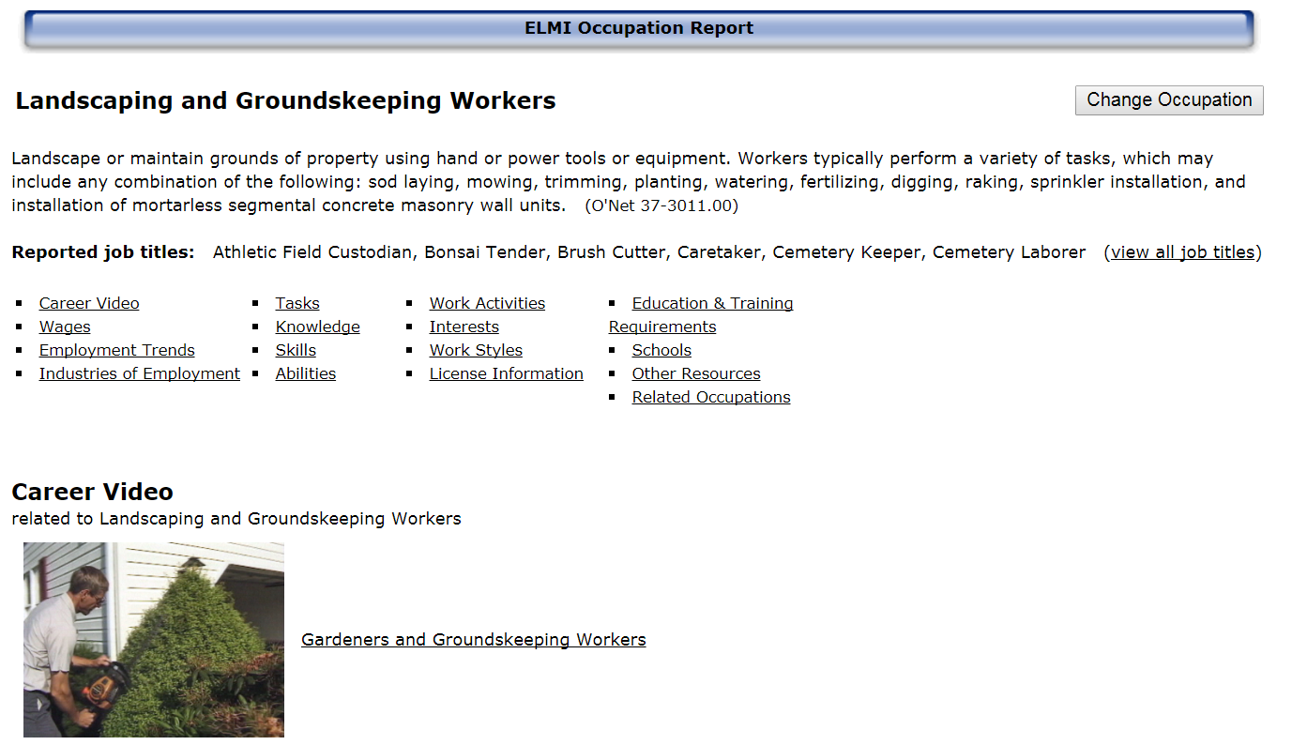
OES Detailed Occupation Reports

Slide 13
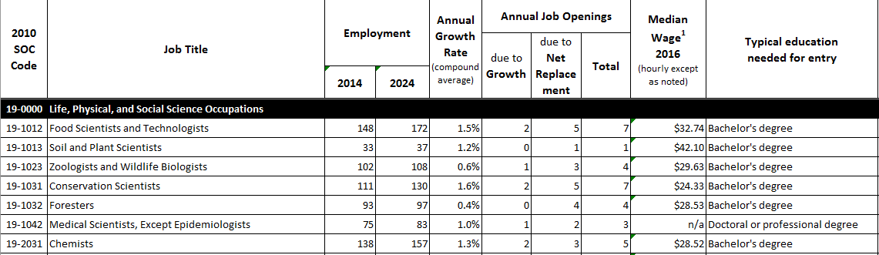
Projections
Occupation and Industry Employment Projections
2-year and 10-year
Statewide and 3 Sub-State Geographies
Secular Estimates

Slide 14
Economic and Demographic Profile
Detailed review of our data products at the town and county levels.
Also includes data from
  BEA
  Census
  QWI
  LEHD
  Education
  Tax
  Agriculture

Slide 15
Other Data Sources:
Longitudinal Employer-Household Dynamics
Data on employment, earnings, and job flows at detailed geographies, industry, and demographics.
Combines administrative data from UI, QCEW and Census
Can be used to measure labor market conditions – Hires, fires, turnover etc… (Quarterly Workforce Indicators, QWI)
Can be used to explore commuting patterns (OnTheMap)

Slide 16
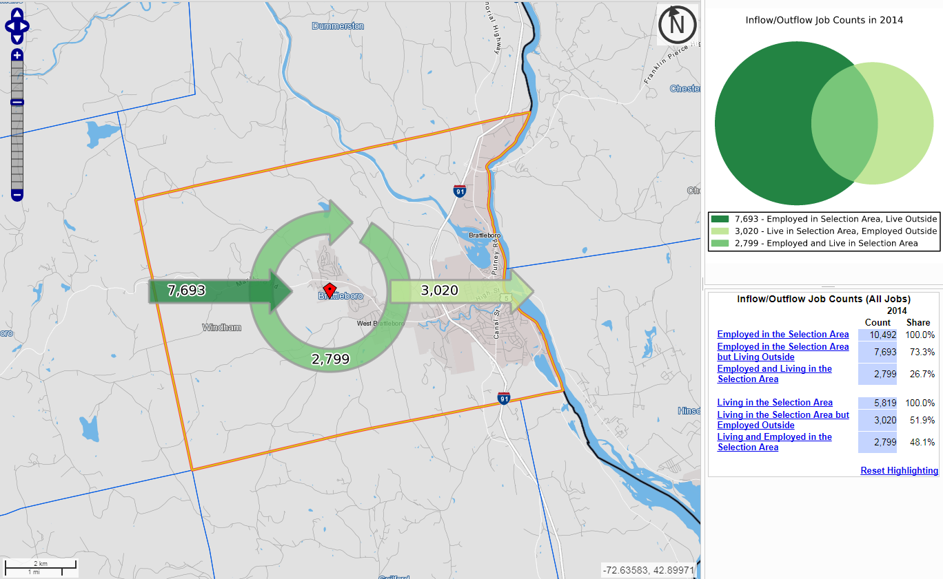

Slide 17
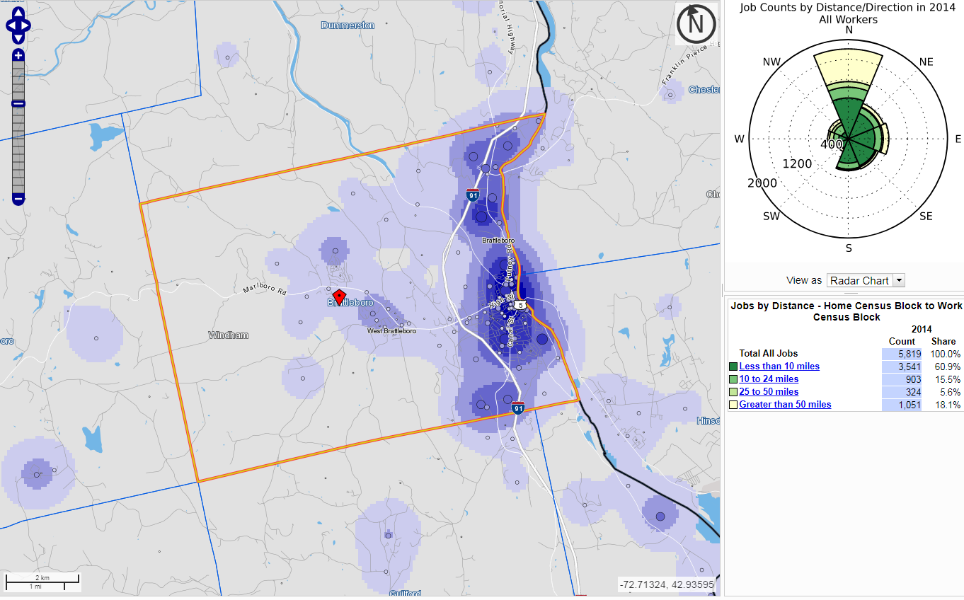

Slide 18

Questions or Comments?
For More Information:
Kevin Stapleton
Assistant Chief
Economic & Labor Market Information Division
Vermont Department of Labor
(802) 868 – 3868
Kevin.stapleton@Vermont.gov
www.vtlmi.info

