Slide 1
Act 185 clean water state revolving fund
September 11, 2018
Knowledge bites webinar
Terisa Thomas, SRF Program manager

Slide 2
What is cwsrf?
Notes:
Clean Water State Revolving Fund (CWSRF) is primarily a subsidized loan program. Every year we receive a grant f/ EPA, that is matched 5:1 with state dollars, loans out, repayments back in.

Slide 3
What did Act 185 Change?
Enable Sponsorship
1
Expand Eligibility to Clean Water Projects
2
Expand Eligibility to Private Entities
3

Slide 4
What is sponsorship?

Slide 5
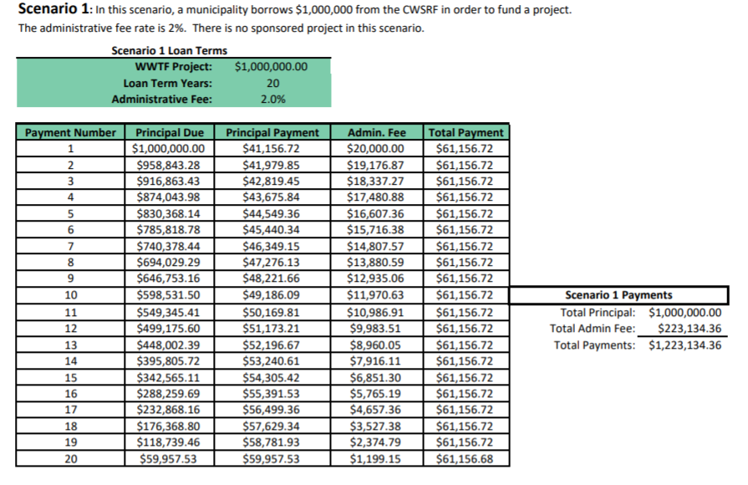
Can you give me an example?
Municipality “X” is takes loan for $1m for a pipe replacement project, they would bond and repay that $1M over 20 years at a 2% admin rate.

Slide 6
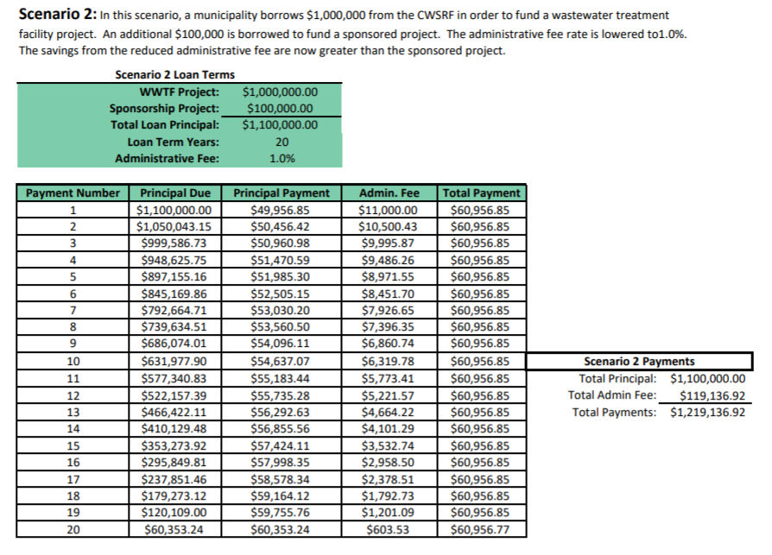
Sponsorship payment
Under sponsorship, that same municipality would combine that pipe replacement project with, for example, a buffer strip for $100k. They would take out a loan for $1.1M, CWSRF would discount the admin fee amount to 1%, so they are paying the same amount over 20 years. This makes the natural resource project “free”.

Slide 7
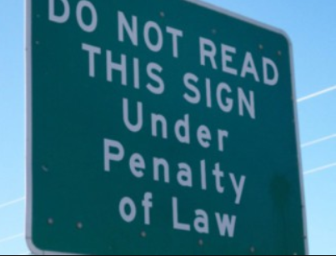
Important statutory language
Sponsorship can only be a municipal/municipal arrangement (town wants to own and maintain project) or municipal/nonprofit
Bonding exemption

Slide 8
Overall proposed process
Nonprofits or municipalities (implementers) complete a project proposal form and receive approval from dec that their project meets criteria
Implementers seek out a municipal entity willing to sponsor their project
Both Projects are submitted for the priority list as a single project and ranked*
Projects apply for funding, receive approval, and construction (if applicable) happens
Long term agreement (easement) is in place to preserve natural resource in perpetuity

Slide 9
Where does the money come from?
Program expanded eligibility to private entities, will charge them a higher rate than municipalities; that excess $ makes up for lost revenue from sponsorship
Note on Additional subsidy: this act preserves adsub for our municipalities; they can still enjoy principal loan forgiveness as outlined in the iup

Slide 10
Ch. 2 Prioritization/PC Grant calculations
Ch. 2 revision (effective 12/2017) gives out state Pollution control grants based on a percentage of points received when ranking criteria is applied
WISPR has a baked in financial incentive: two projects together are likely to increase overall points which means the traditional CWSRF project will be elevated higher on priority list
AND higher points equals higher grant percentage community is eligible for
AND higher points means that project will have a greater likelihood of getting high enough on the grant funding list to receive grant

Slide 11
Goals for Focus Groups (& Non-Goals)
Today is:
Getting input on incentives and application procedure proposals
Gauging interest
Learning common vocabulary and learning perspectives from both groups
Today is NOT:
The beginning “matchmaking” session to start pairing up projects

