Slide 1
CVFiber Case STudy
Presented by: Jeremy A. Hansen, Ph.D CISSP

Slide 2
About me…
PhD in Computer Science
Associate Professor at Norwich University
10+ years in information technology & security
Experience in Fortune 500 down to 2 person organizations
Selectboard member in Berlin since 2013

Slide 3
Motivation
“…ensure that by the end of the year 2024 every E-911 business and residential location in Vermont has infrastructure capable of delivering Internet access with service that has a minimum download speed of 100 Mbps symmetrical.”
30 V.S.A § 202c (b)(10)

Slide 5
What We Did
Started a community-owned Internet Service Provider
Communications Union District: a municipal entity
Add language to 2+ Town Meeting ballots:
“Shall the Town of Berlin enter into a communications union district to be known as Central Vermont Internet*, under the provisions of 30 VSA Ch 82?”

Slide 7
Selling it to Selectboards
The member towns are totally insulated from the financial activities of the district. No tax money may be used!
The statute requires: “Each member shall make available for lease to the district one or more sites for a communications plant or components thereof within such member municipality.”
Appoint a governing board member, an alternate, and the town is done!

Slide 8
Why do this as a municipal entity?
Existing ISPs have little motivation to provide truly high-speed Internet
Local governance = local control = local accountability
No profit motive + municipal bonding → cheaper rates
Net neutrality & subscriber privacy concerns
Economic development
Telecommuters
Internet-based companies
Draw more young workers & entrepreneurs to Vermont

Slide 9
Mission & Vision
Mission “We provide Central Vermont residents, businesses, and civic institutions with universal access to a reliable, secure, locally-owned and governed communications network able to grow to meet future community needs.”
Vision “We envision a high-speed digital highway where traffic flows freely, growing the regional economy and broadening digital opportunities for people of all ages, means, and interests, thereby enriching the public and private lives of our residents.”

Slide 10
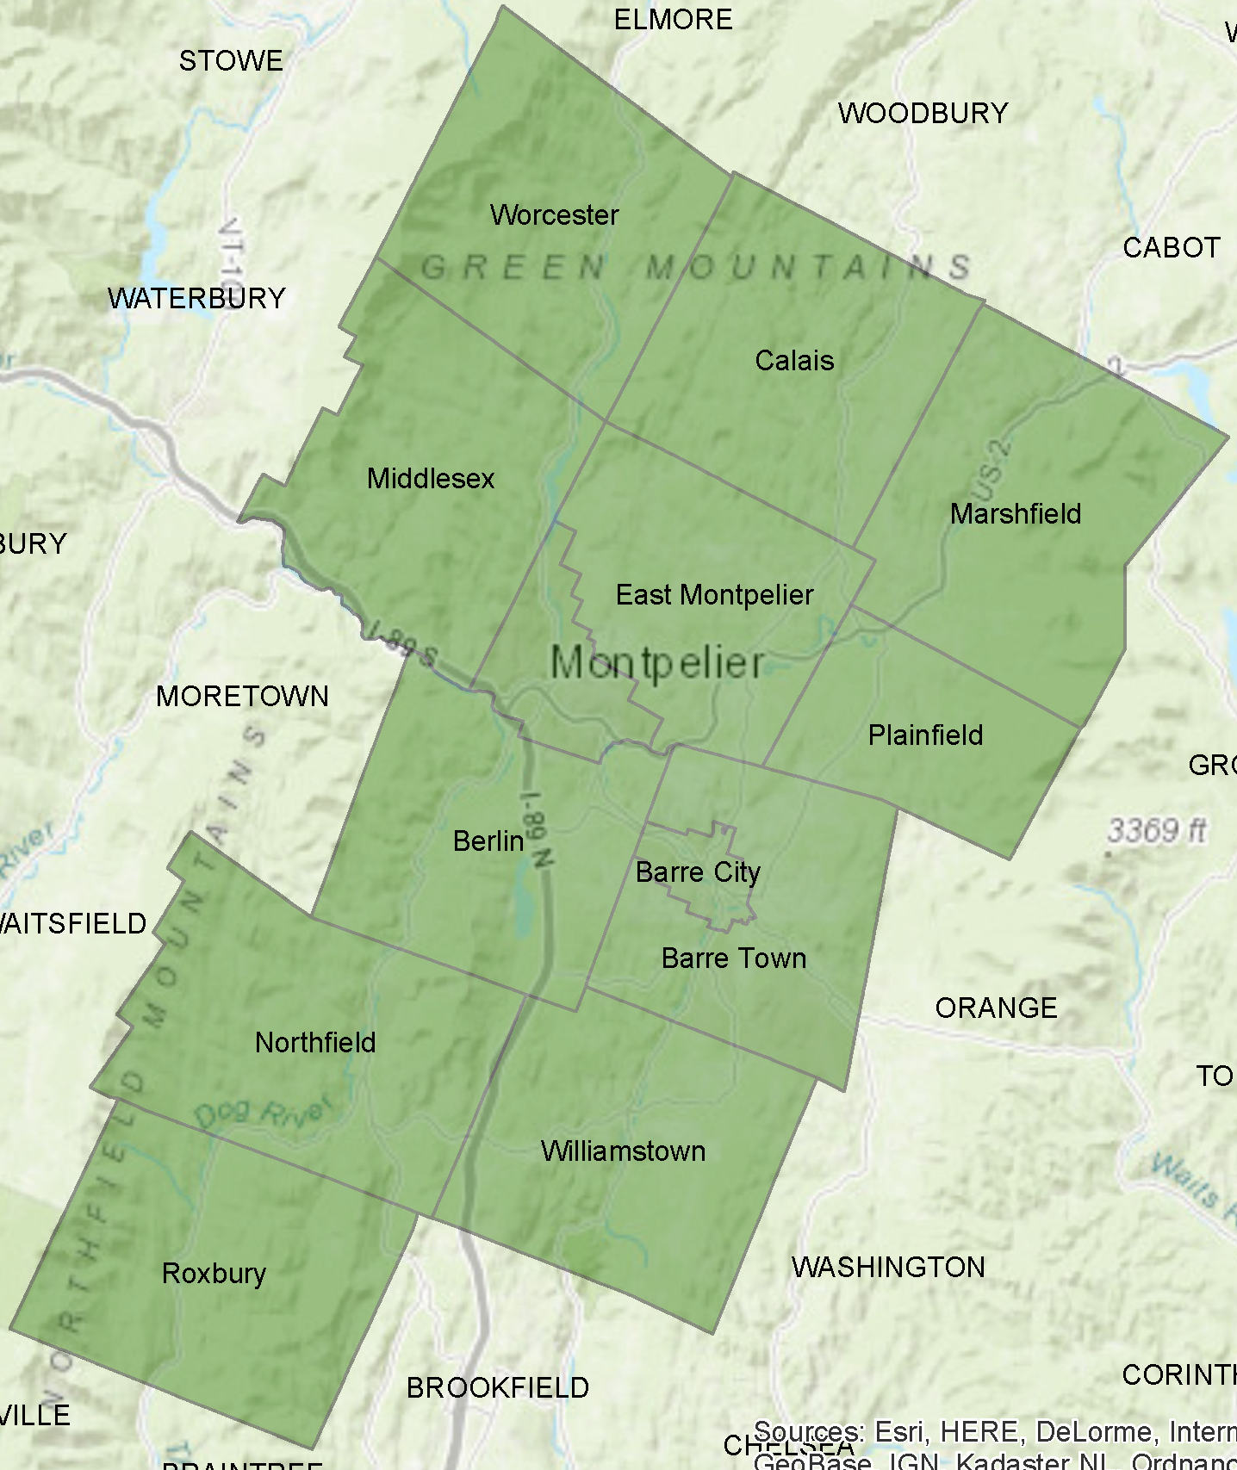
Passed Town Meeting BALLOT IN:
Barre City
Barre Town
Berlin
Calais
East Montpelier
Elmore
Marshfield
Middlesex
Montpelier
Northfield
Plainfield
Roxbury
Williamstown
Worcester

Slide 11
Added LATER:
Cabot
Orange
Interested:
Moretown
Washington
ECFiber:
Braintree
Brookfield
Granville

Slide 12
Next Steps & ROUGH TIMELINE
NOTE: Lots of “chicken & egg” situations to untangle
Set up organization [finishing]
Add additional members(?)
Identify sources of seed money* and anchor institutions [in process]
Identify a network operator [in process]
Work with network operator to survey, draft business plan, and design a pilot project [in process]
First construction at end of 2019(?)

Slide 13
Questions?
Feel free to contact me:
central.vermont.internet@gmail.com
802-279-6054

Slide 14
Want to Donate?
http://bit.ly/CVFdonate2018

