Slide 1
“Future-ready” economic development organizations
Jonathan Cooper
Bennington County Regional Commission
Knowledge Bites Webinar Series: March 19, 2019

Slide 2
International economic development council webinar series
How Economic Developers are Thinking about the Future
The Future of Infrastructure
The Future of Work
The Future of Technology Development and Commercialization
The Future of Economic Development Practices

Slide 3
The future-ready framework: control what you can control
“Not all ED employees need to be a technologist or engineer but they do need to understand it.”
Awareness = Bona Fides
“You have to start rebuilding economic development from the ground up… change is an opportunity if you understand it and embrace it – and disruptive only if you don’t.”

Slide 4
“Today’s systems are never built for our next pivot.”

Slide 5
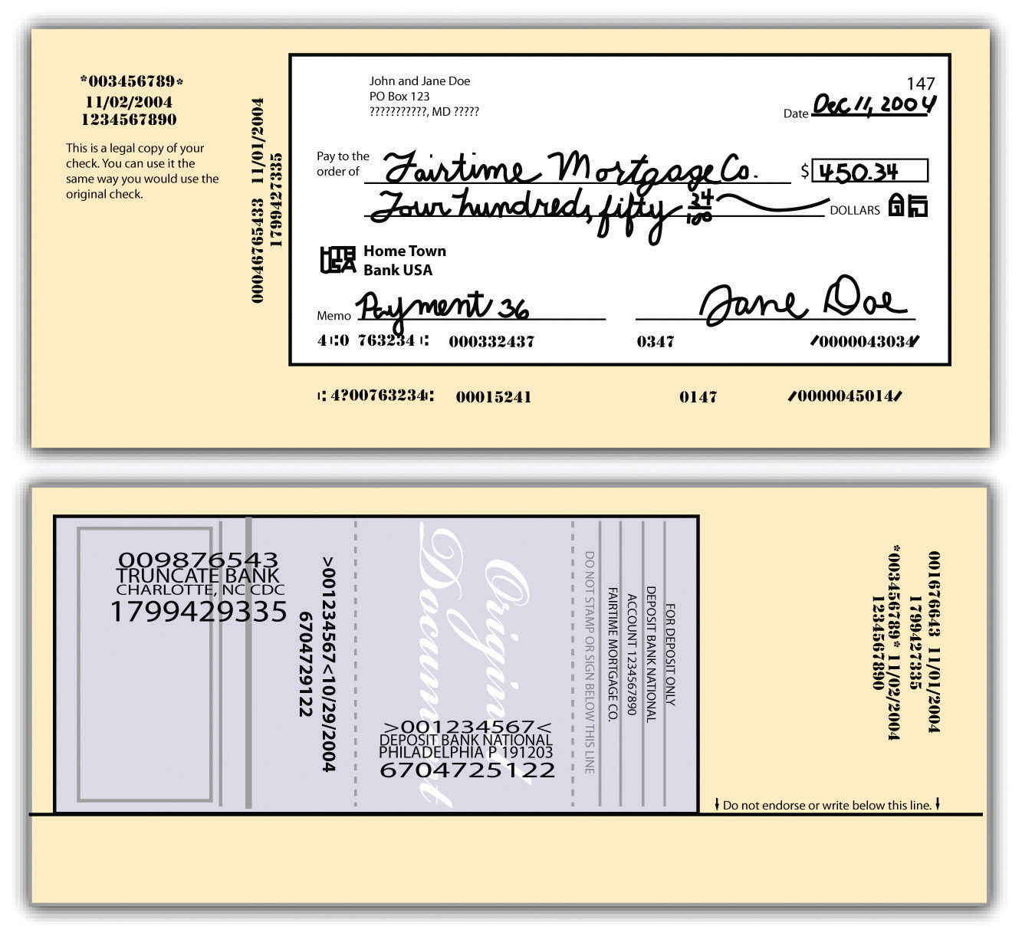
“Today’s systems are never built for our next pivot.”
But “disruption” does not equal “disaster!”
Can make previous status quo can seem silly.

Slide 6
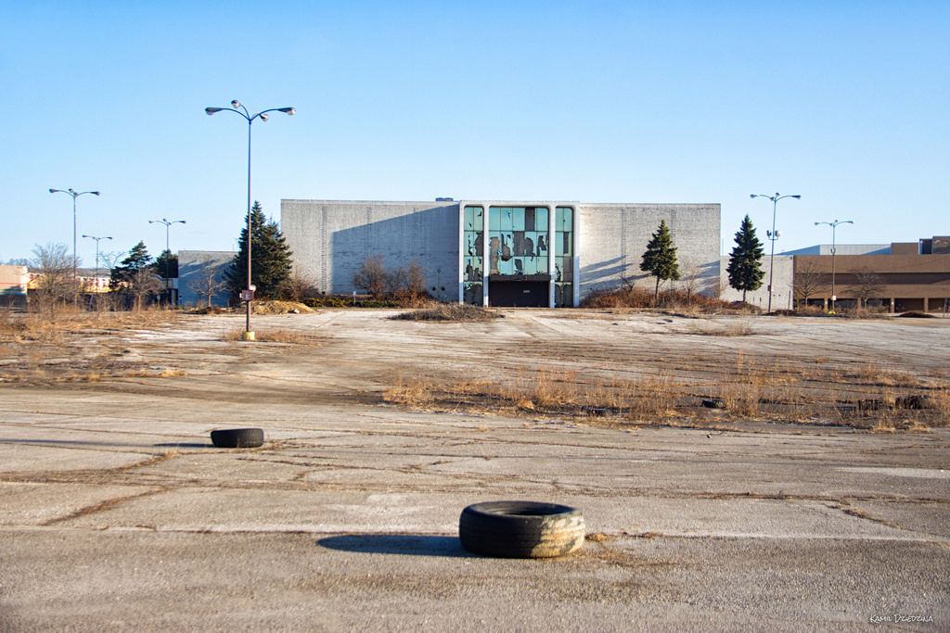
1. Thinking about the future

Slide 7
1. Thinking about the future
People can work from anywhere.
  Companies are taking less office space per employee.
Key institutions may be overbuilt: hospitals, colleges, business parks.
  Big implications where public services are dependent on real estate tax base.
  MUCH more interest locally in 2,500-10,000 sf scale for industry than in 25,000-plus.
  Potential business opportunity for key institutions in creating “condo” spaces for businesses.
    Can create a sensible talent pipeline option!
Only two ways to attract/retain companies.
  Pursue industries for which a community has requisite assets/amenities.
  Identify desired industries, analyze required assets/amenities, and acquire them.
Modern telecom infrastructure is necessary no matter how rural.
KNOW THYSELF: your assets and your limitations.
  Overselling is a waste of time and energy!

Slide 8
2. the future of infrastructure

Slide 9
2. the future of infrastructure
By 2030: high quality visual communication enabling virtual meetings.
  Visual communication technology establishes trust between parties.
    Major implications for rural businesses with non-local customer base: virtual storefront.
Augmented reality has applications beyond Pokemon Go
  Enhance street life
  Engage residents and visitors
  Reframe public space uses and images
Many ways to provide broadband
  Fiber, Satellite, Fixed Wireless, Balloons
  Municipal Electric Utilities as providers
The MOST SUCCESSFUL projects are multi-purpose, especially in rural areas
  Healthcare services
  Educational facilities
  Business development
  Smart Grid and other utility management

Slide 10
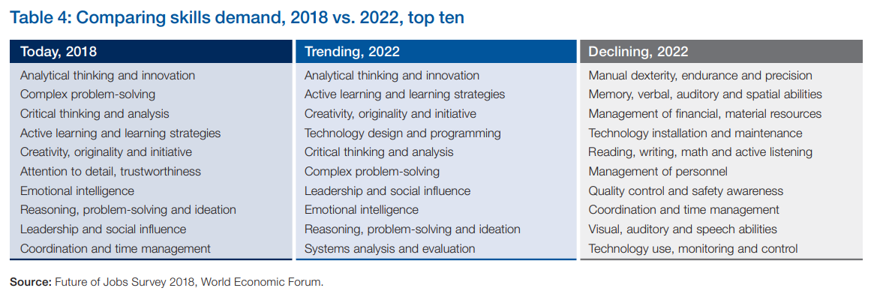
3. The Future of Work

Slide 11
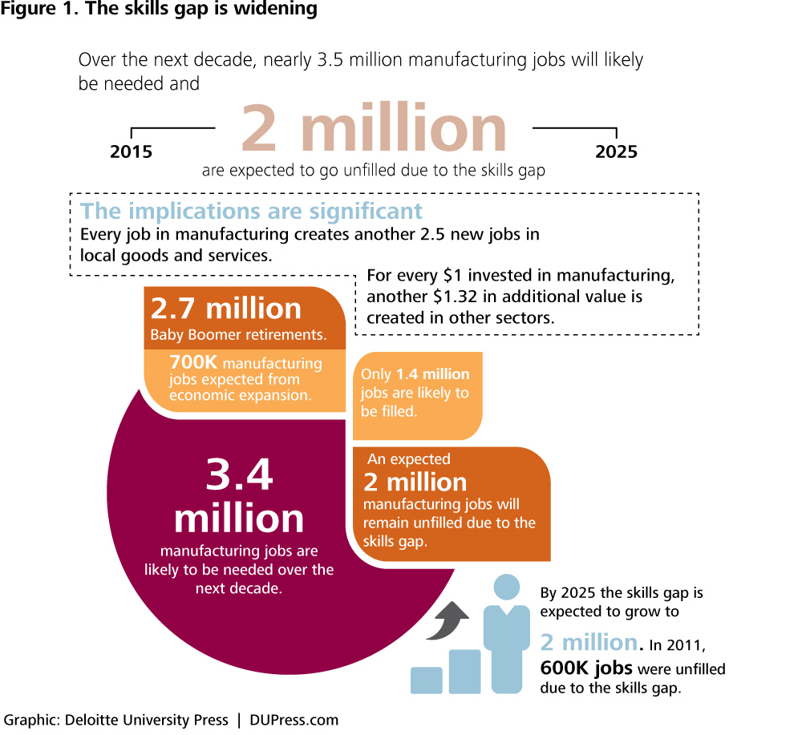
3. the future of Work
Agility enables quick responses to business needs. Two factors:
  Mindset: cooperation, speed of decision making, knowledge sharing, innovation focus.
  Tools/Processes: simplicity, technology adoption, empowerment, trial tolerance.
Employees in an Agile workplace believe in their company’s future success.
  But only 18 percent of US workers report workplace agility, while 59 percent report non-agile workplaces.
  This is a new form of employee opinion: new terminology, new perspectives, new definitions of company success.

Slide 12
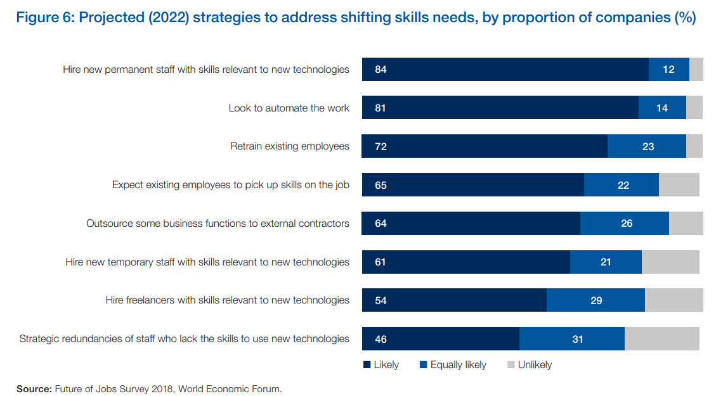
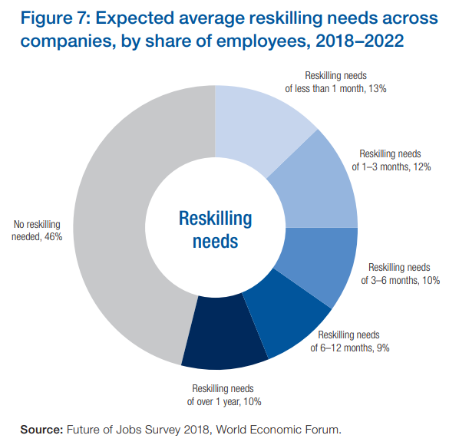
3. the future of Work

Slide 13
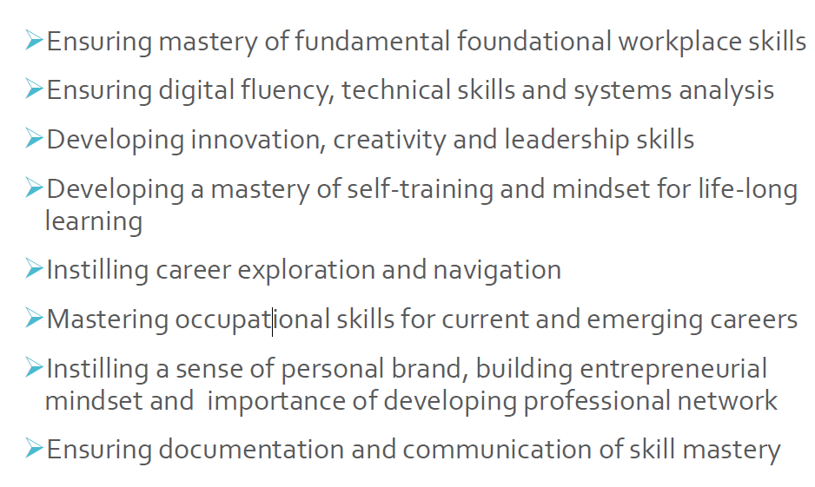
3. The Future of Work
Grant funding for reskilling is essential.
  Vermont Training Program
  Department of Labor
Community Colleges are in an increasingly prominent role.
  State-funded with access to federal and philanthropic support.
  Distributed campus model can tailor offerings to local needs.

Slide 14
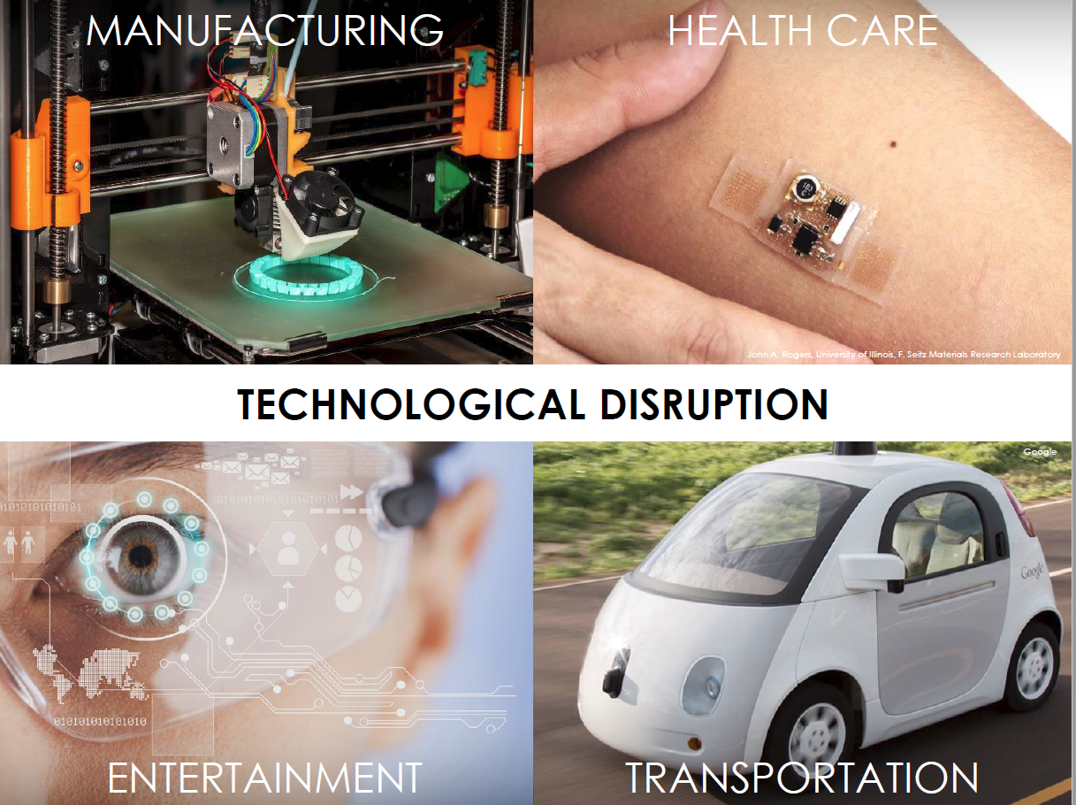
4. The future of technology development and commercialization

Slide 15
“If you don’t have the talent, you will probably be fighting a losing battle.”

Slide 16
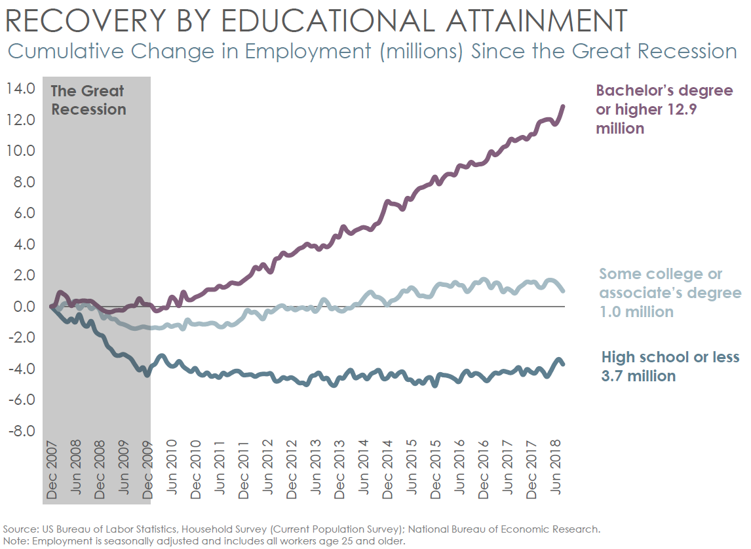
4. The future of technology development and commercialization
Major investments expected in a range of industries:
  Blockchain Technology
    Exists in Southern Vermont!
  Artificial Intelligence businesses
    Exists in Southern Vermont!
  Pop-up Stores
    Exists in Southern Vermont!
  Voice-centric Devices
  Subscription-based Products
    Software as a Service (SaaS)
    Exists in Southern Vermont!

Slide 17
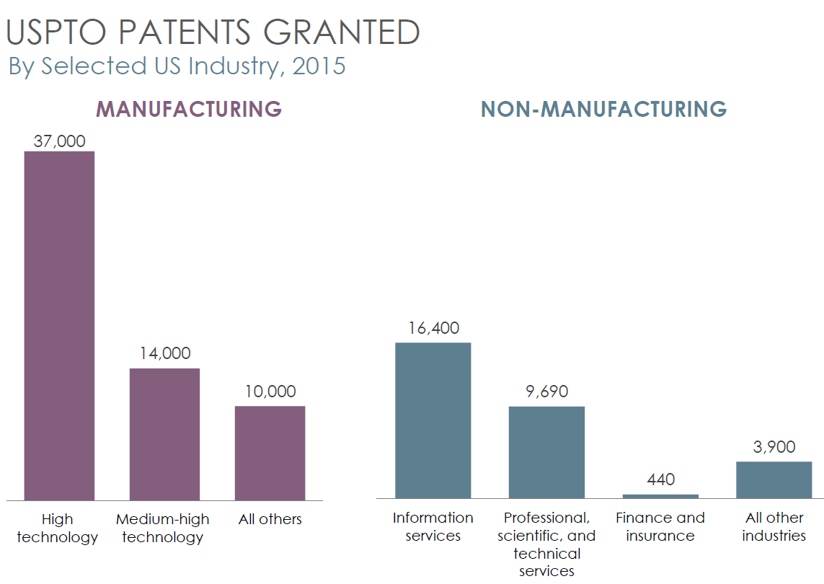
4. The future of technology development and commercialization
Major innovations in manufacturing sector will continue.
  Some technology is about automation.
  Some technology is about skill-building.
  Some technology is about new production.
Regional disadvantage: a major employment base in Southern Vermont will need to forge a stronger partnership with UVM’s office of Technology Commercialization (UVM Innovations)

Slide 18
4. The future of technology development and commercialization
Tech Market evaluations are based on data Southern Vermont professionals should know.
  Tech jobs as percent of total jobs.
  Average wage.
  Average rents for apartments and office space.
  Educational attainment rates.
  Millennial demographic concentration and growth rate.
  Tech degree concentration and growth rate.

Slide 19
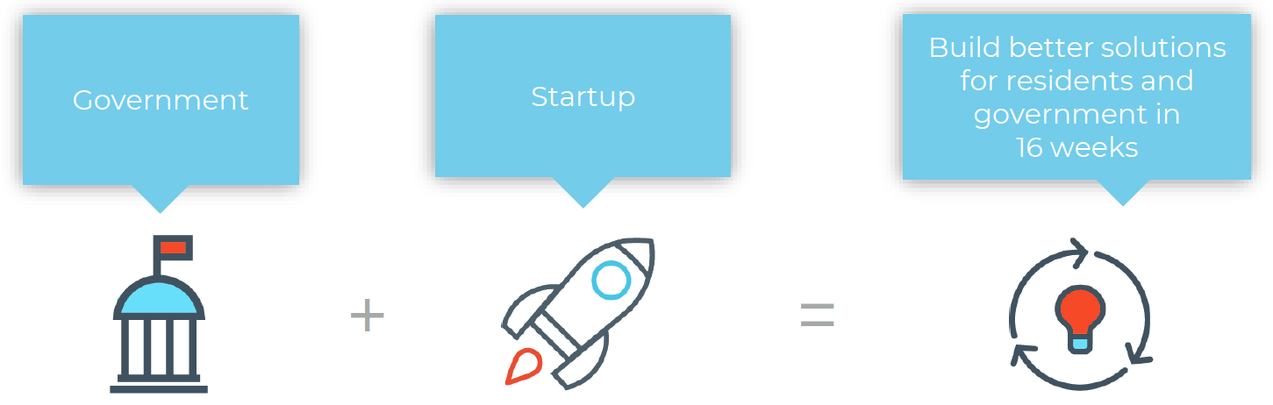
5. The future of economic development practices

Slide 20
5. The future of economic development practices

Slide 21
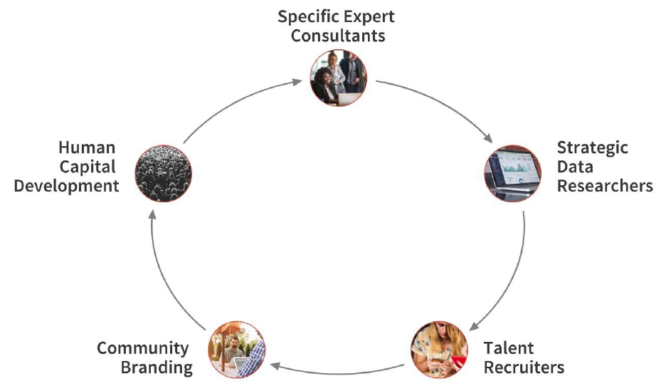
5. The future of economic development practices
Outdated models facilitated traditional economic development
  “Give Because it is Expected” – United Way
  “Social Pressure to Join” – Rotary, Country Clubs, Masons
  “Government-Driven Missions” – Public/Private Partnerships
New approaches to economic development have emerged.

Slide 22
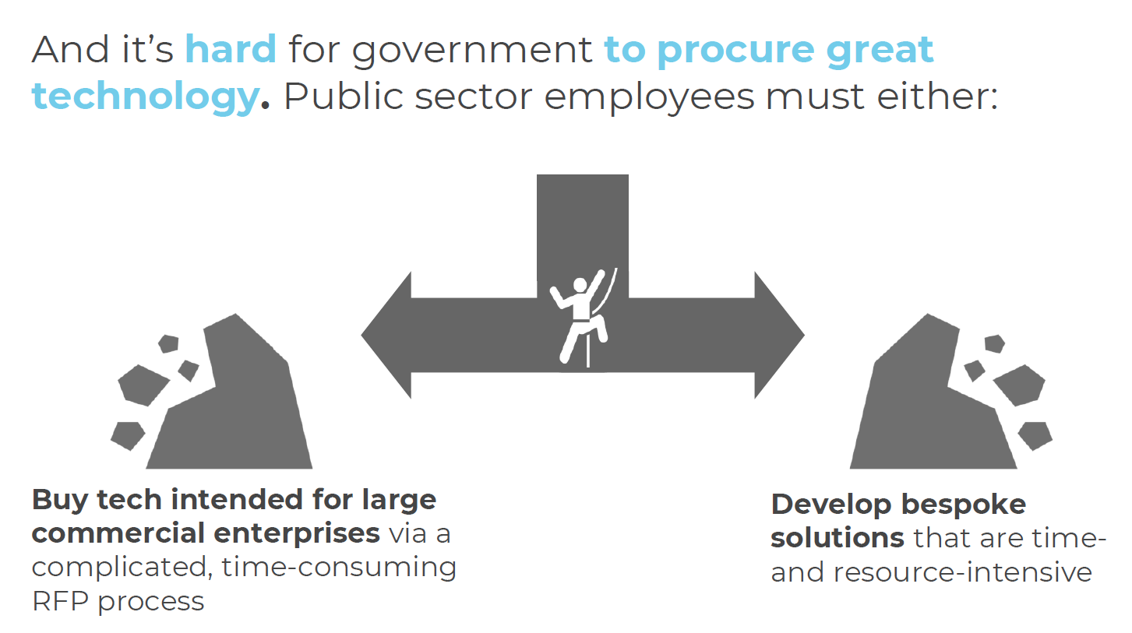
5. The future of economic development practices
Governments beginning to think like a business.
  Public sector tech systems are about two decades behind private sector.
Entrepreneurial approaches resolve barriers to public sector tech adaptation.
  Smart sensors on public trashcans.
  Streamlined and user-friendly foster family registrations.
  Predictive analytics and data to determine available on-street parking near transit stops.
ACCD is a client of City Innovate’s Startup in Residence (STiR) program!

Slide 23
5. The future of economic development practices
Key Issues
  Automation: which of our industries are vulnerable? What skills will still be required, and what new skills need development?
  Workforce: attracting top talent by marketing opportunities to address industry challenges. Addressing legal/admin issues of operating in gig economy, and creating pathways to future prosperity.
  Infrastructure: how will we ensure that Southern Vermont is connected to the worldwide marketplace?
  Message: what identity do our communities wish to present to the world. Where do residential values and business values converge and diverge?
Key Action Items
  Develop a Learning Strategy: stay abreast of trends and content that brings new perspetives.
  Get in on the Jargon Economy: language differences between your established and emerging sectors could be telling you something.
  Expand Technology Adaptation: start in the office, and take advantage of recent innovations to bring new services to the marketplace.

Slide 24
Thanks very much!
Jonathan Cooper
Bennington County Regional Commission

Slide 25

About the iedc
IEDC is the world’s largest membership organization serving the economic development profession, with more than 5,000 members and a network of more than 25,000 economic development professionals and allies. From public to private, rural to urban, and local to international, our members represent the entire range of economic development experience.

