Slide 1
Insurance How-to’s
SOVtyp

Slide 2
Insurance How-to’s
Intros
Brittany Schmidt, DC
Works in health care as a chiropractor
Daniel Quipp
Health care assister with sevca
Goals for tonight
Basic insurance terminology 101
How to navigate vt health connect
What you need to know as a health insurance consumer
Asking all the questions!

Slide 3
disclaimer
Educational purposes only
No medical, legal, or insurance advice
We can’t tell you what plan to pick
We are not insurance experts

Slide 4
Basic terms
Definitions from healthcare.gov Glossary
premium
network
Different plan types
The amount you pay for your health insurance every month. In addition to your premium, you usually have to pay other costs for your health care, including a deductible, copayments, and coinsurance.
The facilities, providers and suppliers your health insurer or plan has contracted with to provide health care services.
In network: providers or facilities contracted with your plan out of network: providers or facilities not contracted with your plan
Medicaid: in Vermont “Green mountain care,” this is a state run program that provides insurance to low income individuals, individuals with disabilities, the elderly, children and families, pregnant women, etcs.
Medicare: federal plan generally for individuals over 65 or individuals with disabilities
Commercial insurance: plans through various insurance companies
hSA/FSA: HSA usually for high deductible plans, it is a savings account used for health purposes. FSA usually a part of benefits package through employer.

Slide 5
Basic terms
deductible
Co-insurance
copayment
The amount you pay for covered health care services before your insurance plan starts to pay.
with a $2,000 deductible, for example, you pay the first $2,000 of covered services yourself.
After you pay your deductible, you usually pay only a copayment or coinsurance for covered services. Your insurance company pays the rest.
The percentage of costs of a covered health care service you pay (20%, for example) after you've paid your deductible.
Let's say your health insurance plan's allowed amount for an office visit is $100 and your coinsurance is 20%.
If you've paid your deductible: You pay 20% of $100, or $20. The insurance company pays the rest.
If you haven't met your deductible: You pay the full allowed amount, $100.
Allowed Amount: The maximum amount a plan will pay for a covered health care service. If your provider charges more than the plan’s allowed amount, you may have to pay the difference.
A fixed amount ($20, for example) you pay for a covered health care service after you've paid your deductible.
Let's say your health insurance plan's allowable cost for a doctor's office visit is $100. Your copayment for a doctor visit is $20.
If you've paid your deductible: You pay $20, usually at the time of the visit.
If you haven't met your deductible: You pay $100, the full allowable amount for the visit.
Copayments (sometimes called "copays") can vary for different services. Generally plans with lower monthly premiums have higher copayments. Plans with higher monthly premiums usually have lower copayments.

Slide 6
Basic terms
Out-of-pocket maximum
Preauthorization
Coordination of benefits
The most you have to pay for covered services in a plan year. After you spend this amount on deductibles, copayments, and coinsurance for in-network care and services, your health plan pays 100% of the costs of covered benefits.
The out-of-pocket limit doesn't include:
Your monthly premiums
Anything you spend for services your plan doesn't cover
Out-of-network care and services
Costs above the allowed amount for a service that a provider may charge
A decision by your health insurer or plan that a health care service, treatment plan, prescription drug or durable medical equipment is medically necessary. Your health insurance or plan may require preauthorization for certain services before you receive them, except in an emergency. Preauthorization isn’t a promise your health insurance or plan will cover the cost.
A way to figure out who pays first when 2 or more health insurance plans are responsible for paying the same medical claim.

Slide 7
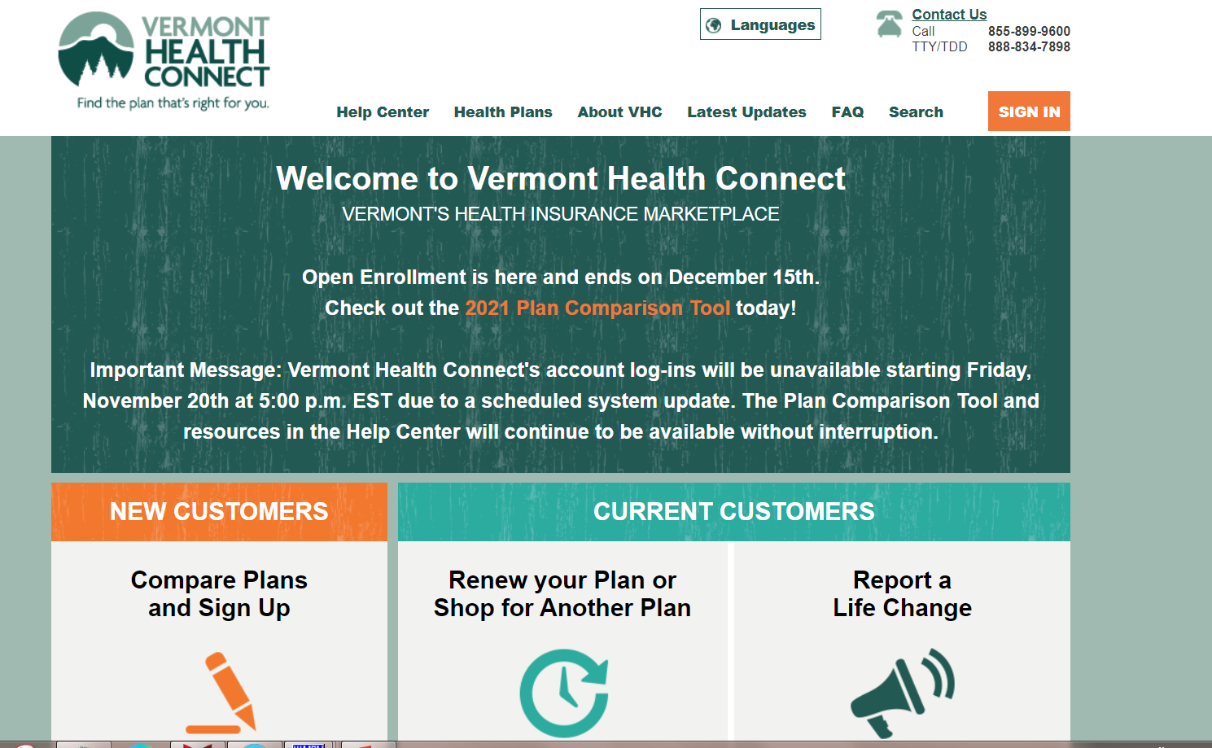
Navigating Vermont health connect
https://portal.healthconnect.vermont.gov/VTHBELand/welcome.action

Slide 8
Local resources to know about?
Vermont 211 is the number to dial to find out about hundreds of important community resources, like emergency food and shelter, disability services, counseling, senior services, health care, child care, drug and alcohol programs, legal assistance, transportation agencies, educational and volunteer opportunities, and much more.
SEVCA

Slide 9
Questions?

