Slide 1
ARPA Funding
What is it and how can it be used?
August 23, 2021

Slide 2
Goals for Today:
Background on ARPA funding
Vermont’s Share of funding
Local allocation and payment schedule
Timeline
What you can and cannot spend ARPA funding on
Overview of reporting
The important role of your RPC

Slide 3
American Rescue Plan Act
American Rescue Plan Act (ARPA) – $1.9 trillion stimulus package signed into law March 11, 2021
Purpose – Combat the COVID-19 pandemic, including health and economic impacts
$350 billion for eligible state, local, territorial and Tribal governments through the Coronavirus State and Local Fiscal Recovery Funds
The money will be distributed through the U.S. Department of the Treasury
It is subject to the requirements specified in the Interim Final Rule adopted by Treasury on May 10, 2021
The Final Rule is expected to be released sometime before the end of 2021

Slide 4
American Rescue Plan Act
Coronavirus State and Local Fiscal Recovery Fund
Vermont’s Share
State of Vermont $1,049,287,303
Counties* $121,202,550
Metro Cities $20,721,902
Non-Entitlement Units $58,788,245 of Government (NEUs)
TOTAL ARPA State and Local Funds: $1,250,000,000
*County money has been reallocated to municipalities

Slide 5
American Rescue Plan Act
Coronavirus State and Local Fiscal Recovery Fund
Payments to Municipalities:
Local ARPA $ – 2 equal payments
1st Payment - August 2021
2nd Payment - August 2022
County ARPA $ - 2 equal payments
1st Payment - September 2021
2nd Payment - September 2022

Slide 6
American Rescue Plan Act
Coronavirus State and Local Fiscal Recovery Fund
Timeline
All funds must be obligated by December 31, 2024
All funds must be expended by December 31, 2026
Any funds not spent by December 31, 2026 must be returned to Treasury

Slide 7
There is no need to rush!
You have time to be:
Patient
Deliberate
Strategic

Slide 9
Treasury Guidance
What You CAN Spend $ On
Pandemic Response: To respond to the public health emergency or its negative economic impacts, including assistance to households, small businesses, and nonprofits, or aid to impacted industries such as tourism, travel, and hospitality;
Premium Pay to Eligible Workers: To respond to workers performing essential work during the COVID-19 public health emergency by providing premium pay to eligible workers;
Lost Revenue: For the provision of government services to the extent of the reduction in revenue due to the COVID–19 public health emergency relative to revenues collected in the most recent full fiscal year prior to the emergency; and
Water, Sewer, and Broadband Infrastructure: To make necessary investments in water, sewer, or broadband infrastructure.

Slide 10
Eligible Uses: COVID-19 Pandemic Response
What You CAN Spend $ On:
1) Pandemic Response (Public Health)
COVID-19 Mitigation and Prevention
Medical Expenses
Behavioral Health Care Including Addiction Treatment
Public Health and Public Safety Employees
Data, Design, and Execution of Health Programs
Health Disparities
Survivors Benefits

Slide 11
Eligible Uses: COVID-19 Pandemic Response
What You CAN Spend $ On:
1) Pandemic Response (Economic Impact)
Grants and Loans to Impacted Businesses and Non-Profits
Housing Assistance
Direct Cash and Loan Interventions to Impacted Individuals
PLUS…if supporting low income or minority populations impacted by the pandemic
(and if you document this goal and impact)…
Childcare and Education
Housing and Community Development
Infrastructure
And more…

Slide 12
Eligible Uses: COVID-19 Pandemic Response
What You CAN Spend $ On:
2) Premium Pay
Provide premium pay to eligible workers performing essential work during the COVID-19 public health emergency or to provide grants to third-party employers with eligible workers performing essential work.
Essential workers are those in critical infrastructure sectors who regularly perform in-person work, interact with others at work, or physically handle items handled by others.
Essential workers include:
Staff at nursing homes, hospitals, and home care settings;
Workers at farms, food production facilities, grocery stores, and restaurants;
Janitors and sanitation workers;
Truck drivers, transit staff, and warehouse workers;
Public health and safety staff;
Childcare workers, educators, and other school staff; and
Social service and human services staff.

Slide 13
Eligible Uses: COVID-19 Pandemic Response
What You CAN Spend $ On:
3) Lost Revenue
For the provision of government services to the extent of the reduction in revenue of such municipality due to the COVID–19 public health emergency relative to revenues collected in the most recent full fiscal year of the municipality prior to the emergency.
Treasury provides a specific formula for calculating loss in the Interim Final Rule
Cities, towns, and villages will calculate the loss based on what could have been expected to occur in absence of the pandemic.
To determine the what would have happened in absence of the pandemic, cities, towns, and villages, will use a predetermined growth rate of 4.1% or the average annual growth rate over the three full fiscal years prior to the pandemic, whichever is greater
Revenue Replacement Calculator (GFOA)

Slide 14
Eligible Uses: COVID-19 Pandemic Response
What You CAN Spend $ On:
4) Water, Sewer, and Broadband Infrastructure
Coronavirus State and Local Fiscal Recovery Funds – “necessary investments in water, sewer, or broadband infrastructure.”
Projects eligible under the Clean Water State Revolving Fund
Construct, improve, and repair wastewater treatment plants; control non-point sources of pollution; create green infrastructure; manage and treat stormwater; water reuse; protect waterbodies from pollution.
Projects eligible under the Drinking Water State Revolving Fund
Build or upgrade facilities to improve water quality; transmission, distribution, and storage systems; consolidation or establishment of drinking water systems
Cybersecurity
Climate Change and Resilience
Lead Service Line Replacement

Slide 15
What You CAN Spend $ On:
4) Water, Sewer, and Broadband Infrastructure
Eligible broadband projects must:
“Be designed to provide service...to unserved and underserved households and businesses."
Unserved and underserved = lacking access at least 25/3 Mbps wireline service
Specific service areas and locations may be defined by community
Provide service that "reliably meets or exceeds symmetrical speeds of 100 Mbps" or, if impossible, at least 100/20 Mbps with the ability to scale to 100 Mbps symmetrical
Eligible broadband projects are encouraged to:
Consider affordability
“Deliver a physical broadband connection by prioritizing projects that achieve last-mile connections"
Prioritize municipal, nonprofit, and cooperative-owned networks
Digital inclusion: assistance to households, including internet access and digital literacy assistance, are eligible uses

Slide 16
Treasury Guidance
What You CAN NOT Spend $ On
Federal Match
Pensions
Infrastructure Not Directly Addressed in ARPA
Rainy Day Funds, Financial Reserves, and Outstanding Debt

Slide 17
Eligible Uses: COVID-19 Pandemic Response
Things to Consider:
You can:
Pool your funds with other municipalities to achieve scale for deeper impact and long-term sustainability that benefits your community.
Transfer your funds to non-profits or other eligible third party organizations performing ARPA eligible projects that benefit your community.
Take time to be patient and think bigger - see how the State of Vermont’s ARPA money will be deployed, as well as other federal funding that could be on its way, like the infrastructure bill that is currently being taken up in Congress.

Slide 18
Reporting Requirements
Municipalities will be required to report on their spending directly to Treasury using an online portal
Annual Project and Expenditure Reporting Requirement for NEUs each October 31 (starting in 2021)
Reporting guidance and additional resources have been issued by Treasury. They are posted on VLCT’s ARPA webpage:
https://www.vlct.org/resources/american-rescue-plan-information

Slide 19
VLCT ARPA Assistance and Coordination Program
Guidance and Project Eligibility Analysis
Webinars, Targeted Training, Technical Assistance, Best Practices
Answer Questions (arpa@vlct.org)
Guidance with Compliance, Reporting, and Transparency
ARPA resources webpage:
https://www.vlct.org/resources/american-rescue-plan-information

Slide 20
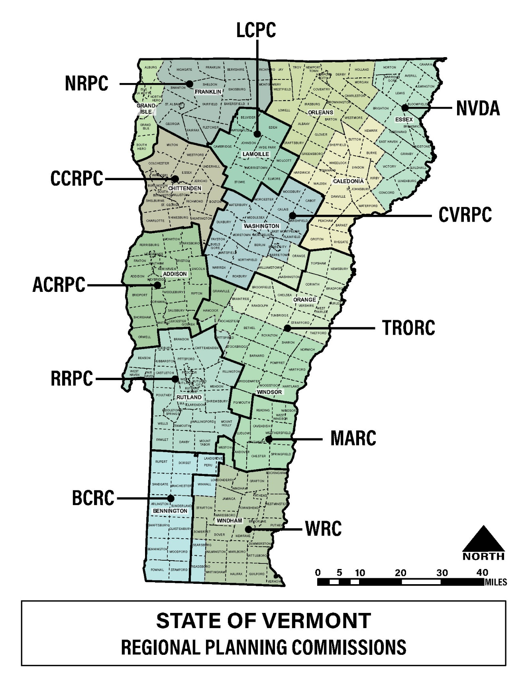
Regional Planning Commission Assistance
Identify needs and top priorities for designing and building projects that are consistent with existing State, regional and local plans.
Respond to inquiries on eligibility to facilitate local discussions among stakeholders on specific projects.
Provide other assistance as needed from local communities in coordination with VLCT.
Work with VLCT, regional development corporations, and private consultants working with municipalities to ensure needs of local communities are met, especially related to project development and management.
For more information on the State of Vermont’s 11 Regional Planning Commissions visit:
https://www.vapda.org/

Slide 21
Thank You!
Katie Buckley
Director, ARPA Assistance and Coordination Program
Vermont League of Cities & Towns
kbuckley@vlct.org
ARPA@vlct.org
(802) 343-6323
https://www.vlct.org/resources/american-rescue-plan-information
Chris Campany
Executive Director
Windham Regional Commission (WRC)
ccampany@windhamregional.org
(802) 257-4547, ext. 106
www.windhamregional.org
Jim Sullivan
Executive Director
Bennington County Regional Commission (BCRC)
Jsullivan@bcrcvt.org
(802) 442-0713, ext. 5
http://www.bcrcvt.org/

