Slide 1
Multifamily Homebuyer Series
Teaser Webinar for 4-Part Course on Buying & Maintaining a Multifamily Property

Slide 2
Introduction
Kayla Bernier-Wright
Homeownership Specialist
Windham & Windsor Housing Trust
kbernier-wright@homemattershere.org
802-689-0981
www.HomeMattersHere.org
Paul Martorano
Multi-Family Rental Improvement Program Coordinator
Windham & Windsor Housing Trust
pmartorano@homemattershere.org
802-689-0426
www.HomeMattersHere.org

Slide 3
Our Mission
Windham & Windsor Housing Trust (WWHT) strengthens the communities of Southeastern Vermont through the development and stewardship of permanently affordable housing through ongoing support and advocacy for its residents.
To accomplish this, WWHT acquires, rehabilitates or constructs, and holds land and housing in trust, providing permanent access to decent and affordable housing for citizens of Windham and Windsor counties.

Slide 4
NeighborWorks Homeownership Center
Windham & Windsor Housing Trust’s Homeownership Center is dedicated to expanding homeownership opportunities as well as helping local homeowners remain in their homes.
Homebuyer Workshops Credit Repair Assistance
Pre-purchase Counseling Home Repair (Single- & Multi-Family)
Shared Equity Program Delinquency Intervention
Foreclosure Prevention Information & Referral Services

Slide 5
Multifamily Homebuyer Zoom Series
How to Purchase a Multifamily Home
Real Estate and Buying
Lending and Legal
How to Own a Multifamily Home
Rehab and Property Management
Tenant Relations
January 18, 20, 25, 27 2022
5:30 PM-7:00 PM
https://brattleborodevelopment.com/public-events/svep-multifamily-homebuying-course/

Slide 6
Traditional Steps to Buying A Home
This is called “In Escrow” or “Under Contract”
Obtain Prequalification/ Certificate of Eligibility
Find a Realtor
Shop for Homes
Make an Offer, Enter into Purchase & Sale Agreement
Obtain Mortgage Approval
Step One
Get a Home Inspection
Your Lender Orders an Appraisal of the Home
Get Homeowners Insurance
Review Loan Estimate & Closing Disclosure
Get an Attorney, Sign Documents at Closing
Keys in Hand: You Own a Home!

Slide 7
Are You “Mortgage-Ready”?
Income: Two years that is reliable, consistent, and likely to continue
Credit scores: Ideally middle score of 660+ *lower options available for first-time homebuyers
Savings: Range from 3.5% to 30% of purchase price required (depending on loan program)
Existing debt: Ideally 10% - 12% of monthly income

Slide 8
Your Loan Options
FHA: 500-620 credit score, 3.5% - 10% down, owner-occupied, up to 4 units, purchase & rehab popular
Conventional: 640+ credit score, down payments vary (could be as low as 3%), may not require owner-occupied
Portfolio Loans: 660+ credit score, down payment vary, may not require owner-occupied, may be a more local option
VA: ~620+ credit score, 0% down, owner-occupied, up to 4 units
VHFA: 640+ credit score, up to $10k assistance available, owner-occupied, 2-unit only
Seller financing: Buyer pays owner in installments

Slide 9
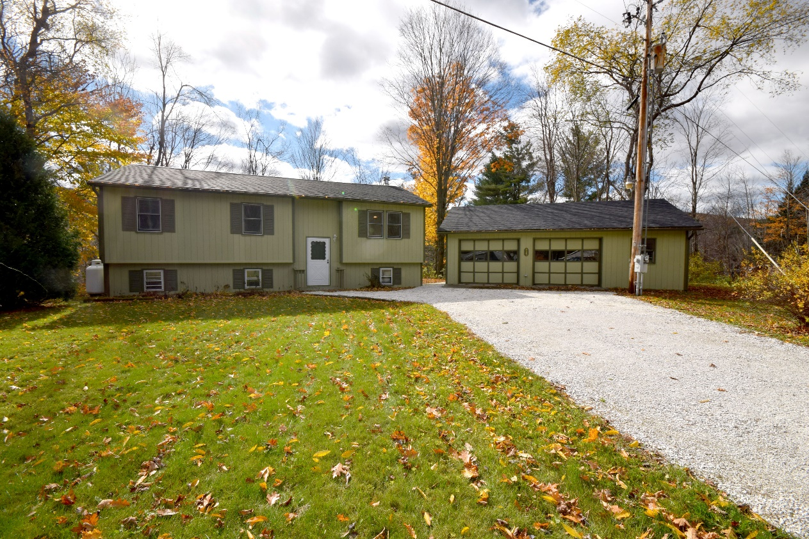
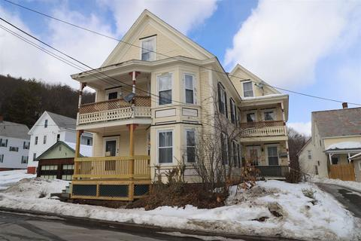
Single-Family vs. Multi-Family Homes

Slide 10
Viewing a Multifamily Home
Look at the major systems…
Basement & foundation
Electrical systems
Plumbing
Water heater
Heating systems
Yard, driveway, walk ways
Roofing (including gutters)
Exterior: siding & fixtures
Attic
Interior condition & fixtures
Kitchen
Bathroom
Septic system

Slide 11
What’s wrong with this picture?

Slide 12
Let’s Talk About What We See
What’s change-able vs. what’s not?
Is there a rehab involved? What does that look like? What contractors will you need? Will you have to live there during the construction?
What is the asking price? What would a rehab cost? What is the cost of ongoing maintenance?
What can you access to help with the rehab & what are those programs looking for? (e.g. lead abatement, energy efficiency upgrades, and general home repair loans or grants)

Slide 13
Tips for Shoppers to Keep in Mind
As soon as you purchase the home, you gain the responsibility – including any code violations. Therefore, the home inspection protects you as the buyer. Inspections can help you negotiate, plan repairs & maintenance, and get to know the home with a professional
Every home & every purchase is different! So make sure to assemble a trusted team of advisors where you can direct your questions along the way –your loan officer, housing counselor, realtor, contractors, attorney, and friends & family can help you navigate guiding the transaction. Listen to their advise & keep them informed!
Don’t be afraid to ask question, request a second viewing, and bring tools to a viewing. You run the show & should never feel pressure to sign on with anything you cannot live with or don’t understand
If you can, be flexible –especially with your timeline! There are many factors & processes outside of your control (e.g. massive waitlist for home appraisals or for contractors)

