Slide 1
Multifamily Homebuyer Series
Part 3: Rehab and Property Management

Slide 2
Introduction
Paul Martorano
Multi-Family Rental Improvement Program Coordinator
Windham & Windsor Housing Trust
pmartorano@homemattershere.org
802-689-0426
www.HomeMattersHere.org

Slide 3
Tips on Viewing a Multifamily Property

Slide 4
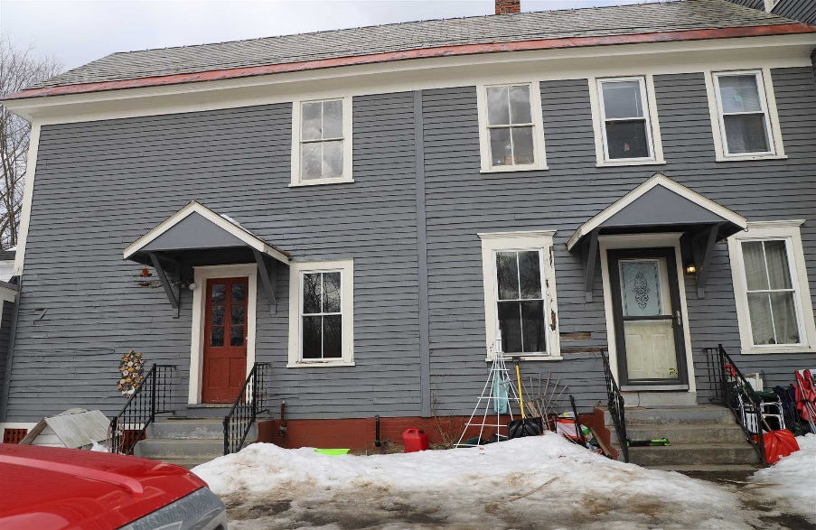
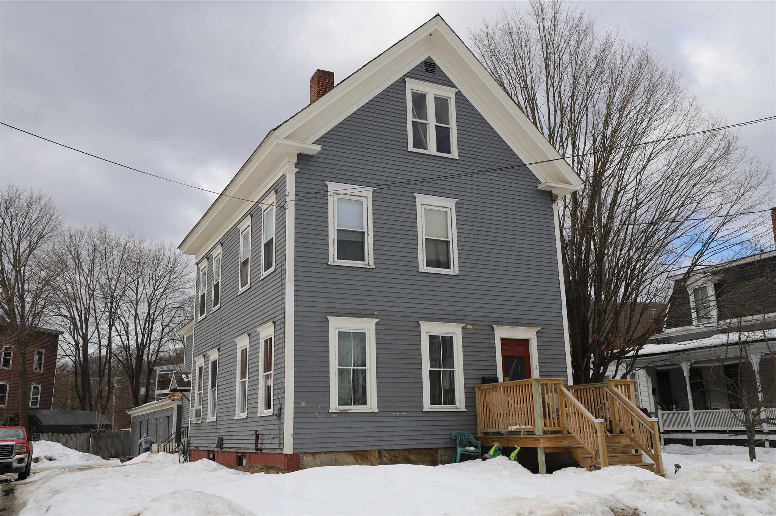
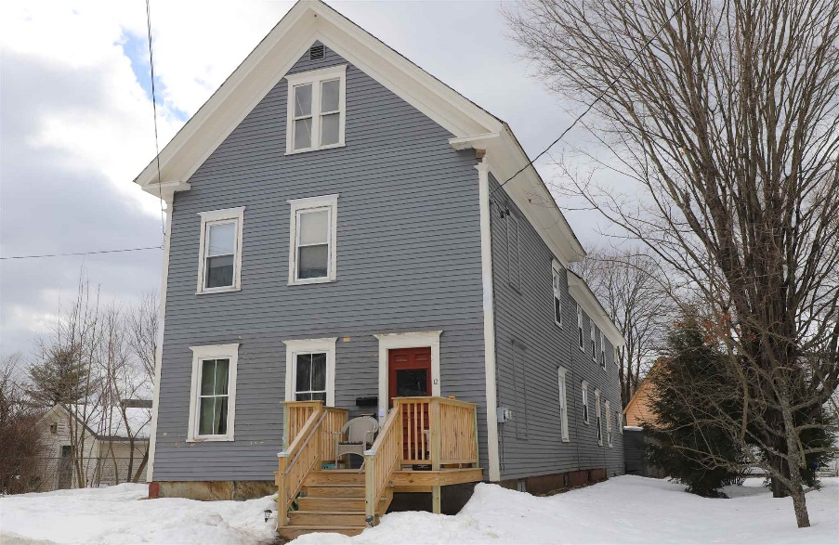
Listing price: $130,000.
Two 3-bedroom apartments. One unit is currently rented for $700 and the other $775.
Credit: www.beangroup.com

Slide 5
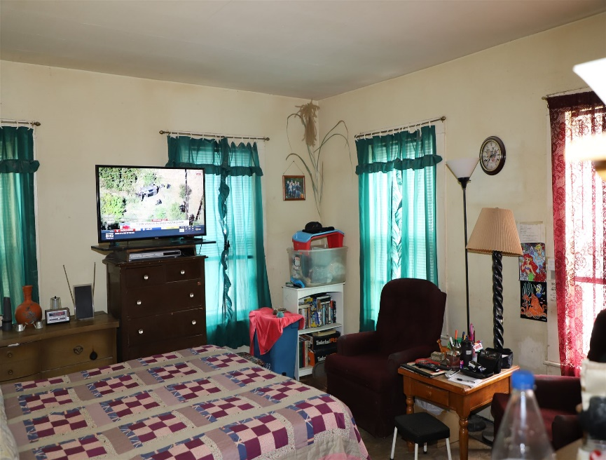
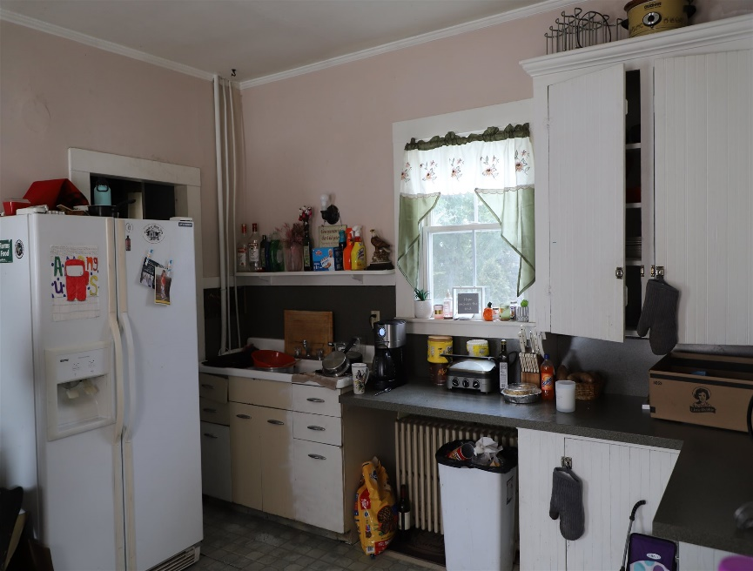
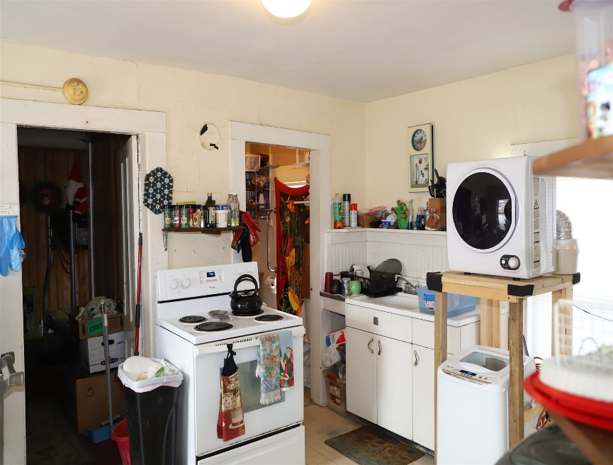
Credit: www.beangroup.com

Slide 6
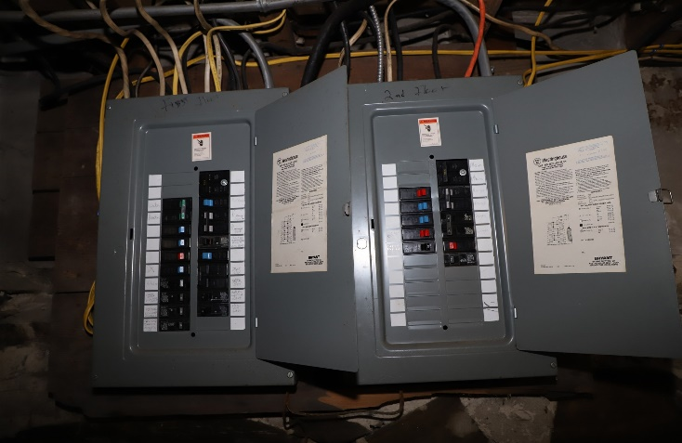
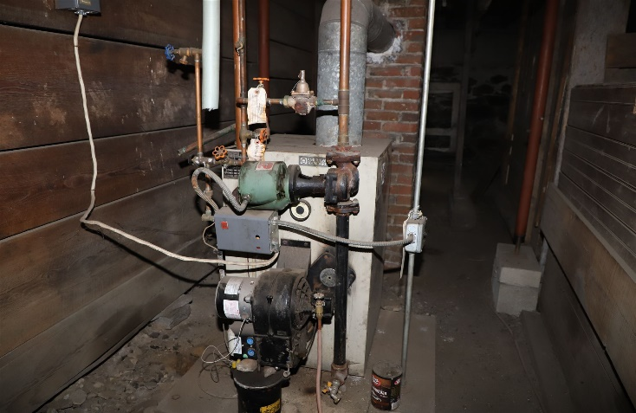
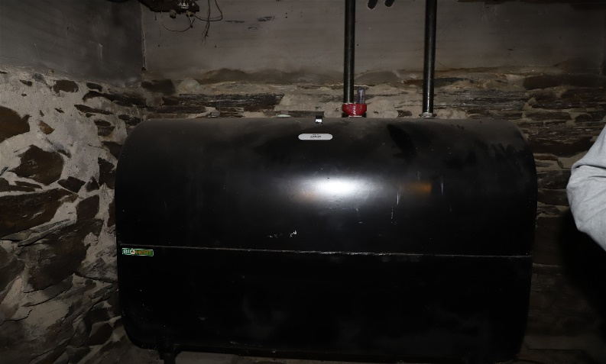
What do you notice about these photos?
Credit: www.beangroup.com

Slide 7
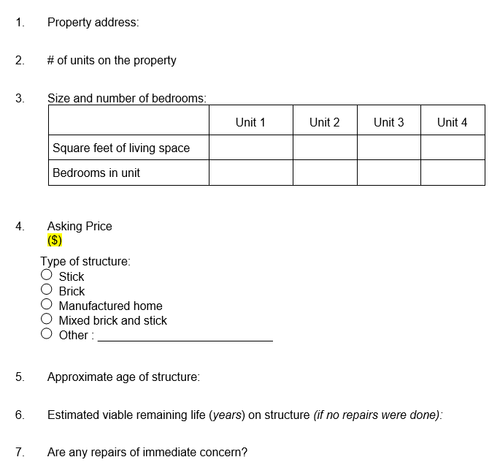

Slide 8
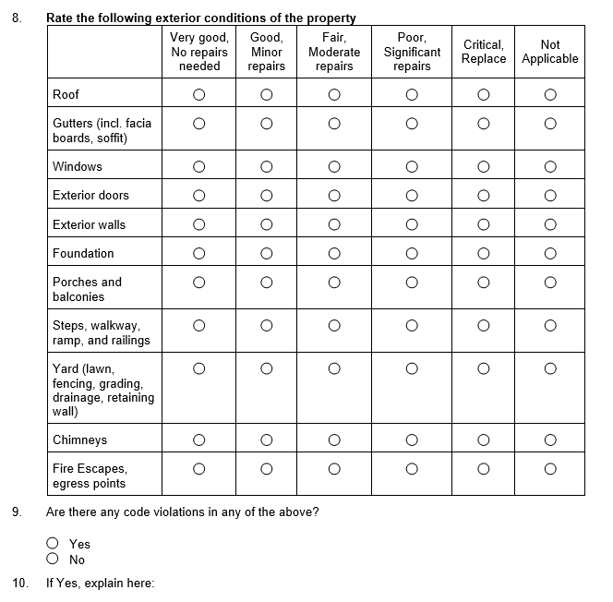

Slide 9
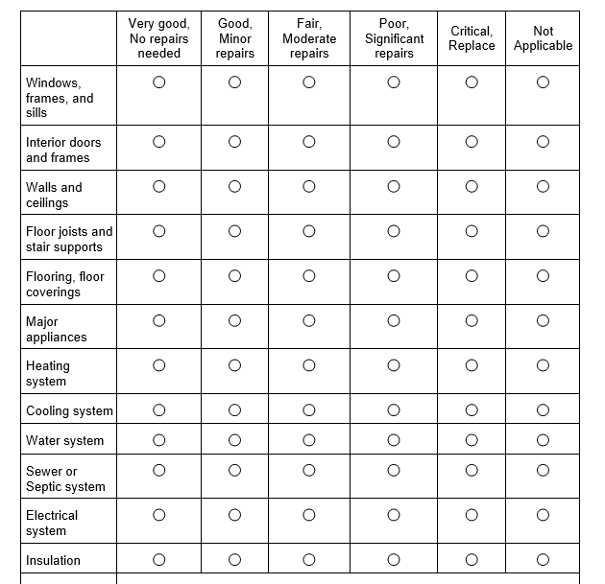

Slide 10
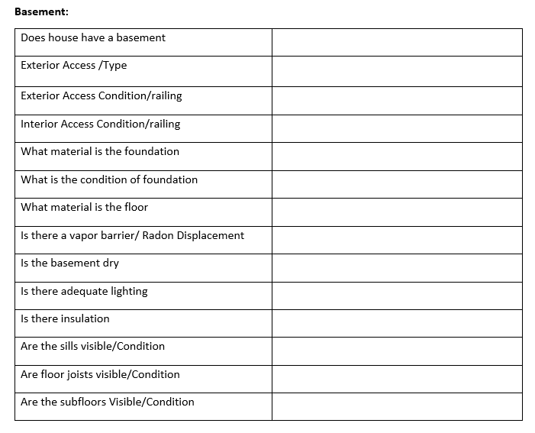

Slide 11
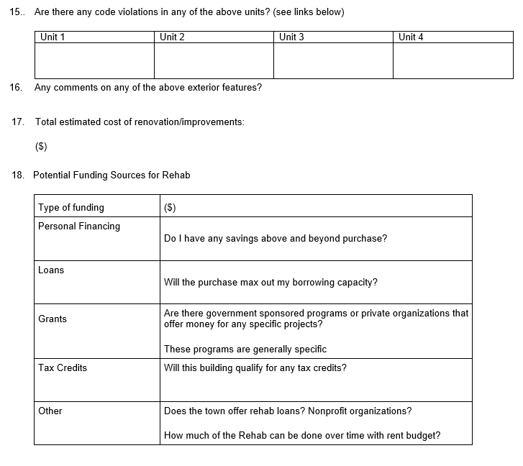

Slide 12
Planning for a Renovation/ Repairs

Slide 13
Home Inspections Protect the Buyer
Look at the major systems…
Basement & foundation
Electrical systems
Plumbing
Water heater
Heating systems
Yard, driveway, walk ways
Roofing (including gutters)
Exterior: siding & fixtures
Water test if there is a well
Attic
Interior condition & fixtures
Kitchen
Bathroom
Septic system

Slide 14
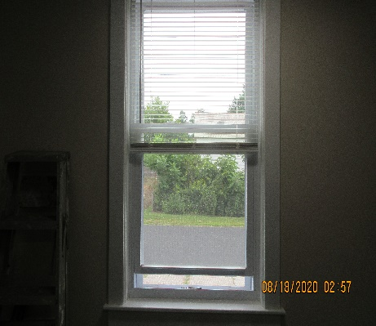
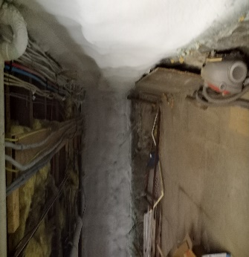
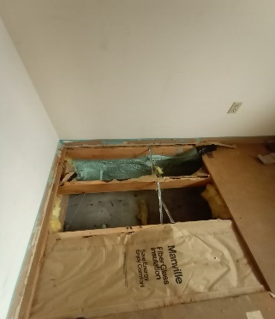
Renovation Example: Insulation & Windows

Slide 15
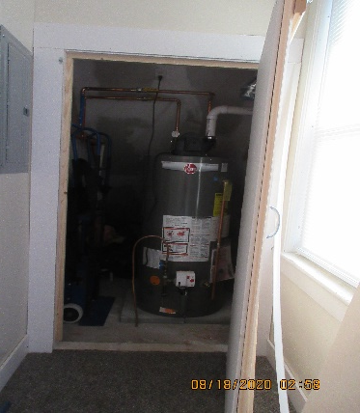
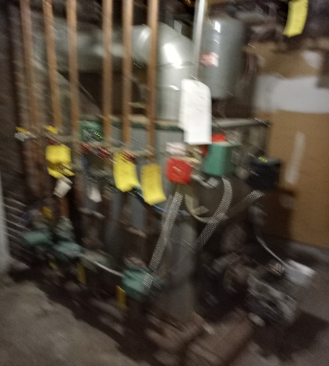
Renovation Example: Utilities

Slide 16
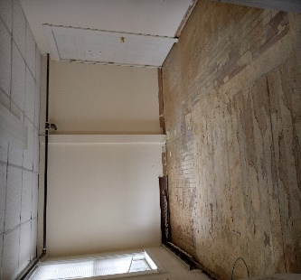
Renovation Example: Before

Slide 17
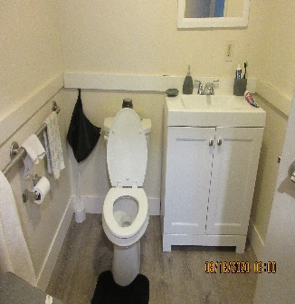
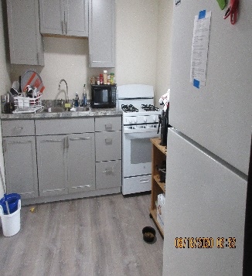
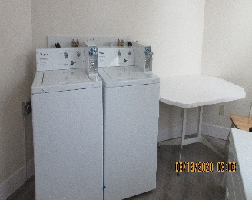
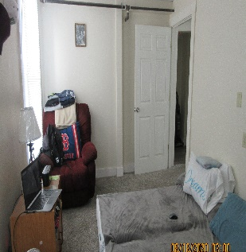
Renovation Example: After ($100k later)

Slide 18
Funding Multifamily Repair

Slide 19
Budget Example: Purchase & Income
Listing Price | 15% Down Payment | ~Closing Costs | Cash to Close | Mortgage
$130,000 | $19,500 | $3,315 | $22,815 | $110,500
Income | Per Unit/Month | Monthly Total | Annual Total | Vacancy Rate 10%
2 unit building | $1,000 | $2,000 | $24,000 | $21,600

Slide 20
Budget Example: Operating Costs
General Expenses |  | Monthly Total | Annual Total | Vacancy Rate 10%
Mortgage |  | $690 | $8,280
Taxes |  | $297 | $3,570
water/sewer |  | $125 | $1,500
Insurance ($250,000) |  | $170 | $2,040
 | Total base cost | $1,282 | $15,390
 |  | Cash reserves | $8,610 | $6,210
Operating Budget | Set up an account: | $517 | $6,210
Monthly Cost
Snow Removal |  | $75 | $900
general maintenance |  | $200 | $2,400
Apartment turnover |  | $150 | $1,800
Total built in cost |  | $425 | $5,100
Remainder for saving |  |  | $1,110

Slide 21
Budget Example: Replacement Costs
System |  |  | Life span
Heat | New Boiler $5,000 | Oil Tank $3,000 | 20 years
Roof | $15,000-$40,000 |  | 20-40 years
Plumbing | Bathroom $5,000 | Kitchen $10,000 | 15-20 years
Siding | $20,000 |  | Paint 5-10 years
Windows | $400 per window |  | 25 years
Energy efficiency | $6,000-$12,000 |  | 20 years or more
Electrical upgrades (panel & rewire) |  | $1500-$15000 | 20+ years

Slide 22
Where to get help
Windham and Windsor Housing Trust (WWHT)
Vermont Housing and Conservation Board (VHCB)
Southeastern Vermont Community Action (SEVCA)
Efficiency VT
3E Thermal Capstone

Slide 23
Final Tips on Property Management

Slide 24
Finding Tenants

Slide 25
Q&A

