Slide 1
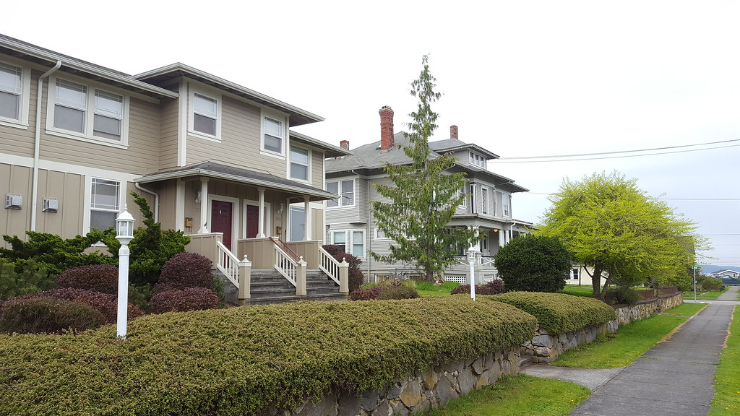
Presented by: Brandy Blackinton, SVP Retail Lending
January 20, 2022, updated August 2023

Slide 2
Primary Residence versus Investment
Financing Program at CSB
Lead Paint Testing requirements for financing
Using rental income to qualify for the loan
Q&A

Slide 3
Will you be living in one of the units?
If so we would finance the home as a conventional mortgage- “owner occupied”
If not, this would be financed as an investment property (not all banks are equal when it comes to financing investment homes)

Slide 4
Max LTV 75% of purchase price or appraised value whichever is less.
20 year maximum term
Contact us for current rates (today in the neighborhood of 7.645%, subject to change)
1% of loan balance investment financing fee in addition to standard closing costs
Lead paint test required for all homes built prior to 1978
You can only own 3 investment properties under this program. If you own more you will need to finance under the commercial program

Slide 5
Lead Based Paint is a serious issue with our children in NH and VT. Lead paint poison can create our children to suffer from irreversible damage to their mental and physical development.
Resources on Lead Paint
New Hampshire
KKirkwood Consulting, LLC - Lead-Edu
KKirkwood Consulting, LLC - Lead Paint Clear and Simple
Lead Paint Abatement & Healthy Homes Program | Sullivan County, NH (sullivancountynh.gov
Lead Inspections by State - American Environmental Testing Services, LLC (aetsne.com)
Vermont
LeadSafeVermont.org - do you know what to look for?
EMP Training | Vermont Housing & Conservation Board (vhcb.org)
How much does a test cost?
the age and size of home
City and town
The nature and extent of renovations done in past
Single family home 8 rooms in NH full lead inspection about $475
3 bedroom apartment 7 rooms multi unit $425 (common areas and exterior)

Slide 6
Existing tenants are staying and have lease agreements we can use 75% of the rent
If it is an ADU (no rental income used)
Already own the multi-family?
The bank will review your most recent 2 years tax returns Schedule E to calculate how much rental income can be used
Any losses that show will reduce income

Slide 7
Construction of Multifamily
Owner-Occupied
Energy efficient incentives for new construction
Appraisal challenges for projects

