Slide 1
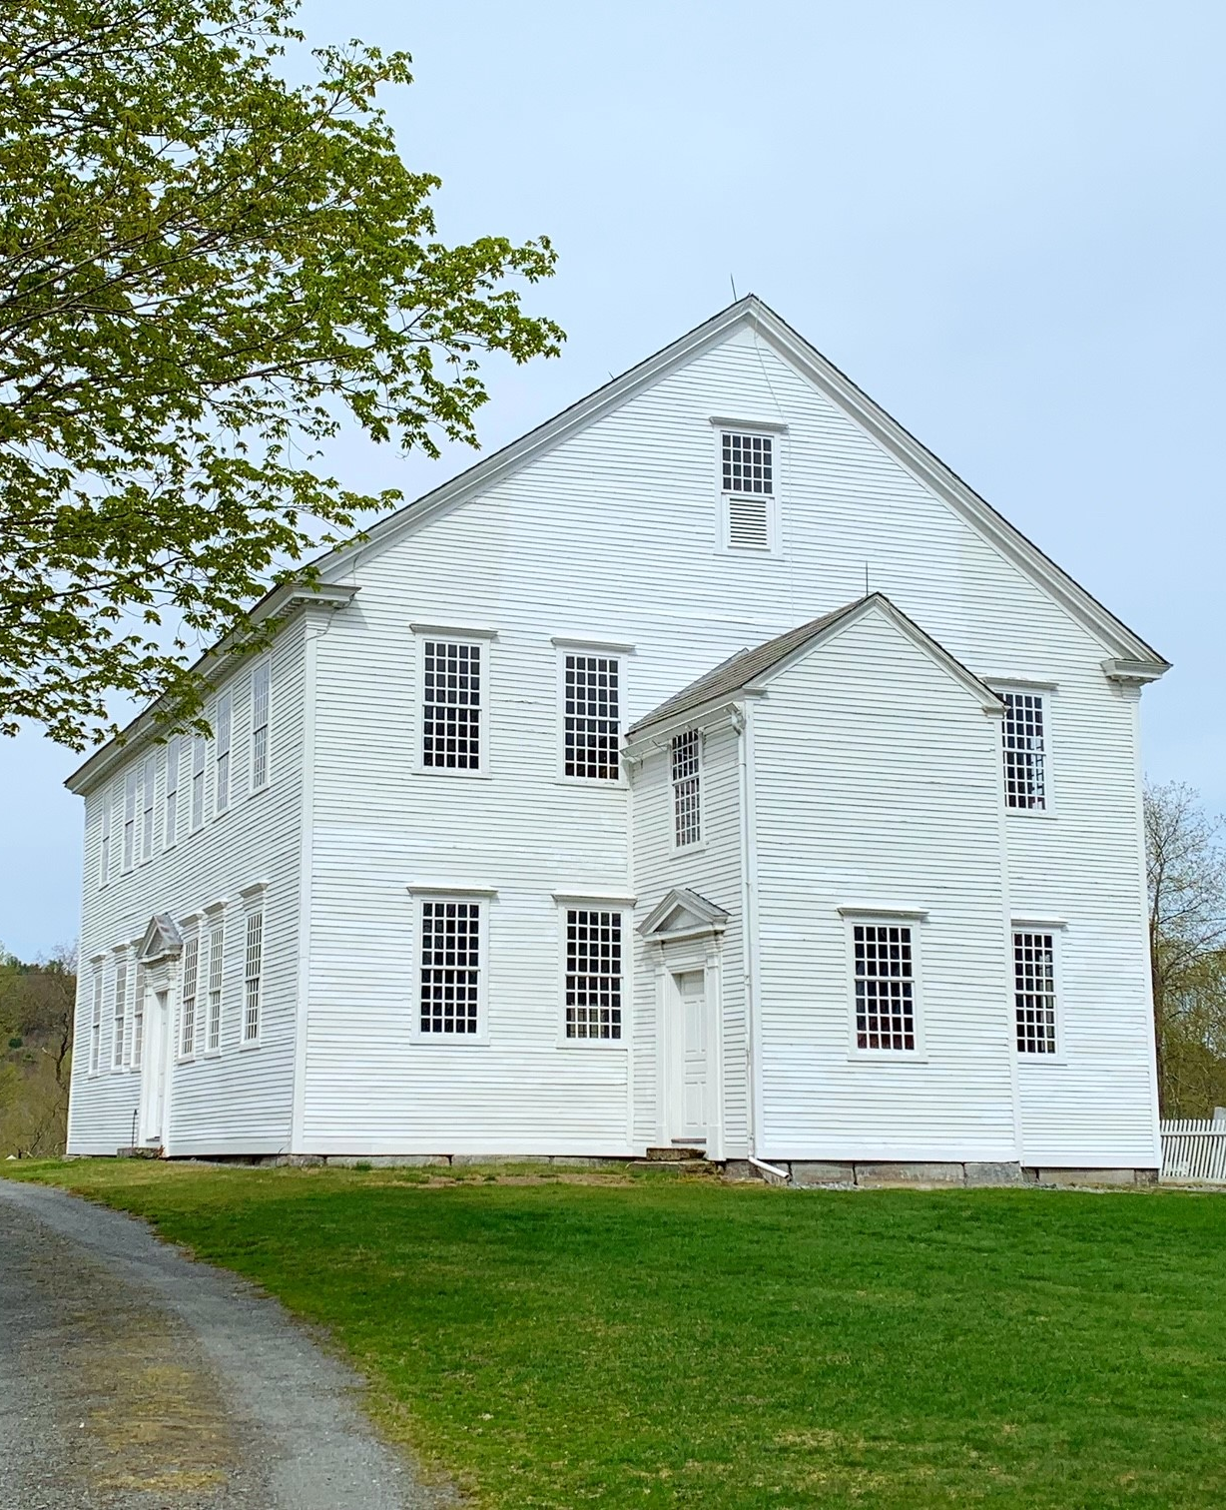
Meeting the Americans with Disabilities Act (ADA) in Historic Buildings
Caitlin Corkins, Tax Credits & Grants Coordinator
Vermont Division for Historic Preservation
Notes:
Good morning. I’m Caitlin Corkins and I work with the Vermont Division for Historic Preservation. In my role, I’m involved in many historic rehabilitation projects that use historic preservation funding, specifically the federal and state historic tax credits, and our state historic preservation grant program. Today, I’m going to focus in on the intersection of the ADA and historic buildings. I want to cover information about historic integrity and how VDHP evaluates historic buildings and then dive into several case studies of projects that I’ve been involved with over the past 10 years.

Slide 2
ADA and Historic Buildings
What does the ADA say?
The ADA provides an exemption for qualified historic properties. Historic buildings may be eligible to meet alternative minimum standards “if full compliance would threaten or destroy the resource’s historic significance.”
Notes:
First, I just want to highlight some language from the ADA as it relates to historic buildings. As many of you probably know, the ADA does provide an exemption for qualified historic properties which states that historic buildings may be eligible to meet alternative minimum standards if full compliance would threaten or destroy the resource’s historic significance. To be considered “historic” building must be either listed in the National Register of Historic Places or formally determined eligible for listing. This could include individually listed buildings or buildings that are listed as contributing structures in a NRHD.
To determine if a building is already listed, you can always reach out to VDHP. The best person to contact is our State Architectural Historian Devin Colman. He can confirm whether a property is currently listed. If not, he is also the contact for staring the determination of eligibility process. VDHP routinely completes DOEs upon request. If you have concerns about the ADA requirements for a specific project, we are also happy to consult with you on the project and, if needed, provide documentation that specific modifications would “threaten or destroy” a resource’s historic significance.

Slide 3
Consultation
VDHP and DFS Partnership:
Virtual project team meetings
On-site consultations
Work to find compromises that meet the spirit of the ADA while protecting a historic building’s most important historic features
Notes:
As part of the consultation process – we want to be involved as early as possible to work through any potential issues. It is so much easier to make changes to a project if needed at the conceptual stage. We are also happy to meet on site to walk through buildings and discuss options. We have a great partnership with the DFS. Our goal is always to find compromises that meet the spirit of the ADA while protecting a building’s most important historic features.

Slide 4
Compliance is the goal
Exemptions only apply to alterations of historic buildings and not additions or new construction.
Even if a historical building qualifies for these exemptions, it still needs to be made accessible to the maximum extent feasible.
Notes:
I do want to note that the “historic exemption” is not a blanket provision to do nothing. There is no “grandfather rule.” Exemptions only apply to alterations of historic buildings, not new additions or new construction. Even if a historic building qualifies, it still needs to be made accessible to the maximum extent feasible. A building that is empty or underutilized because it doesn’t accommodate our needs and the needs of everyone doesn’t serve the cause of preservation. Why invest in buildings if they don’t have a purpose? We want to see historic buildings in use. If this requires modifications, we are open to that. We just always want changes to be made thoughtfully and in consideration of what makes the building historic in the first place..

Slide 5
Tips for Designing Sensitive Solutions
Remember every project is unique
First step is to determine the character-defining features of the resource
Design solutions that minimize changes to those features
Details matter. Material choices and design details are important
Early consultation with VDHP is welcome!
Notes:
These are my quick tips for thinking about design solutions in historic buildings. Most important, each project is unique! There are no cookie-cutter solutions when it comes to historic buildings. Being open to creative solutions is important for success – rather than coming to a project with a preconceived idea of what must happen. In any project involving a historic building, the first step is to identify the character-defining features of that building. What are the things that are really important to defining the history of this building. Sometimes they may be obvious, but other times they are not. It is important to consider how the building was used historically, not just how it looks. You should also consider changes over time and what past changes may have their own importance. Once you know what’s important to preserve, you can look at design solutions to avoid changes to those features or minimize changes to those features. Reversibility is also a great thing to consider. We can’t know what the future holds and what future uses might require different solutions – so making our changes reversible is an important preservation technique. It probably goes without saying that details matter … but details matter. I’ve seen plenty of conceptual designs where the early direction of a project is good, but then some final material choice or design detail can really derail what would otherwise be a sensitive alteration. Leaving final detail choices to volunteers or contractors isn’t a good idea. And finally, VDHP is always happy to be a partner. The earlier you get in touch with us, the better! We can’t always give definitive answers at an early stage – but we can help identify what’s important, what to avoid and generally get a project headed down the right path to avoid costly design changes later in the process.

Slide 6
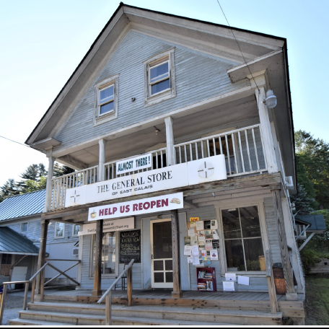
Clarence Dwinell Store
East Calais
Constructed c. 1850
Character Defining Features: Vernacular Greek Revival details, two-story porch with chamfered posts, storefront windows, three-bay layout, wood strip flooring and beadboard finishes
Notes:
This is a recent federal tax credit project that is just about complete you may have heard about – the East Calais General store. This is an anchor to the East Calais Village NRD. As one of the most prominent buildings in the village, preservation of its historic integrity is important not just for the building itself, but for the entire district.

Slide 7
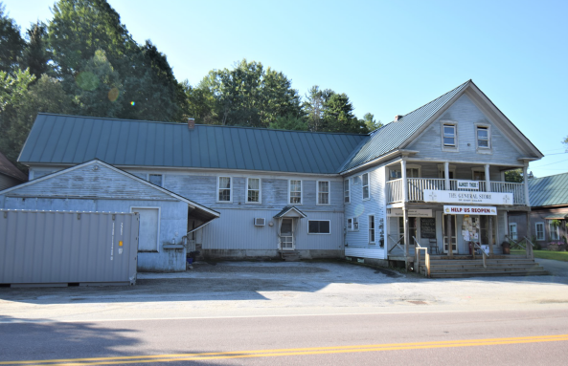
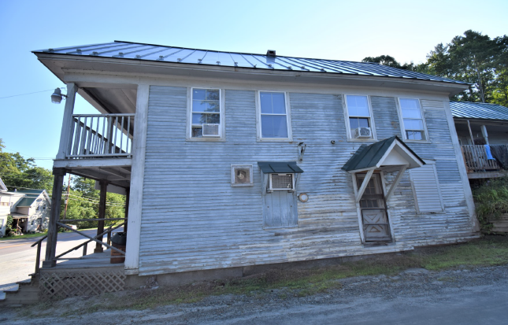
Considerations:
Sloping site
Elevation change between grade and ground floor
Parking
Previous alterations
Weather
Materials
Notes:
So, considerations for this project. The existing made entry was up a set of steps on the two-story porch … a significant elevation change. There wasn’t room for a ramp on the east or west elevations with a public road along the side of the main building and tight lot lines. We also were asked to consider demolition of the existing garage addition which was constructed some time after 1920 (not original but within the period of significance for the district and therefore potentially historic). This was mostly motivated by a desire to free up space for parking. So, we evaluated the integrity of the garage addition – in other words, did it retain enough of its historic features and material to convey its historic use and therefore contribute to the historic character of the resource.
We argued that it did not. While the footprint of the garage remained, it had lost its false front, garage, doors, and original siding. There were no remaining significant interior features. Further, historic photographs gave a clear picture of what had preceded the addition – open horse bays from an earlier form of transportation. The project team liked the idea of restoring the appearance of these horse bays (on the exterior) which would also allow for restoration of the second-story windows above which had been modified or lost with the construction of the addition.
In general, the front elevation of the ell showed significant modifications over the years and was a mess when the project began. Given all this, we (and NPS) approved the demolition of the garage and looked at this area as an opportunity for the location of a new ramp.

Slide 8
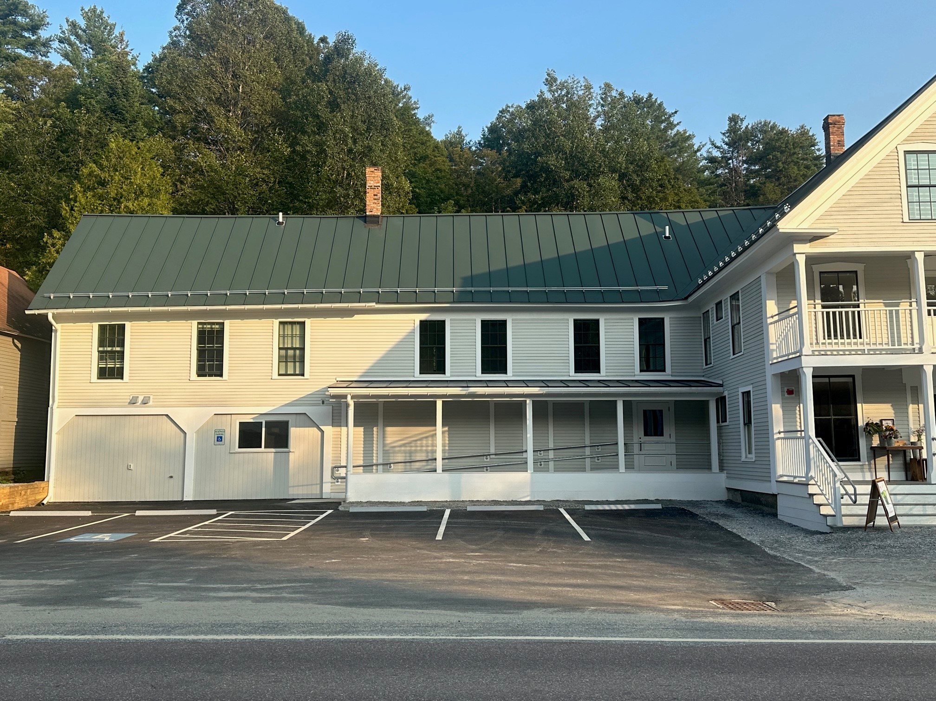
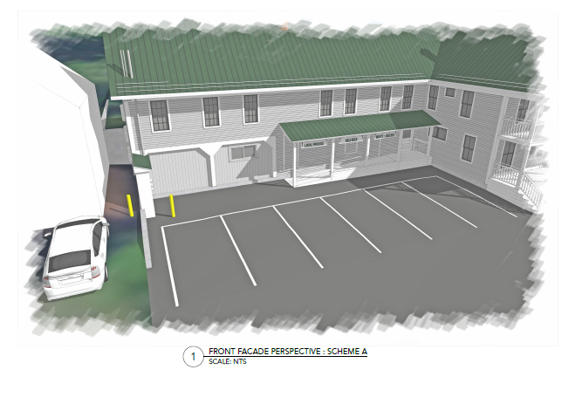
Approved Design
Notes:
As we kept looking at the building – we realized that the poor east ell had really seen a lot of change over the years. The current configuration – including the doorway we were building the ramp around did not retain significant trim or a historic door.
Thus, we worked with NPS to shift the ramp to the west, creating a new doorway into the east ell and closing the existing opening. This allowed the ramp to avoid crossing in front of the former horse bay openings but remain straight and fully covered.

Slide 9
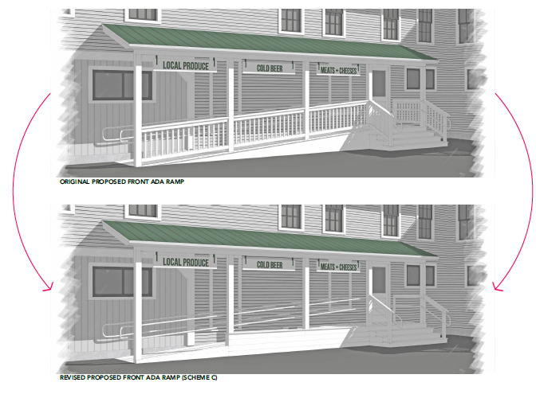
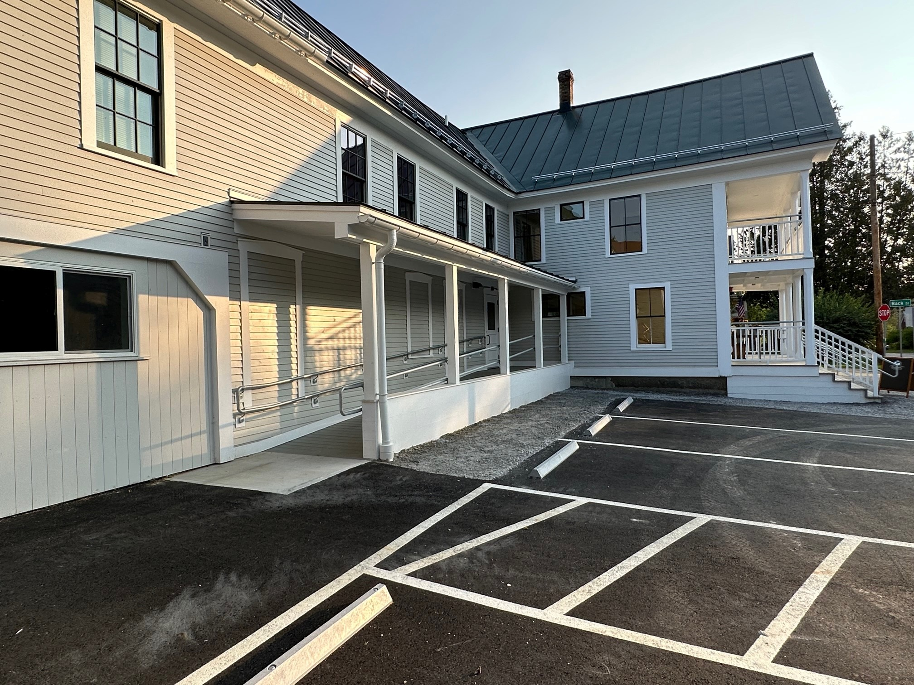
Railing Detail
Notes:
Additionally, other details of the original plan were modified. The wooden railing was replaced with a metal pipe railing, which is lighter and “more transparent” while still meeting code. In response to NPS comments, the exterior side of the ramp was also be finished with horizontal wood planking to create a low wall that further reduces the amount of railing required and sort of hides the sloping ramp from view. You will also notice that they took out the steps – everyone entering the building here will walk up the ramp. It further simplifies the design minimizes the railing and maximizes the parking!
They still need to paint the pipe railing – but overall, I think this design was very successful. This ramp is on the front elevation of the building – but it is on a secondary addition which had already be heavily modified in the past. There were a lot of thoughtful details in the design that keep it from overtaking the building and allow it to blend in.

Slide 10
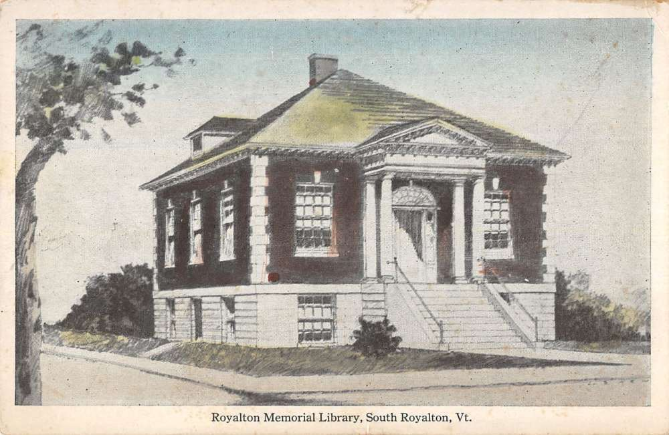
Royalton Memorial Library
Royalton, VT
Constructed 1920-24
Character Defining Features: Raised cement foundation, brick masonry and corner quoins, slate roof, pedimented gable entry, double-hung windows.
Notes:
Moving away from ramps – lets talk about vertical access and additions.
Vermont has so many of these wonderful little jewel box libraries. Unfortunately, they are often not accessible, and hard to modify given their small lots and small footprints. May of these libraries have been modified with additions to provide access – some more successfully that others. This is one we worked on a few years ago – though the process from initial conception to construction was, I believe, about 20 years in the making.
The Town offices were in the lower level of the building and there was an at grade entry on the north elevation. There just wasn’t going to be a way to get a ramp into the front entry to make the man level of the library accessible and the building was so small that introducing an elevator within the existing building would make the remaining space unusable.

Slide 11
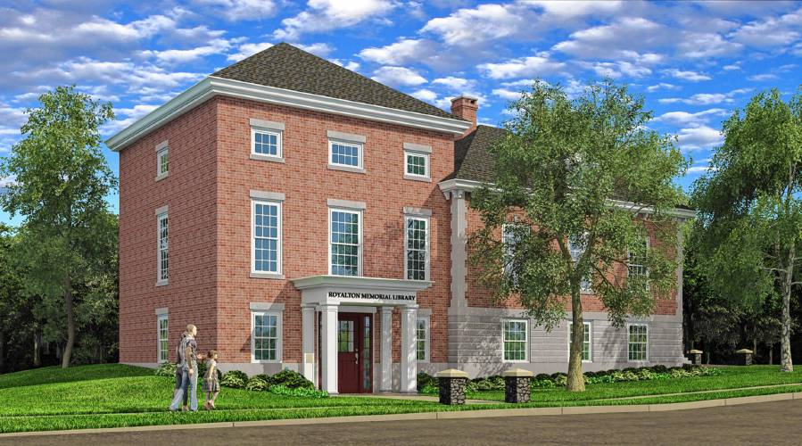
Early Conceptual Design
Location was appropriate but massing overwhelmed historic structure
Notes:
So, an addition was the solution. This could provide vertical access and a code compliant staircase between two levels. Bathrooms would also be modified on each level to provide ADA compliant restrooms.
This was an initial concept rendering. A few things to note here. We agreed that the location for the proposed addition was appropriate – off the back of the existing building but felt the massing of the addition was too big and overwhelmed the historic building. The initial thought here was to provide a lift that also provided access to the attic level of the main block which was used to store books. Access to the attic (not a public space) was not required by the ADA. And as it turned out, the price tag for this plan was too high.

Slide 12
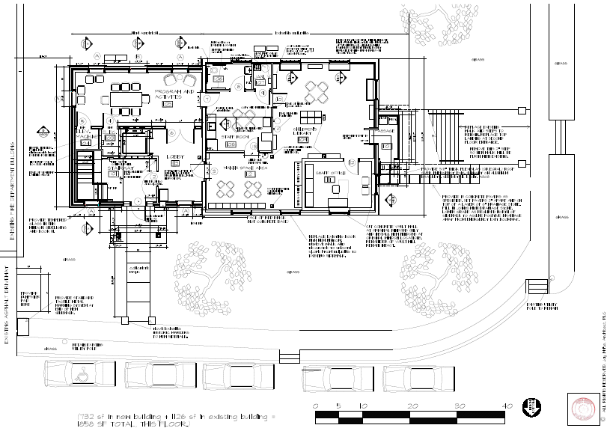
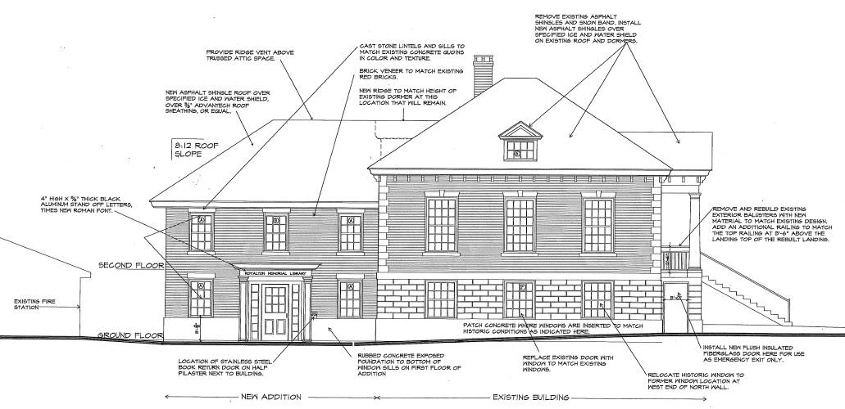
Approved Design
Notes:
So here is a floor plan of the approved design. We are looking at the ground floor. You can see that the mass of the addition is set back from the original building which helps to convey its secondary nature. I love that they also put a new staircase in the addition as the original staircase between the two levels wasn’t safe and this freed up space for them in the historic building to use for a staff room. In this case, the internal staircase wasn’t an important design element or historic feature. It was definitely a “back of the house” element.
You can see that change in the final elevation plan. This really reads an addition, not a competing building. Like I always say, the historic building is still the star of the show. I also like how the design references the materials and colonial revival details of the historic building without completely matching them. The cladding is brick and concrete – but a slightly difference brick and a plain concrete instead of rusticated stone. The corner quoins were left off the addition, but the six-over-six windows and entry portico are very colonial revival in design.

Slide 13
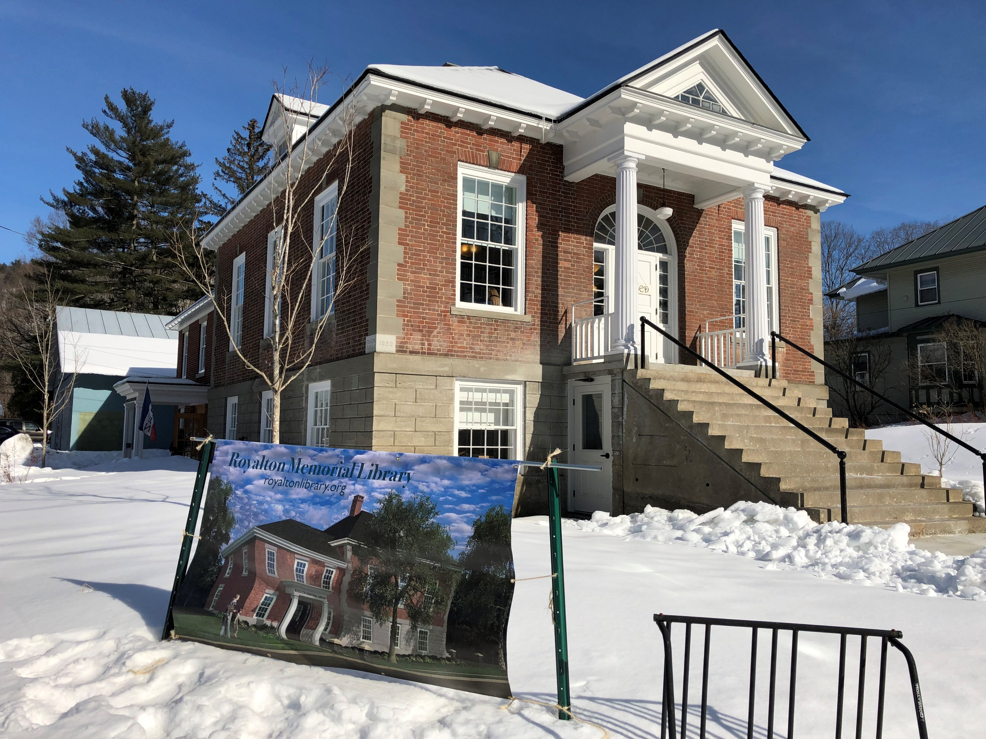
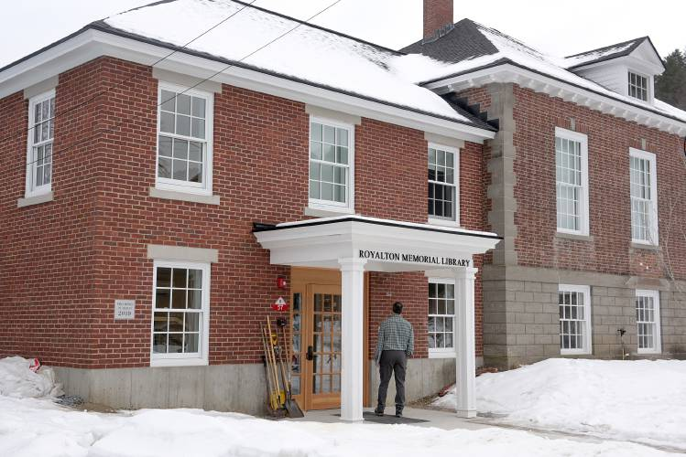
Completed Project
Notes:
A few pictures of the completed project. The new entrance is welcoming. It isn’t hidden around back or look “secondary,” and it doesn’t compete with the original historic entry portico which is a win-win.
Discuss visually different but compatible if time ….

Slide 14
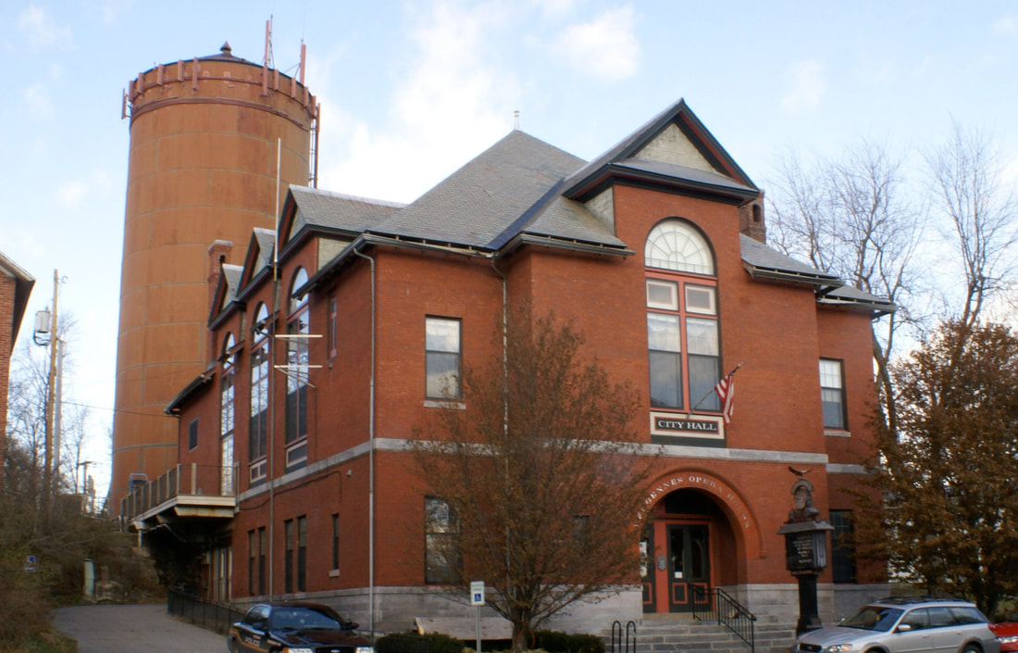
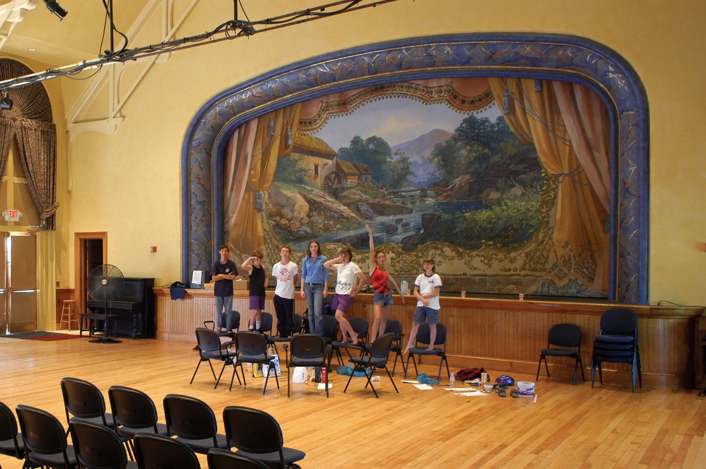
Vergennes Opera House
Constructed in 1897
Character Defining Features: Exterior brick and marble masonry, projecting pavilion with arched entry, monumental arched windows, slate roof, interior auditorium and stage, interior woodwork.
Notes:
This next case study is a project that hasn’t begun yet … but I wanted to highlight it because the project team is doing such a wonderful job of thinking really wholistically about access. The Opera House is also the City’s municipal offices. It is a beautiful historic building – and it really has to be ADA compliant to serve its residents into the future.
The current accessible entrance is far from ideal. To access the first floor, people must traverse this alley between the building and the neighboring church to a dingy secondary door … it is really unwelcoming. And I’m not sure the grade of the alley is even compliant.
To get to the auditorium level. It is even more ridiculous. You need to get yourself up around the back of the building (there is a steep gravel driveway but no parking) and from there take the little bridge to the second-floor doorway through a modified window. You can see the path of travel on this site plan.
When the project team started to look at this project, they had the goal of not only making the main two levels accessible and providing a more welcoming entry for users of the compliant entry. They also wanted to provide access to the opera house stage and green rooms.

Slide 15
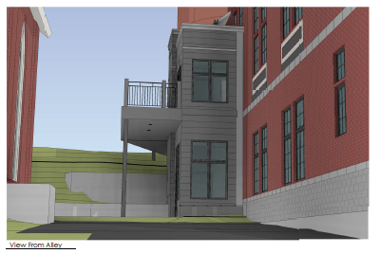
Current Plan
Notes:
A few more renderings … and you can see the version on the left which is where we are today. We did ask them to simply for the windows on the addition and add the parapet roof along the front to simplify the shape of the addition.
I don’t really have time today to show you the floor plans as well. But just wanted to reiterate that in addition to providing a more welcoming entry and vertical access to the main levels of the building. This project will also provide a second internal lift to provide ADA compliant access to the stage and the green rooms … and ADA compliant restrooms in the green rooms so that anyone can take part in all aspects of the activities within the building. All sensitively designed to minimize the changes to the important architectural and historic details of the building.

Slide 16
Resources
National Park Service Preservation Briefs:
https://www.nps.gov/orgs/1739/preservation-briefs.htm
#14 – Exterior Additions
#15 – Architectural Character
#32 – Making Historic Properties Accessible

Slide 17
Resources
Community Development Block Grants for Accessibility (CDBG): https://accd.vermont.gov/community-development/funding-incentives/vcdp
Vermont Arts Council Community Facilities Grants: https://www.vermontartscouncil.org/grants/find-a-grant/organizations/cultural-facilities/

Slide 18
Questions?
Caitlin Corkins, Tax Credits & Grants Coordinator
Vermont Division for Historic Preservation
caitlin.corkins@vermont.gov

