Slide 1
YIKES! – Where do I start?
Achieving access is an on-going process
Not something that you do and you’re done
Priority 1 - Parking, accessible approach & entrance
Priority 2 - Access to goods & services
Priority 3 - Toilet Rooms
Priority 4 – Other items such as water fountains and public telephones

Slide 2
Self Evaluation & Transition Plan
Places of Public Accommodation are not required to do a self evaluation and transition plan – but it’s a good thing to do
Requires a Transition Plan where physical changes are necessary to achieve program access (if 50 or more employees)
Use a checklist
www.adachecklist.org

Slide 3
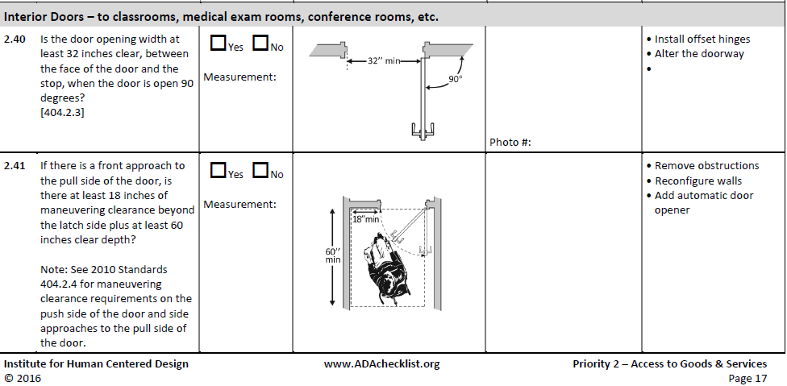

Slide 4
Transition Plan
A Transition Plan – documents the results of the Self Evaluation
The plan should detail how and when barriers are to be removed with a specific timeline and who is responsible
Some things you may be able to do immediately, others will take longer – years- if it involves complete renovations
This document shows your ‘good faith’ effort to come into compliance with the ADA

Slide 5
Resources
www.VCIL.org
www.access-board.gov/adaag/html/adaag.htm
www.adachecklist.org
http://AskJAN.org/links/adalinks.htm#III
www.ada.gov

Slide 6
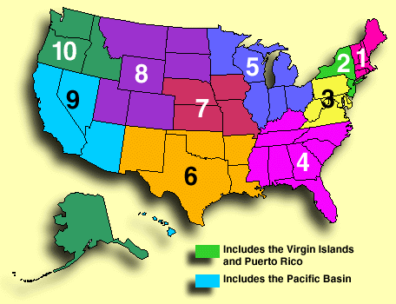
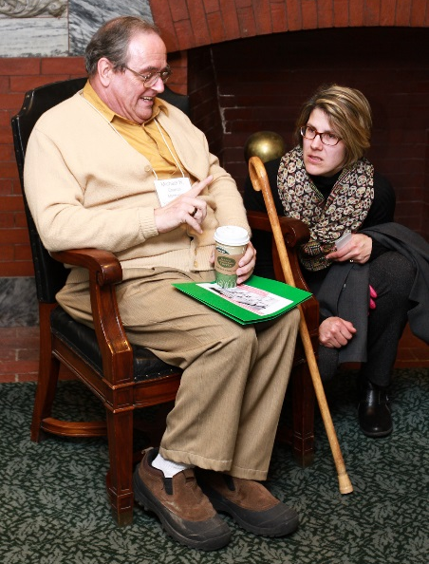
Vermont ADA Tech Assistance
New England ADA Center 800-949-4232 voice/TTY www.NewEnglandADA.org
Vermont Center for Independent Living
11 East State Street, Montpelier, VT 05602
800-639-1522 voice/TTY www.vcil.org
Mike Charron
mcharron@vcil.org

Slide 7
Knowledge Bites: Accessibility Upgrades in Community Projects
Peter Johnke, Vermont Center for Independent Living
Caitlin Corkins, Vermont Division for Historic Preservation
Presented by the Southern Vermont Economy Project, a program of BDCC & SeVEDS
Funded in part by USDA Rural Development

