Slide 1

Mission:
To provide engagement opportunities and partnerships with the University of Vermont for the benefit of our rural places.
Mission:
To provide engagement opportunities and partnerships with the University of Vermont for the benefit of our rural places.
Notes:
This text is boring. Feel free to change it. The logo is kind of bleeding, too.

Slide 2
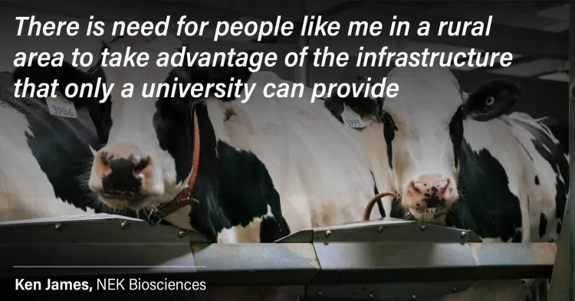

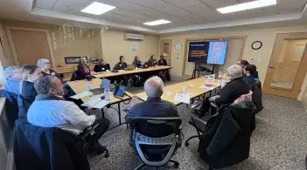
Office of Engagement and
Leahy Institute for Rural Partnerships
Grant-Funded Partnerships
Engagement Initiatives
Convenings

Slide 3
Elements of a Partnership Grant
$20,000-$250,000 grants
One-year period of performance
Community partner-university collaboration
Centers rural problem solving
Involves students
Considers scalability, sustainability,
and impact
Cycle 4 Schedule
Applications Open | May 4, 2026
Letter of Intent (LOI) Due | August 10, 2026
Invitation to Submit Proposal / LOI Denial | September 10, 2026
Proposal Due | October 13, 2026
Award Notification | November 23, 2026
Period of Performance | January 1, 2027 – December 31, 2027

Slide 4
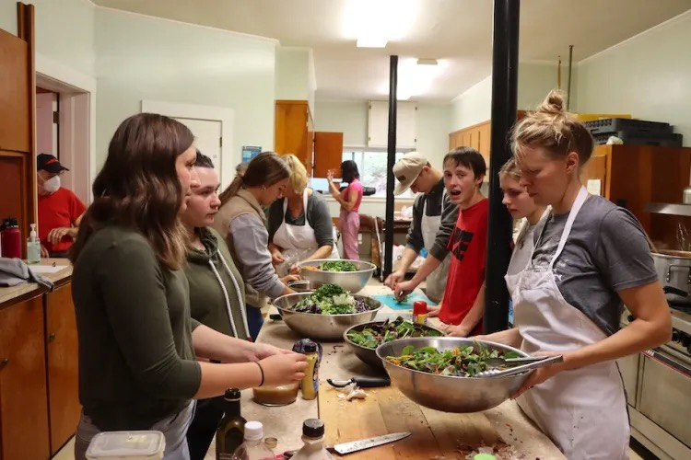
Grant: Catamount Community Schools Initiative
Notes:
Put a picture of Community Schools here. No text.

Slide 5
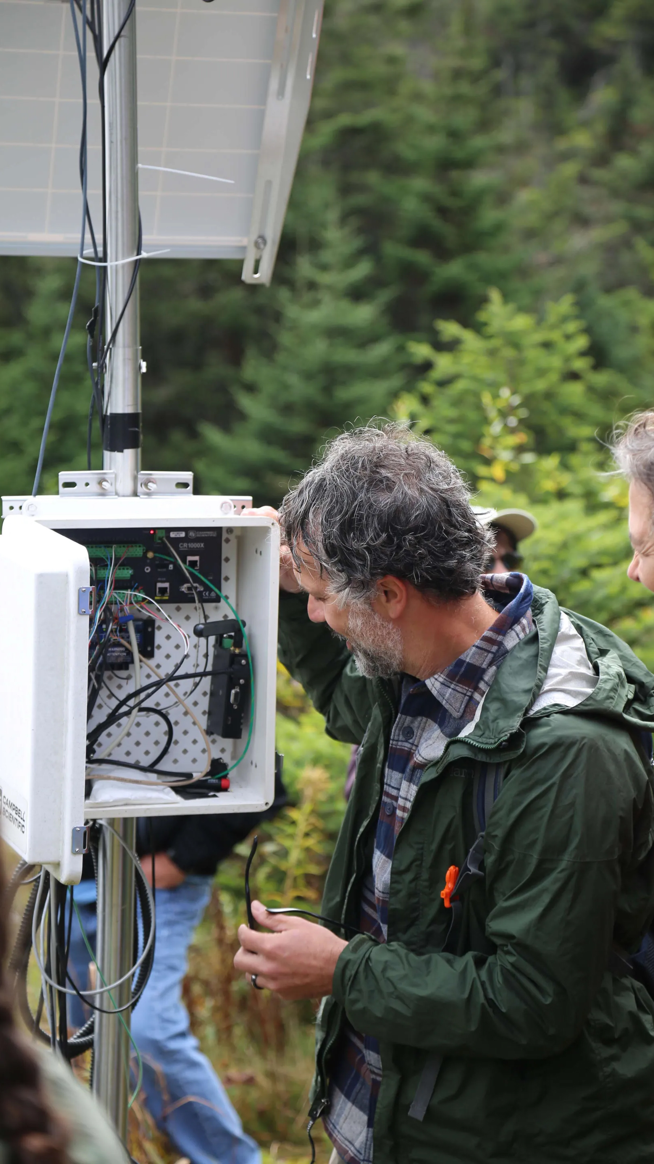
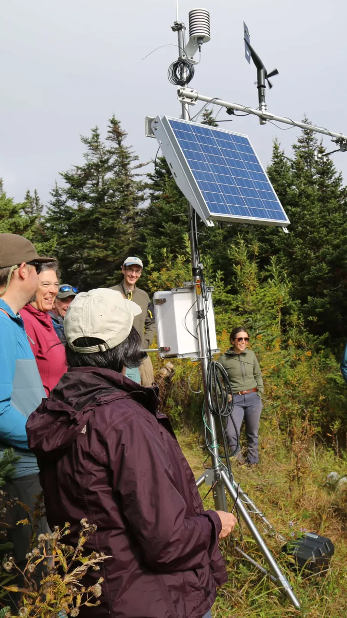
Grant: Vermont Mesonet
Notes:
Mesonet picture here.

Slide 6
Additional Ways to Partner with the Leahy Institute

Slide 7
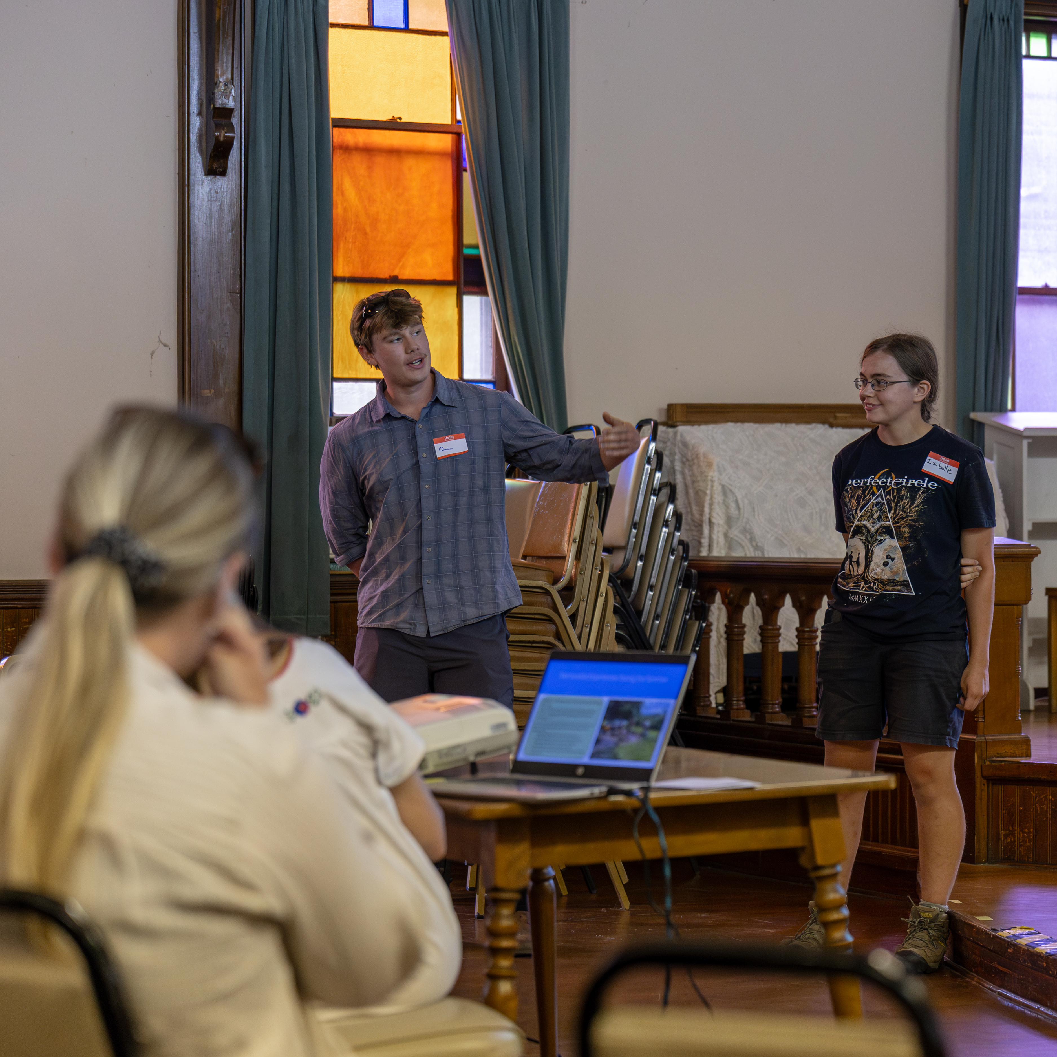
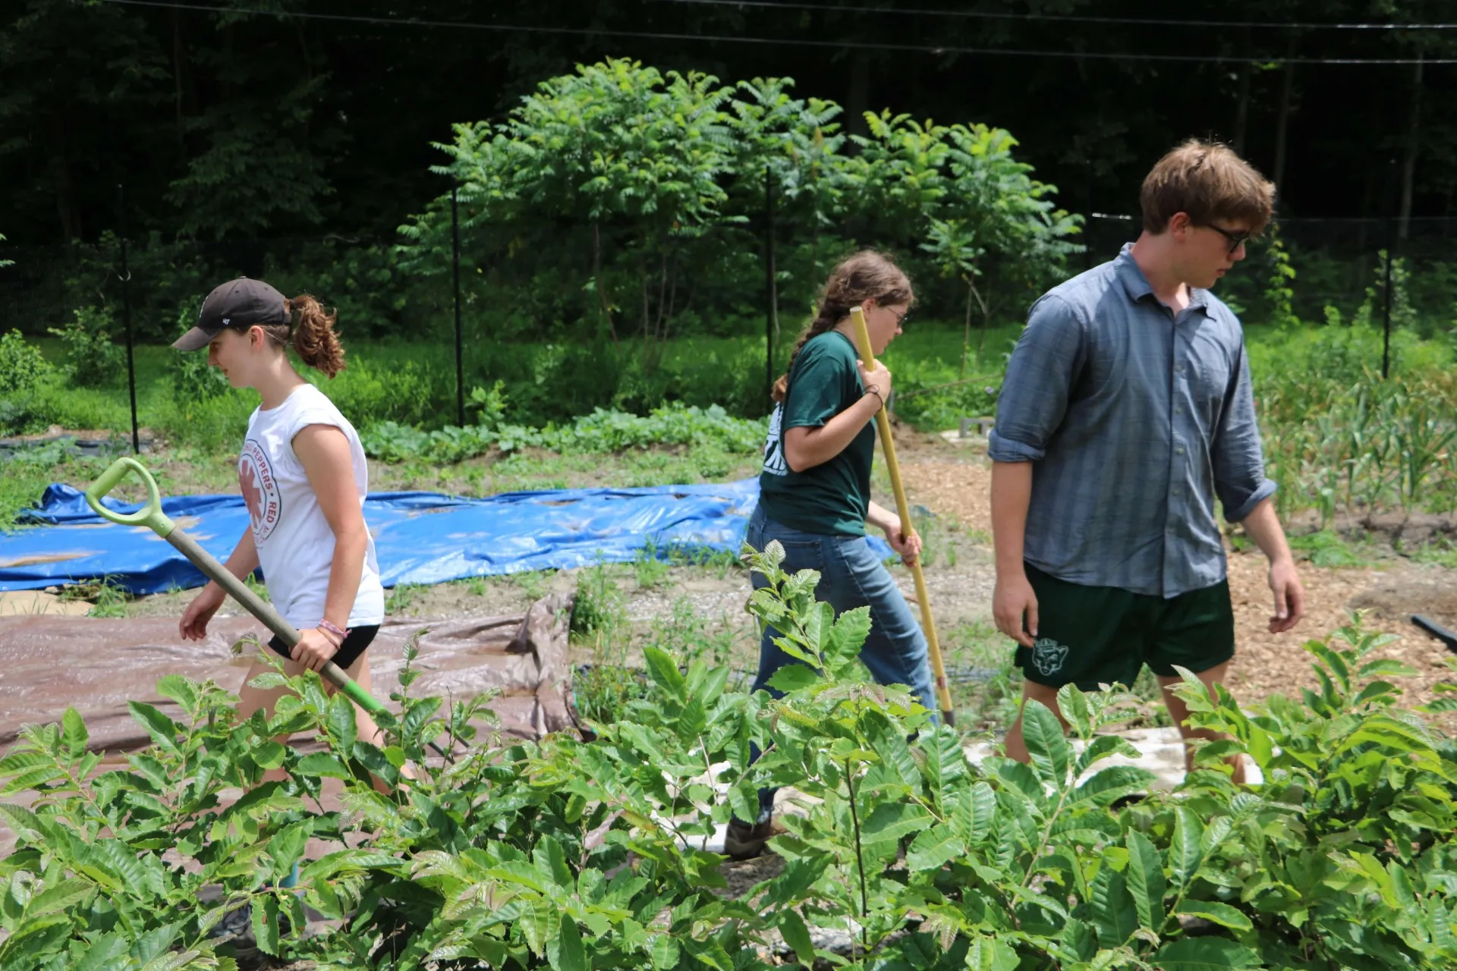
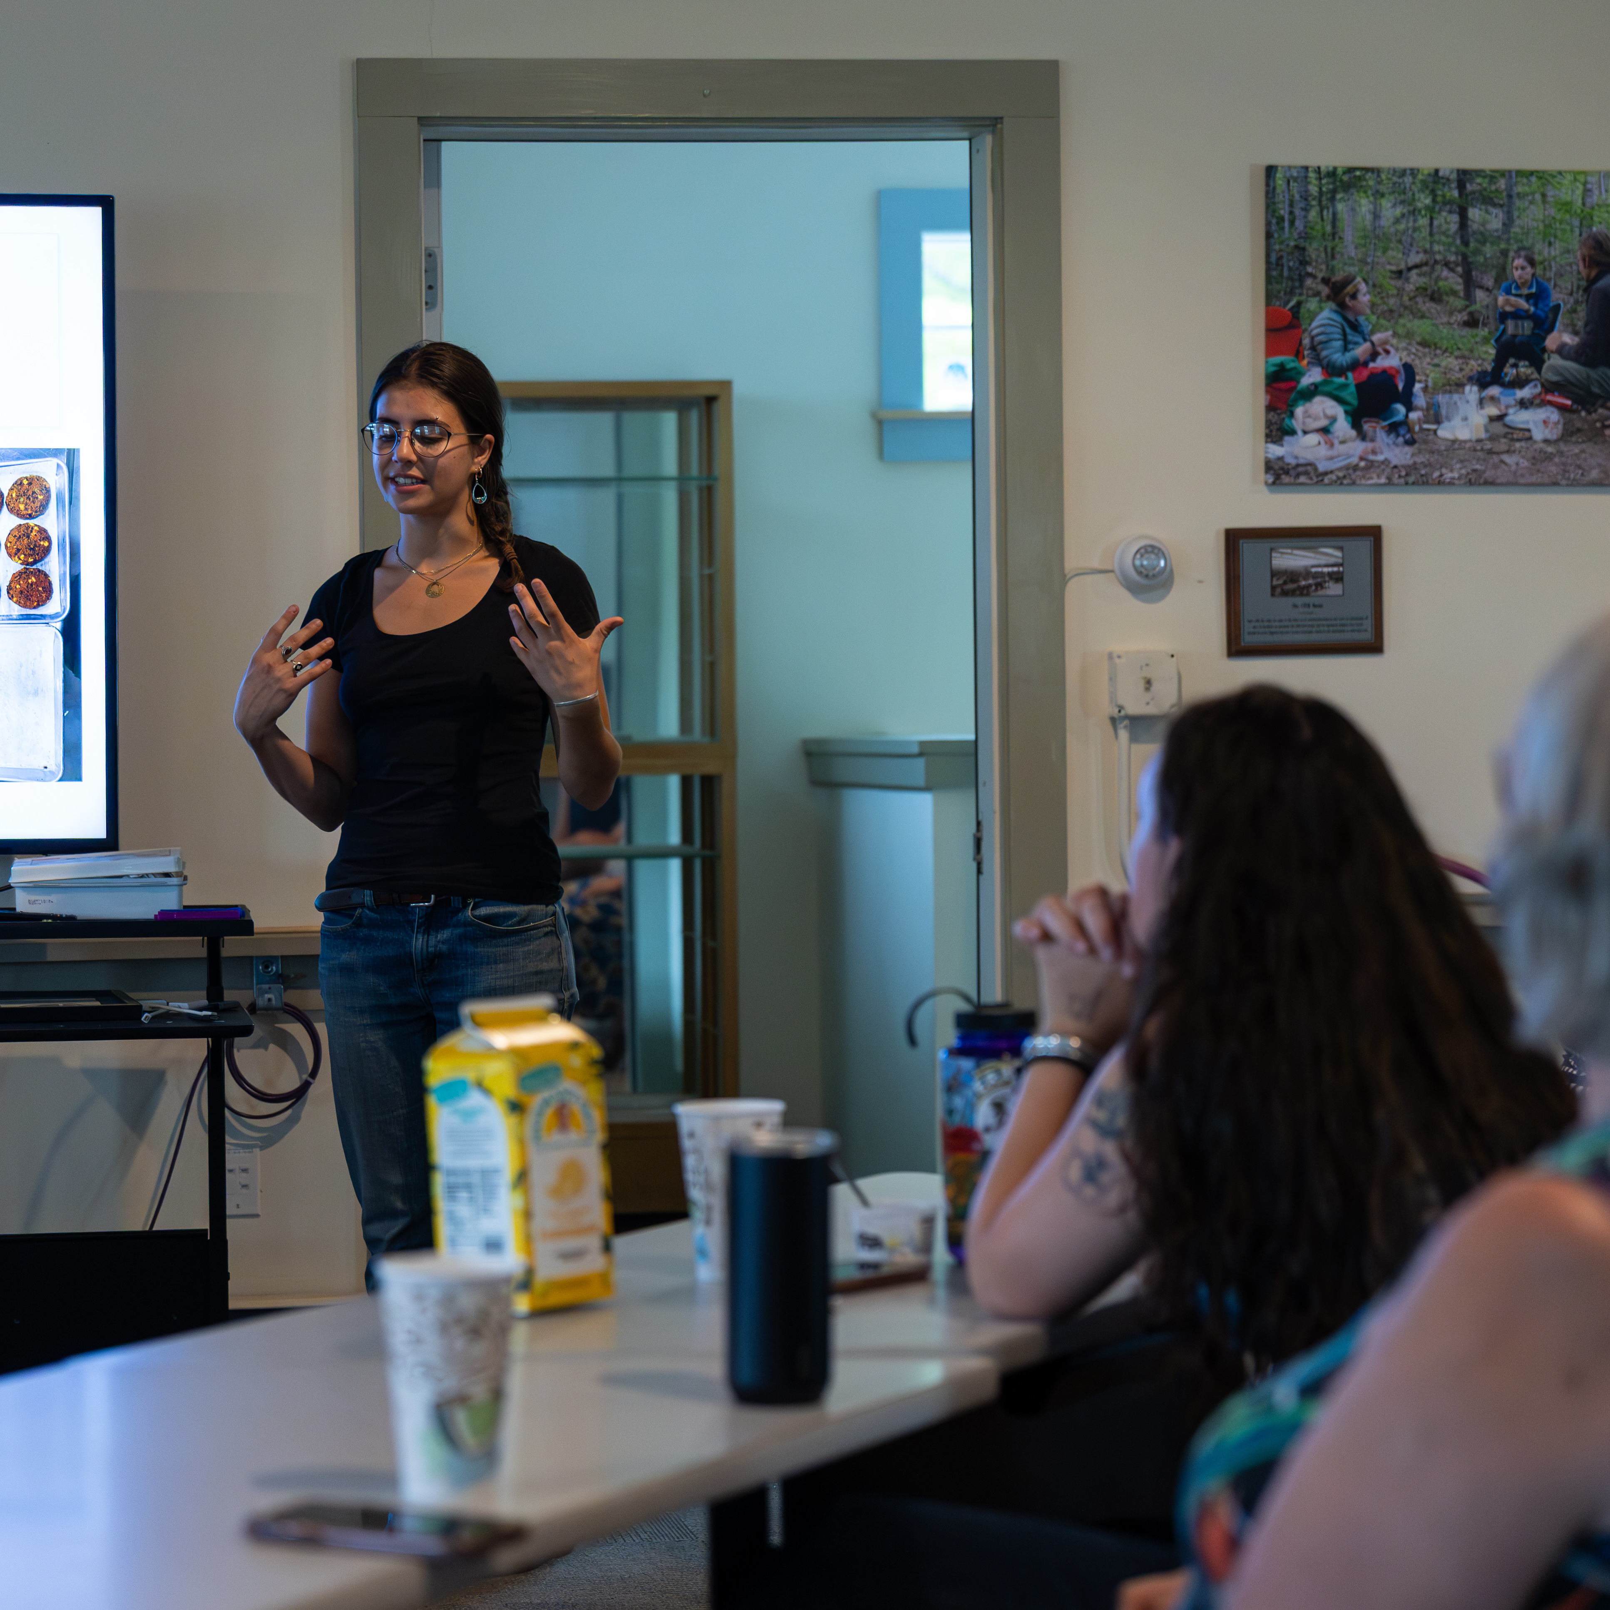
Statewide Summer Internship Program
Notes:
A collage of summer intern pictures here

Slide 8
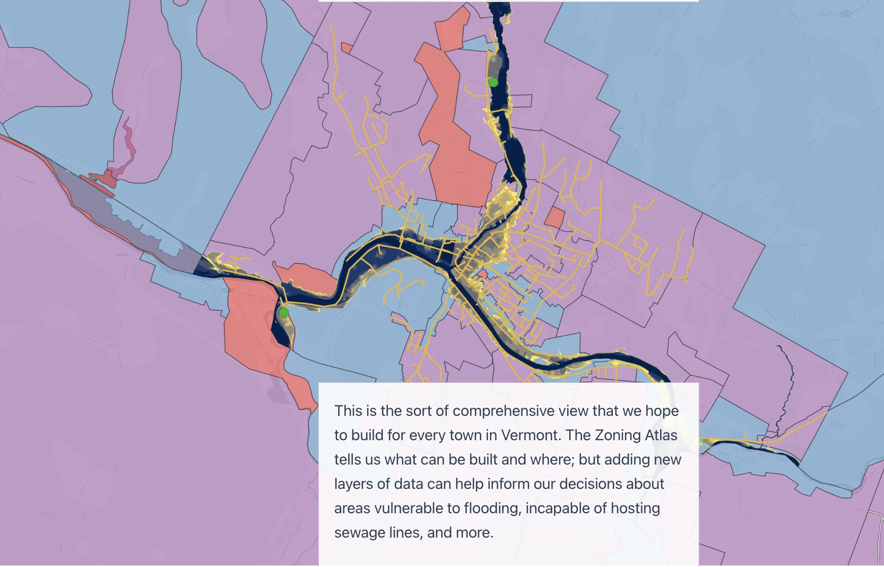

Engagement Initiative:
Vermont Data Collaborative
Notes:
New Data Collaborative slide here.

Slide 9
Questions? Want to chat?
Emma Spett
emma.spett@uvm.edu

