Slide 1



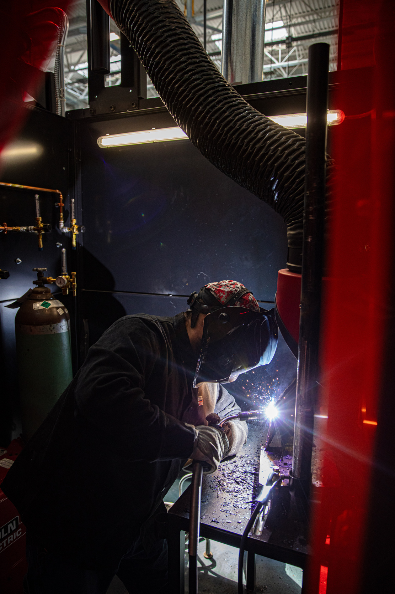
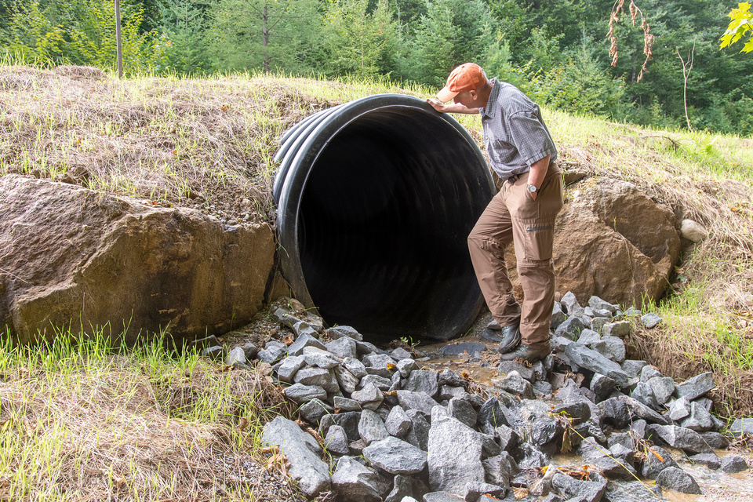
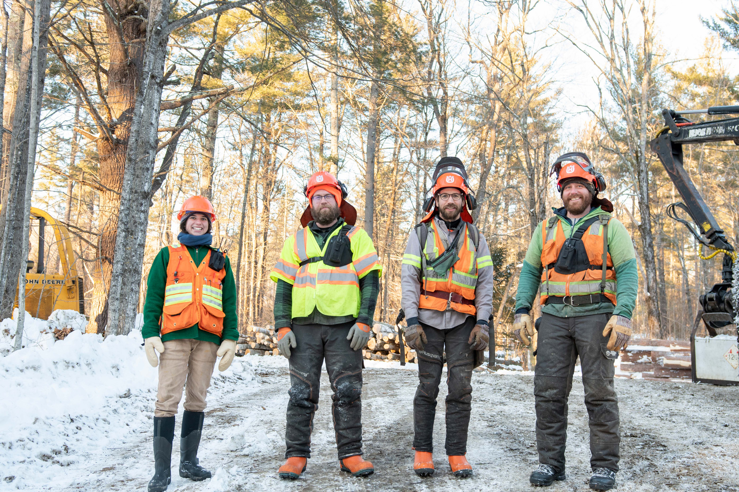

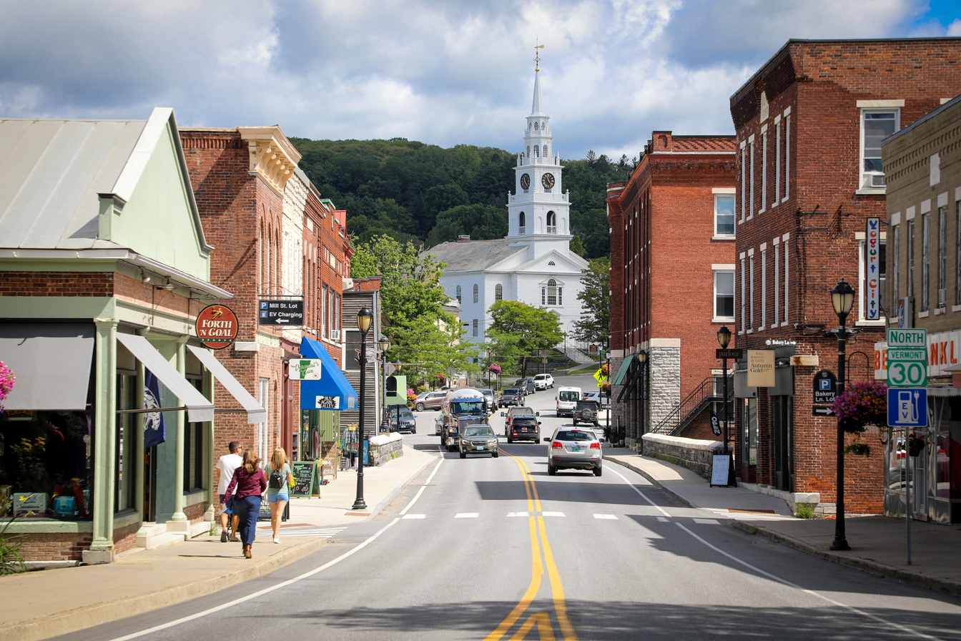

Competitive Grant Programs Overview
Windham Leadership Series
June 25, 2026
Presented by Sarah Waring, Executive Director
And Elisabeth Nance, Grant Programs Manager
FOSTERING VIBRANT FUTURES FOR RURAL COMMUNITIES

Slide 2

The Northern Border Regional Commission (NBRC) is a federal-state partnership for economic and community development in northern Maine, New Hampshire, and New York, and all of Vermont. Each year, the NBRC provides federal funds for critical economic and community development projects throughout the northeast, prioritizing areas of socio-economic distress. ​
NBRC’S MISSION:
We catalyze community vitality and economic prosperity in the northern border region with flexible funding and strategic support.

Slide 3
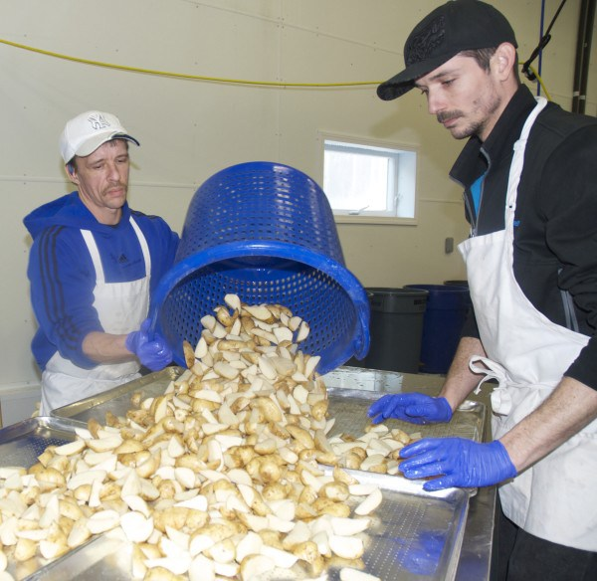
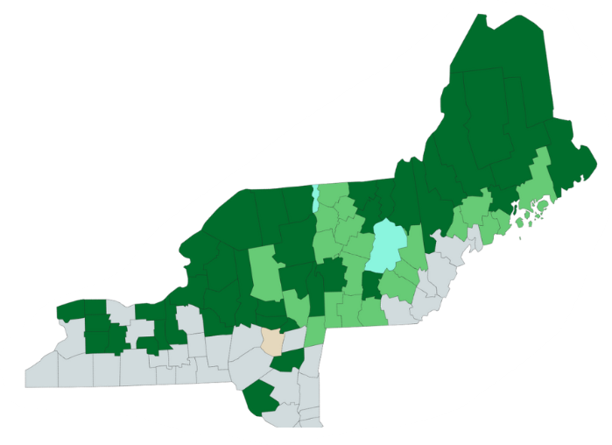
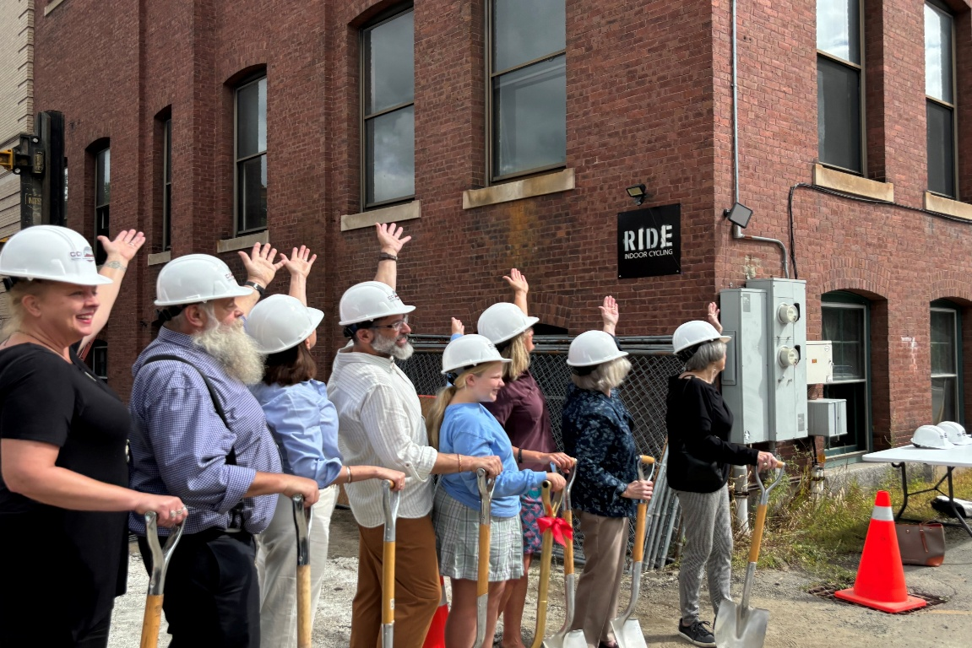
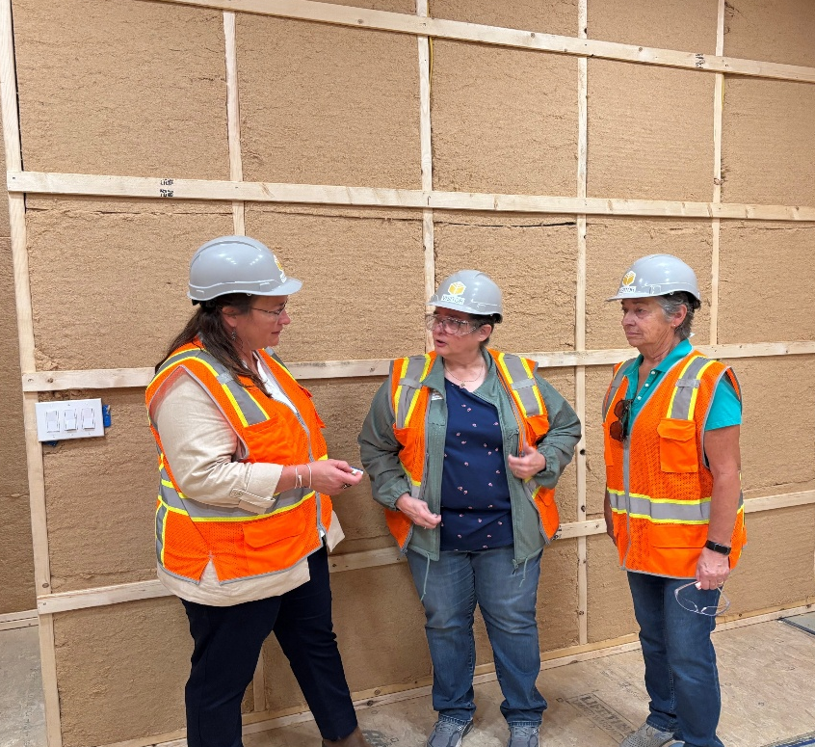
How it Works:
4 Governors and
1 Federal Appointee
focus on ‘distressed’ communities through:
Competitive Grants
Partnership Programs
Research
Collaborative Initiatives
Strategic Convening
Participatory, on-the-ground coordination for pro-active and responsive programming
What Makes It Unique: Shared Decision-Making
Congressionally appropriated funding
State-determined economic development priorities
Community-led projects and initiatives
Built-In grant administration assistance
Capacity funding for regional partners to support communities

Slide 4

Eligibility: Organization Type and Program Criteria
Your application must come from an eligible entity, and for NBRC funds these are:
    State and Local Govts, or subdivisions of State Govt
    Non Profit entities
    Institutes of higher education, career and technical centers
    Federally Recognized Tribes
Your application must include only eligible activities, and for NBRC funds these are based on the goals of each of our three competitive grant programs:
    Catalyst Program supports broad economic development activities: from water and wastewater systems to business incubators and childcare facilities, based on State’s stated economic development goals.
    Forest Economy Program supports the forest-based economy and assists in the industry’s evolution to include new technologies and viable business models.
    Timber for Transit Program supports the use of domestic forest products in transportation infrastructure projects to showcase the capabilities of wood in these applications.

Slide 5
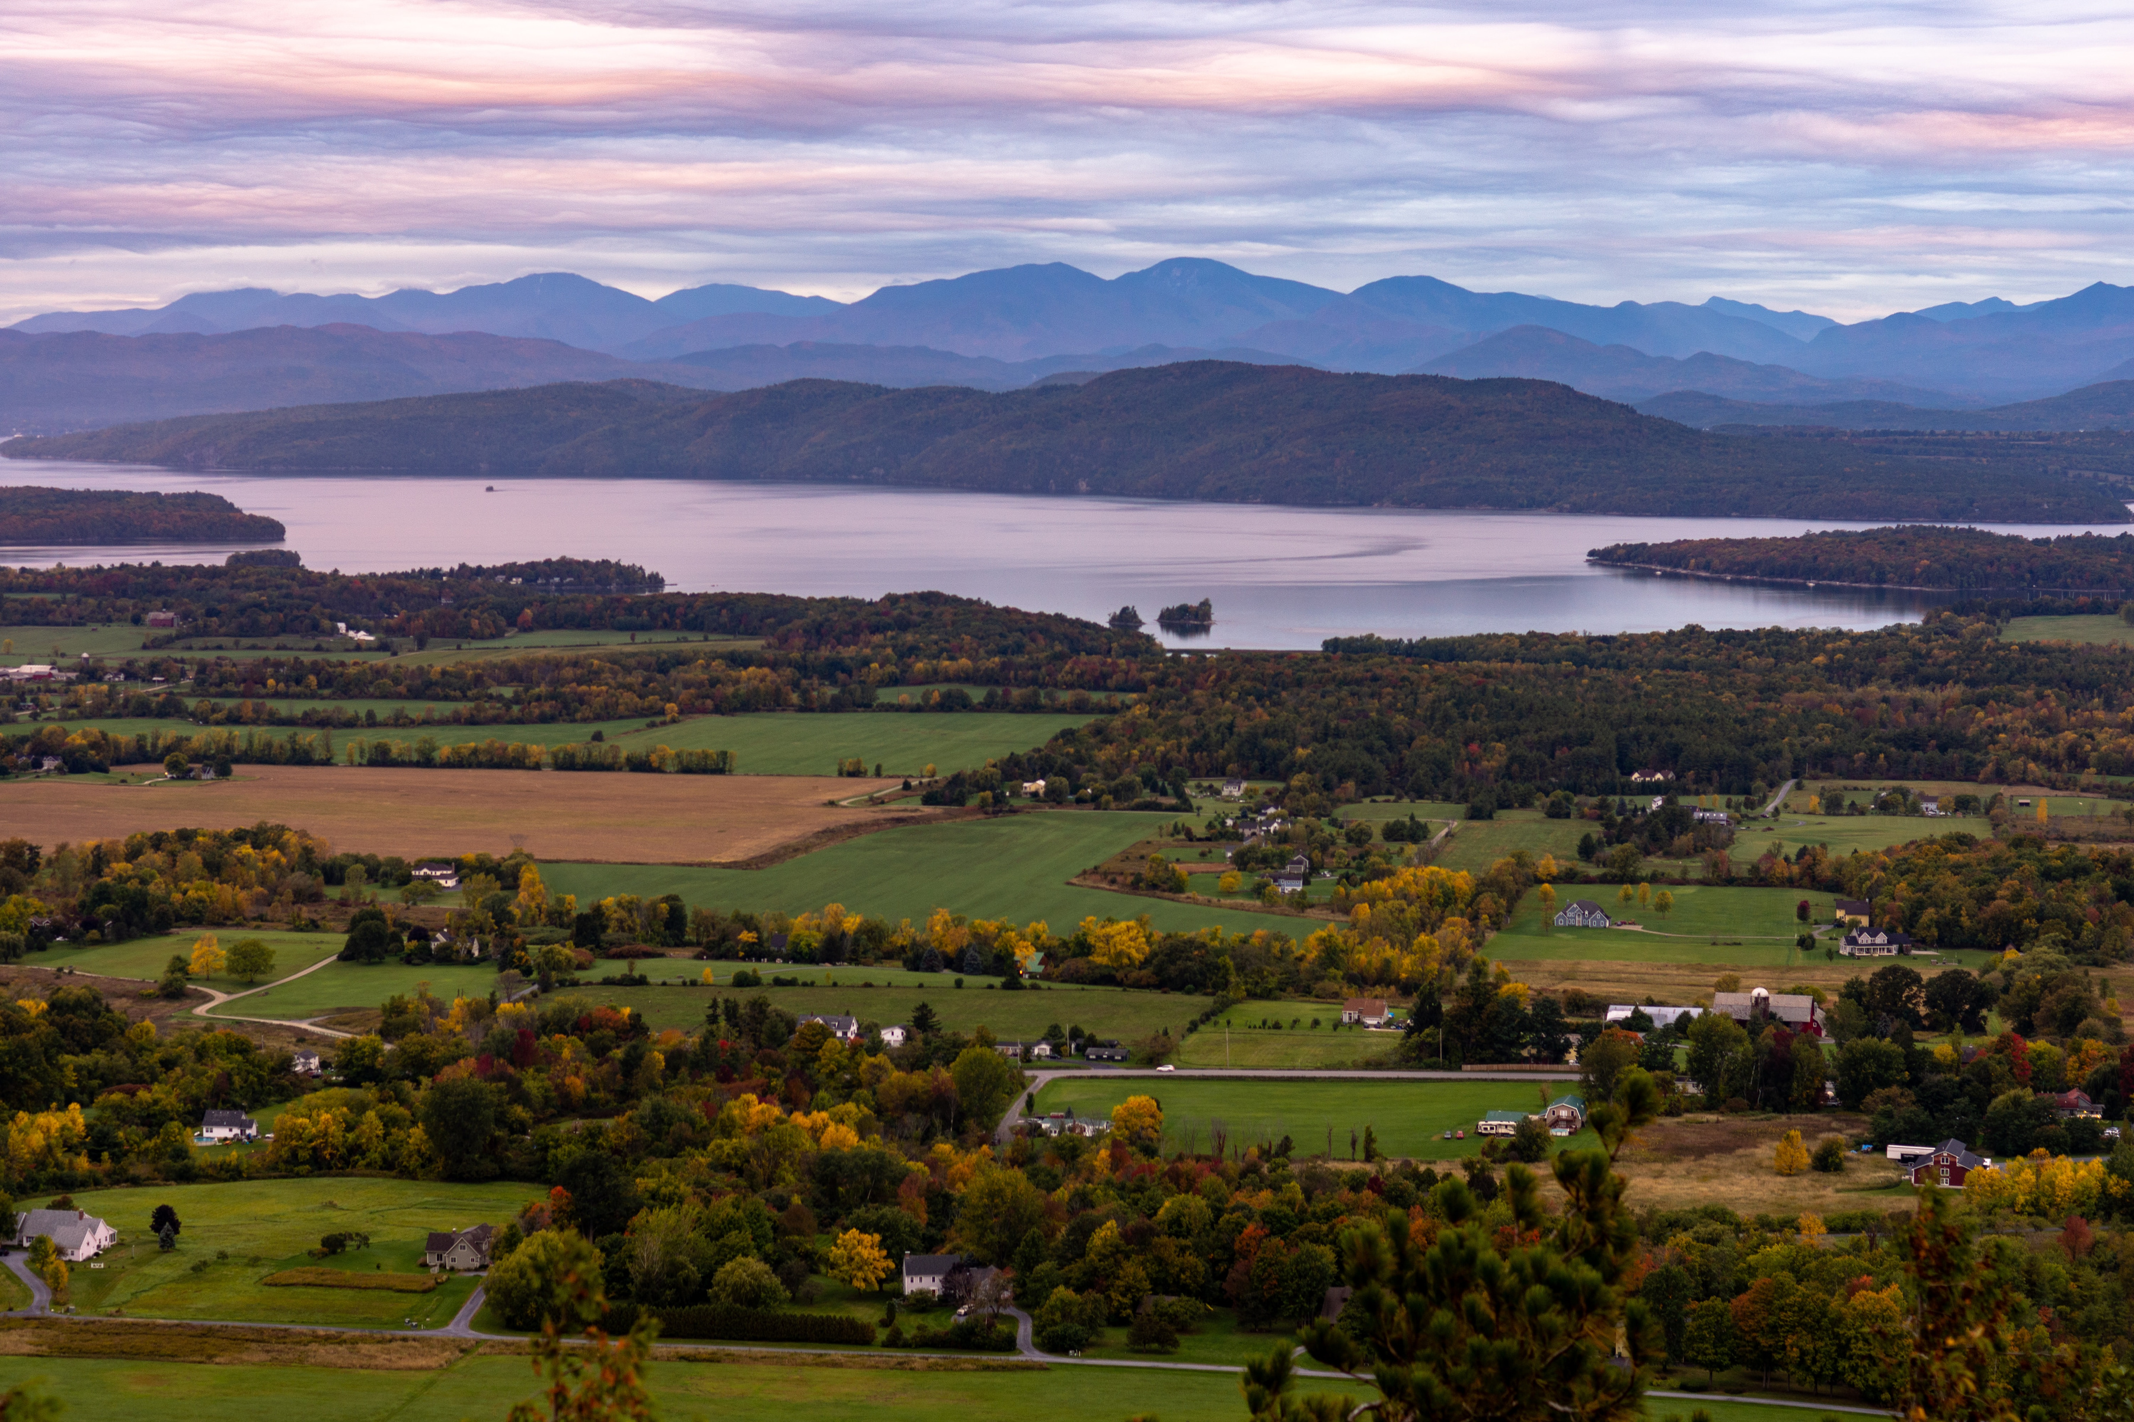
CATALYST PROGRAM
The Catalyst Program supports a broad range of economic development initiatives intended to modernize and expand the region’s basic infrastructure and revitalize communities to support and attract the region’s workforce.
Projects fall within one of two categories:
INFRASTRUCTURE
  Transportation
  Water and Wastewater
  Solid Waste
  Heat Generation Systems
  Basic Public
NON-INFRASTRUCTURE
  Feasibility Projects
  Business and Workforce Development
  Resource Conservation, Tourism, Recreation
  Basic Healthcare
*This program includes built-in grant administration assistance.

Slide 6

FOREST ECONOMY PROGRAM (FEP)
FEP supports the forest-based economy and assists in the industry’s evolution to include new technologies and viable business models across the 4-state NBRC region.
Examples of successful projects may include:
  Public infrastructure projects that directly support the forest industry
  Community development projects that support the diversified use of forest for economic activity
  Workforce training and development projects for the purpose of building the skills, recruiting, and retaining the workforce needed for forest businesses
  Marketing, communication and education projects that are paired with a public infrastructure, community development or workforce training or development project

Slide 7
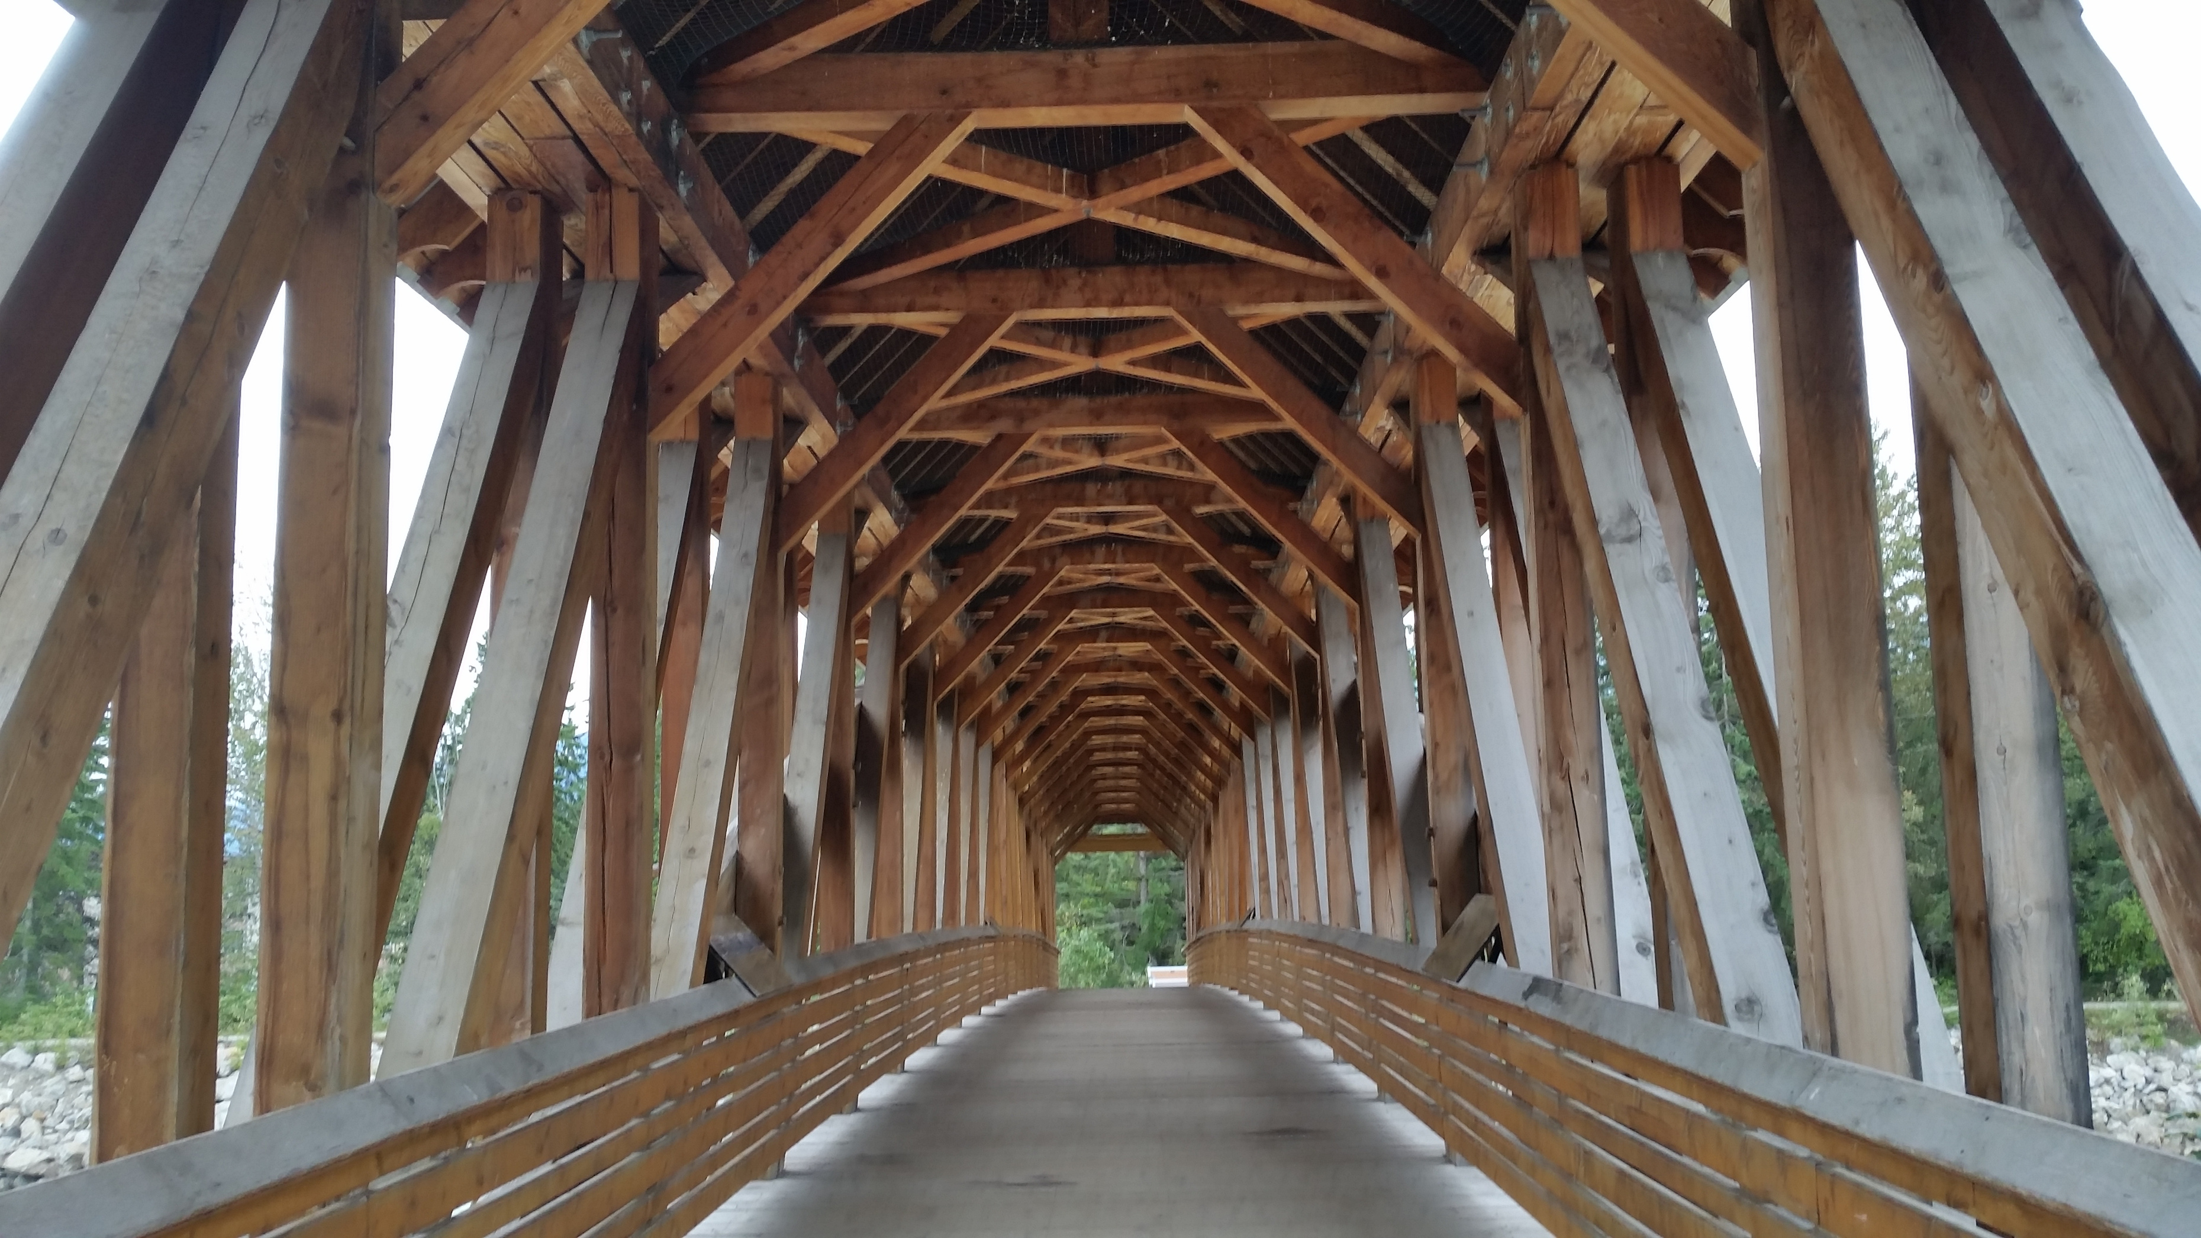
TIMBER FOR TRANSIT PROGRAM (T4T)
T4T advances the use of domestic forest products in transportation infrastructure projects across the NBRC region.
Examples of successful feasibility and implementation projects may include:
  State or regional inventory assessments of the suitability of wood components for necessary transportation infrastructure improvements and/or new construction
  Architectural and engineering designs, cost analyses, and permitting necessary for implementation of transportation infrastructure projects
  Transportation infrastructure projects and transportation-adjacent structures which utilize commercialized wood products and advanced wood materials
  Design and construction of pilot and demonstration projects that showcase the capabilities and benefits of utilizing advanced wood materials in transportation infrastructure

Slide 8
Funding: Grants Sizes and Applicant Match
But wait, it’s federal funding, so you also need MATCH funding (funds contributed by the applicant and/or outside sources):
Your % of MATCH funds depends on your socioeconomic DISTRESS
Your project’s service area will help determine if you have a COUNTY or COMMUNITY project
Go to NBRC’s website to find the annually published MATCH and DISTRESS criteria for your service area!(nbrc.gov)
PROGRAM | Project Categories | MAXIMUM Grant
Catalyst | Feasibility/Pre-Development | Up to $100K
Catalyst | Non-Infrastructure | Up to $500K
Catalyst | Infrastructure Implementation | Up to $1M
Catalyst | Multi-Jurisdictional or Multi-Infrastructure | Up to $3M
Forest Economy | All FEP Activities (Marketing/Comms/Education not stand alone) | Up to $1M
Timber for Transit | Feasibility/Pre-Development | $250K to $1M
Timber for Transit | Infrastructure Implementation | Up to $5M
Distressed: Eligible for 80% funding.
Requires a 20% match.
Transitional: Eligible for 50% funding.
Requires a 50% match.
Attainment: Ineligible for funding.
(Some exceptions apply.)

Slide 9
Competitive Grant Programs Application Process
APPLICATION PROCESS
Pre-App
Applicant connects with State Program Manager and Local Development District
Applicant submits a Pre-Application
Review
NBRC reviews Pre-Application for Eligibility and Activities alignment
State of Vermont review Pre-Applications for State Economic Development goal priorities
App
All Applicants receives feedback through Grants Management System, Invitations are issued
Selection
Invited Applicant edits and submits Application
NBRC review Application based on Scoring Criteria
State of Vermont reviews Application based on Scoring Criteria
Selected Applicants are notified of Grant Award and can begin process to reach Notice to Proceed

Slide 10
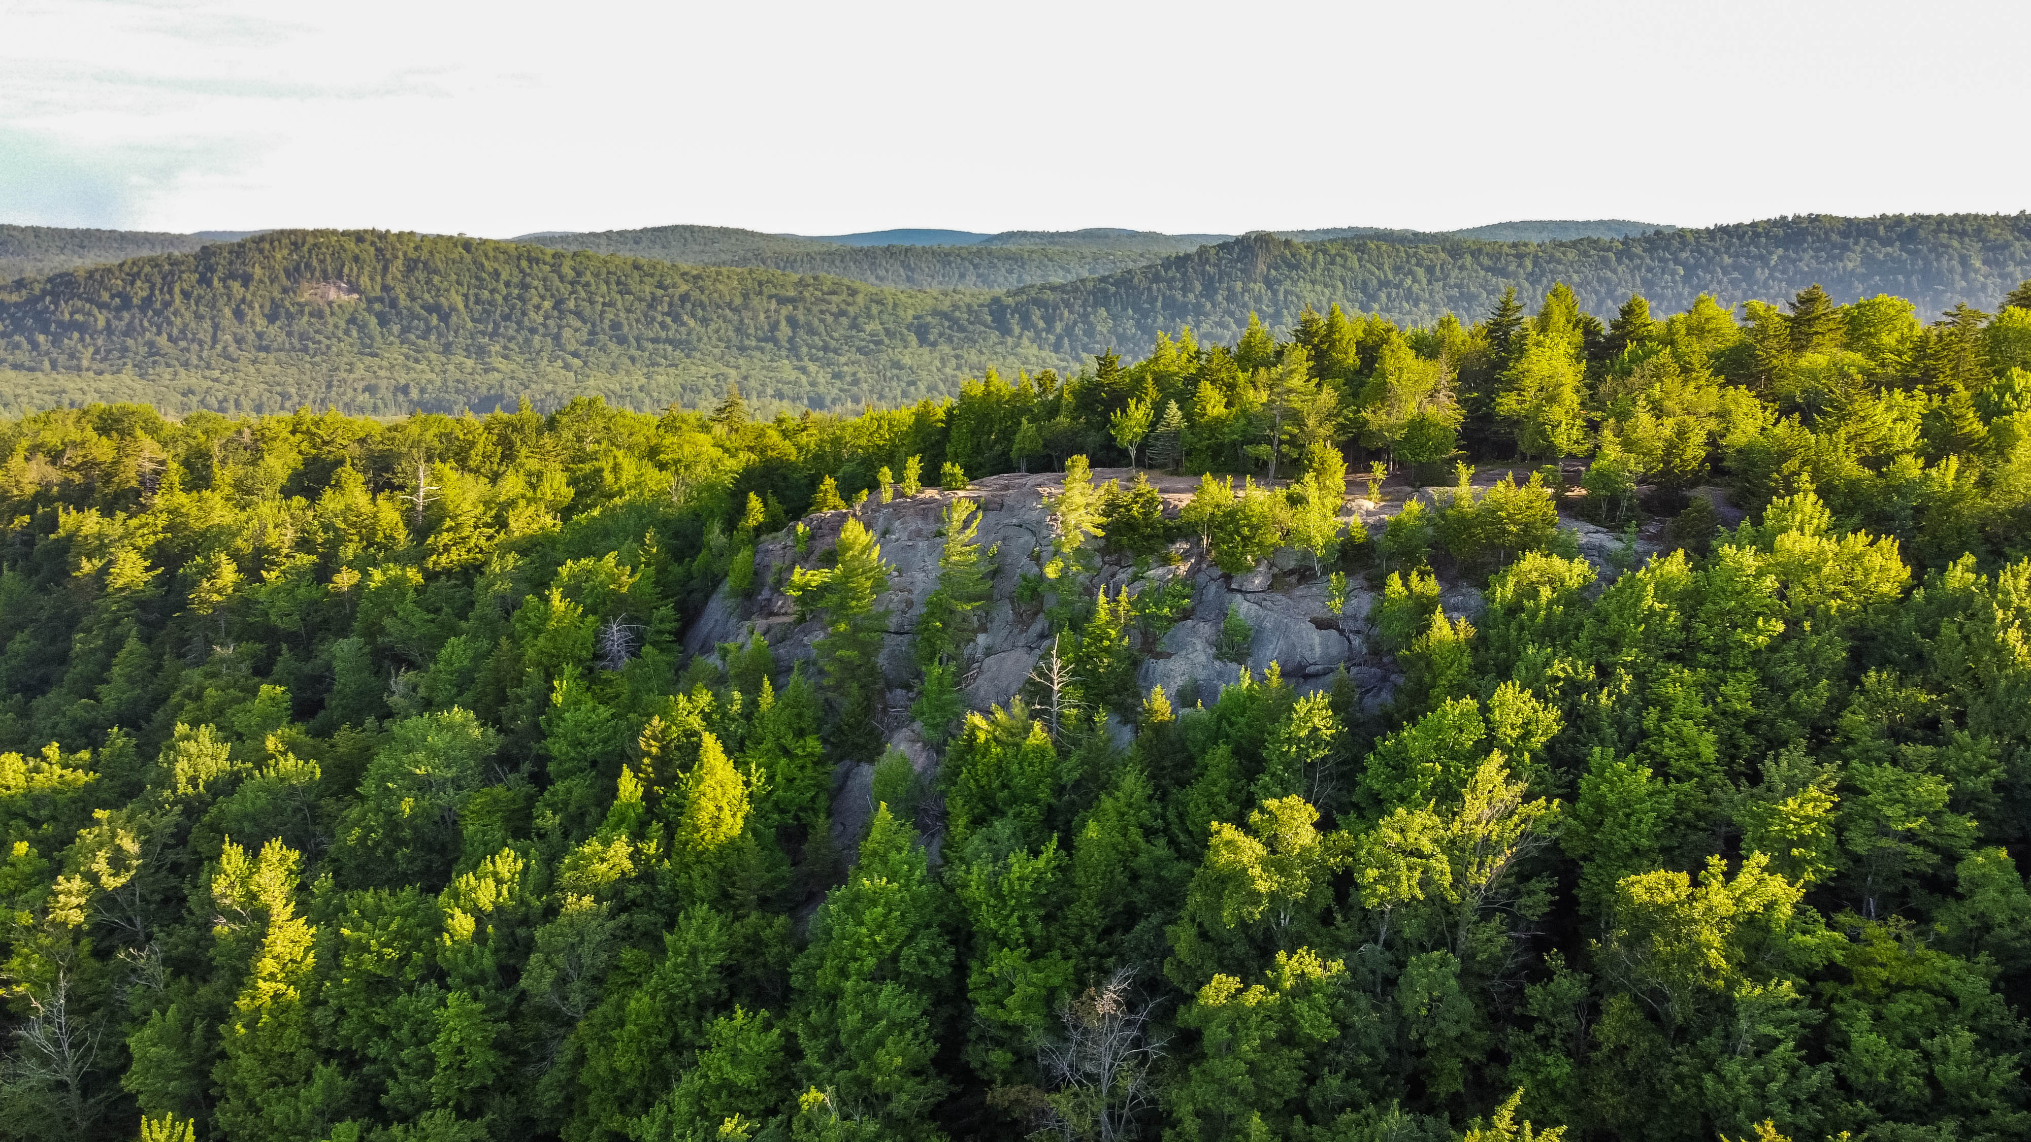
I am eligible, but is my CATALYST project competitive?
NBRC Scoring is based on 5 categories:
Project Readiness and Methodology
  Does this project demonstrate the proposed project can be completed within 3 years and that funds will start getting drawn down in the first year? Does this project clearly describe all major tasks and milestones including planning tasks before application and implementation tasks after award?
Project Budget and Documentation
  Does the project clearly show how NBRC funds will be used? Does the budget include realistic cost estimates? Does the budget narrative explain how the costs were developed and explain costs above $5,000?
Economic Impact and Alignment with Agency Priorities
  Does this project align with NBRC strategic investment goals and program priorities? Does the applicant clearly show the economic impact of this project? Have they provided feasibility studies and/or local, state or regional data to support these economic impacts
Organizational Capacity
  Has the applicant demonstrated they have sufficient organizational capacity to meet NBRC program requirements like completing their project on time, staff qualifications, partnerships, etc.

Slide 11
I am eligible, but is my CATALYST project competitive?
Vermont Scoring based on 5 categories:
Supports/expands/retains Vermont's skilled workforce
  Does this project demonstrate the proposed project directly or indirectly demonstrate impact(s) on the local, regional, or state workforce?
Infrastructure Investment
  Does the project support one or more of the infrastructure categories leading to long-term community and economic impacts?
Project Readiness
  Does the narrative and budget reflect the applicant's ability to successfully manage and complete the project?
Project Location
  Is the project located in or near an opportunity zone, state designated downtown, village center, etc.?
Regional Project Prioritization (RPP) List
  Is the project included on the region's RPP List?
Transformational
  Does the project aim to have a significant impact on the community and/or region?

Slide 12
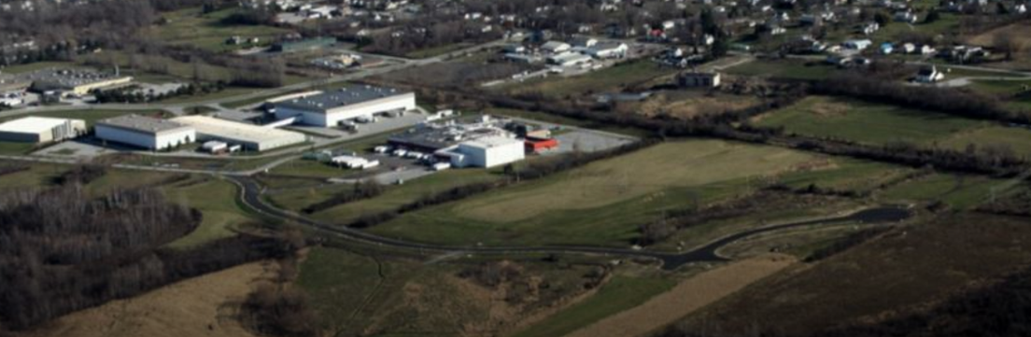
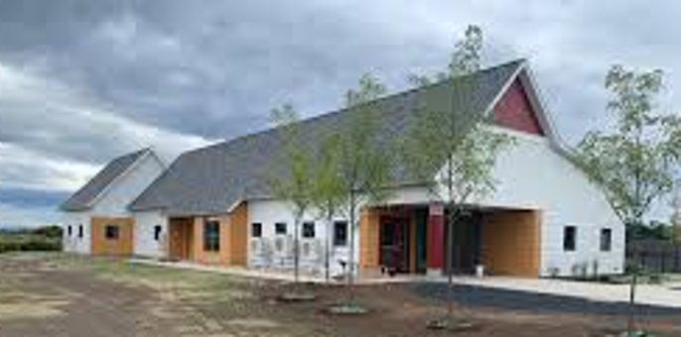
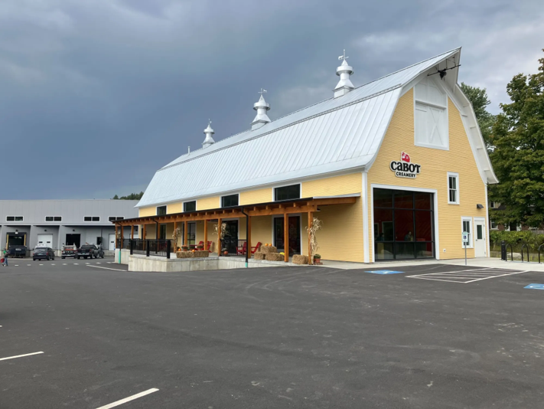
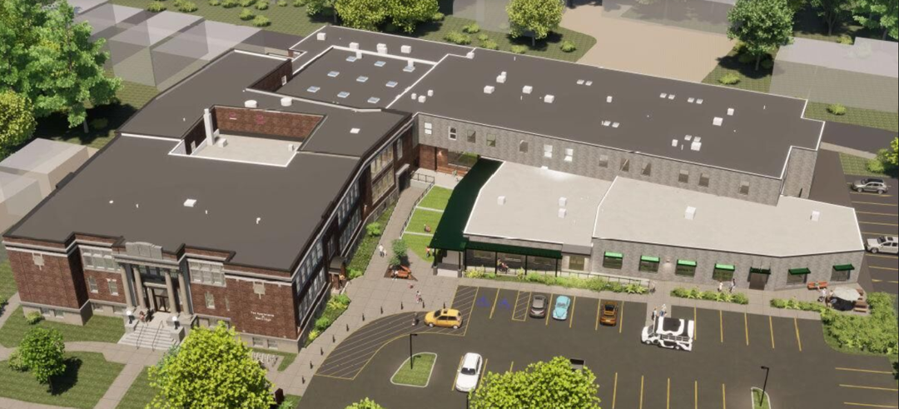

Slide 13
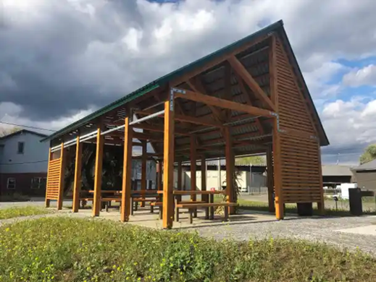
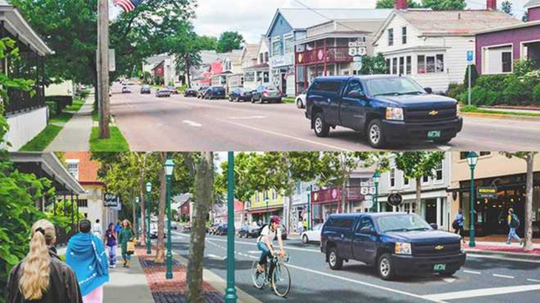
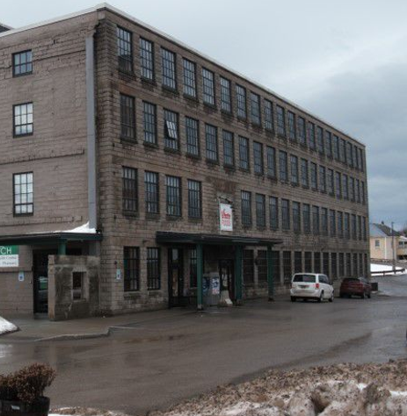
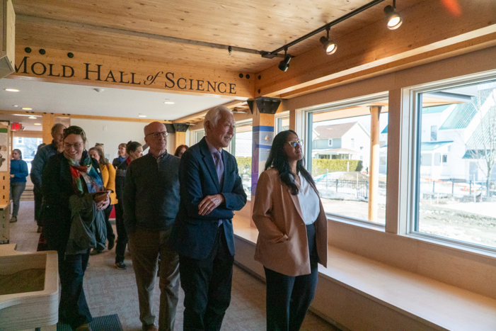
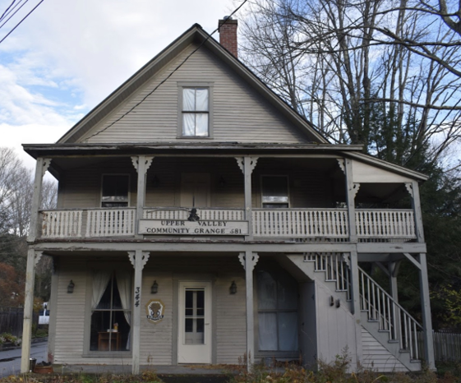
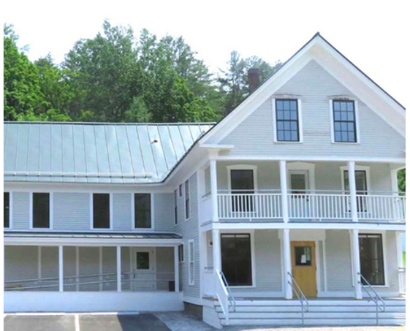

Slide 14
I am eligible, but is my FEP project competitive?
FEP Scoring is based on 6 categories:
Alignment with Agency Investment Priorities
  Does this project fit within the Forest Economy Program purpose, investment goals, and program priorities? Does the project identify beneficiaries and community context?
Project Budget
  Does the applicant provide a budget and costs that are clear and reasonable? Have they identified secured and appropriate match funding? Are estimates realistic?
Approach and Methodology
  Are major tasks, partnerships and other necessary details required to complete the project explained clearly? Do they address the sustainability of the project beyond the grant (if applicable)?
Forest Economy Sector Impacts
  Does the applicant clearly show the economic impact of this project? Have they provided feasibility studies and/or local, state or regional data to support these economic impacts?
Project Readiness
  Is applicant able to perform the proposed work within the 3-year performance period, from planning and design through permitting, engineering and implementation? Can the project move to a Notice to Proceed within 12 months of award date?
Organizational Capacity
  Has the applicant demonstrated they have sufficient organizational capacity to meet NBRC program requirements like completing their project on time, staff qualifications, partnerships, etc.

Slide 15
I am eligible, but is my T4T project competitive?
T4T Scoring is based on 6 categories:
Alignment with Agency Investment Priorities
  Does this project fit within the Forest Economy Program purpose, investment goals, and program priorities?
Project Budget
  Does the applicant provide a budget and costs that are clear and reasonable? Have they identified secured and appropriate match funding? Are detailed costs for wood product components included?
Approach and Methodology
  Are major tasks, partnerships and other necessary details required to complete the project explained clearly? Do they address the sustainability of the project beyond the grant (if applicable)?
Forest Economy Sector Impacts
  Does the applicant clearly show the economic impact of this project?Have they provided feasibility studies and/or local, state or regional data to support these economic impacts?
Project Readiness
  Is applicant able to perform the proposed work within the 3-year performance period, and begin to draw down NBRC funds within 12 months of award date?
Organizational Capacity
  Has the applicant demonstrated they have sufficient organizational capacity to meet NBRC program requirements like completing their project on time, staff qualifications, partnerships, etc.

Slide 16
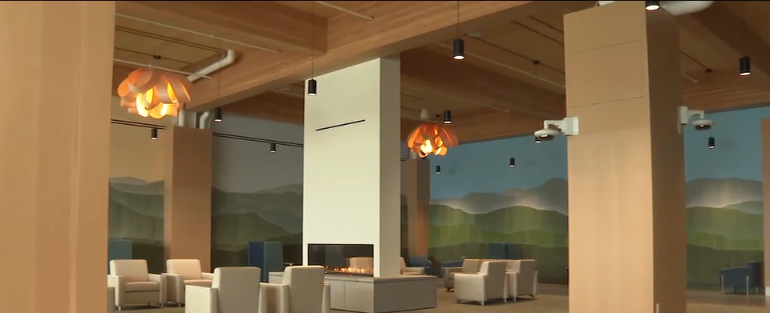
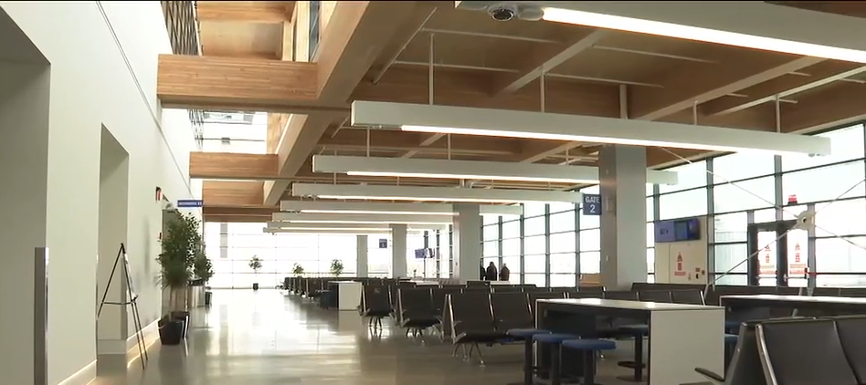
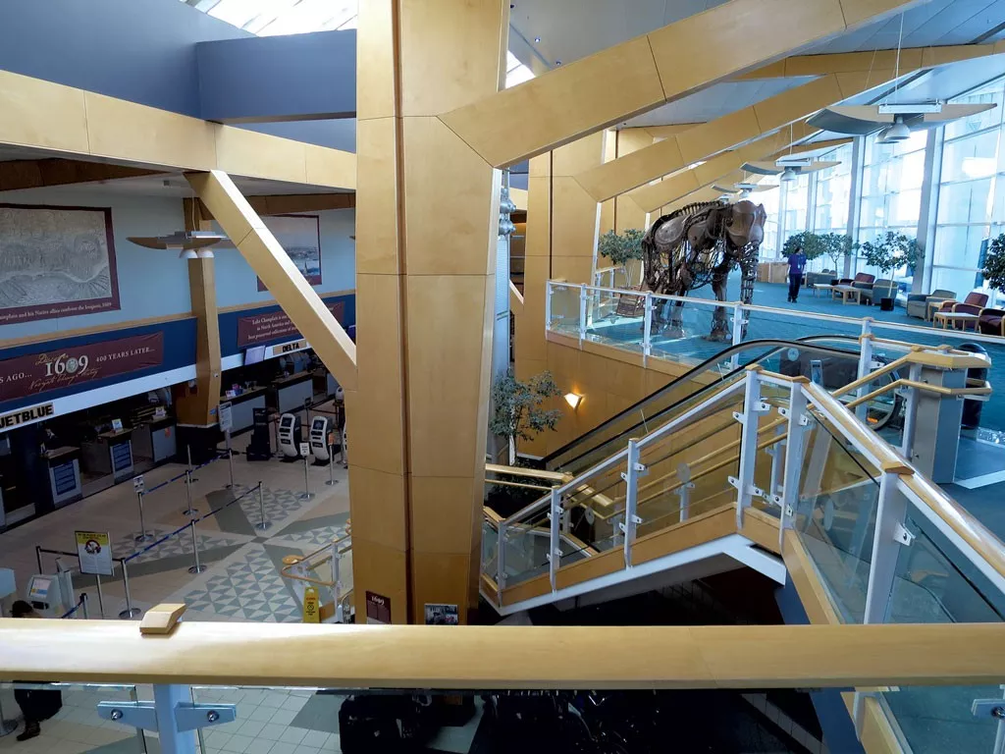
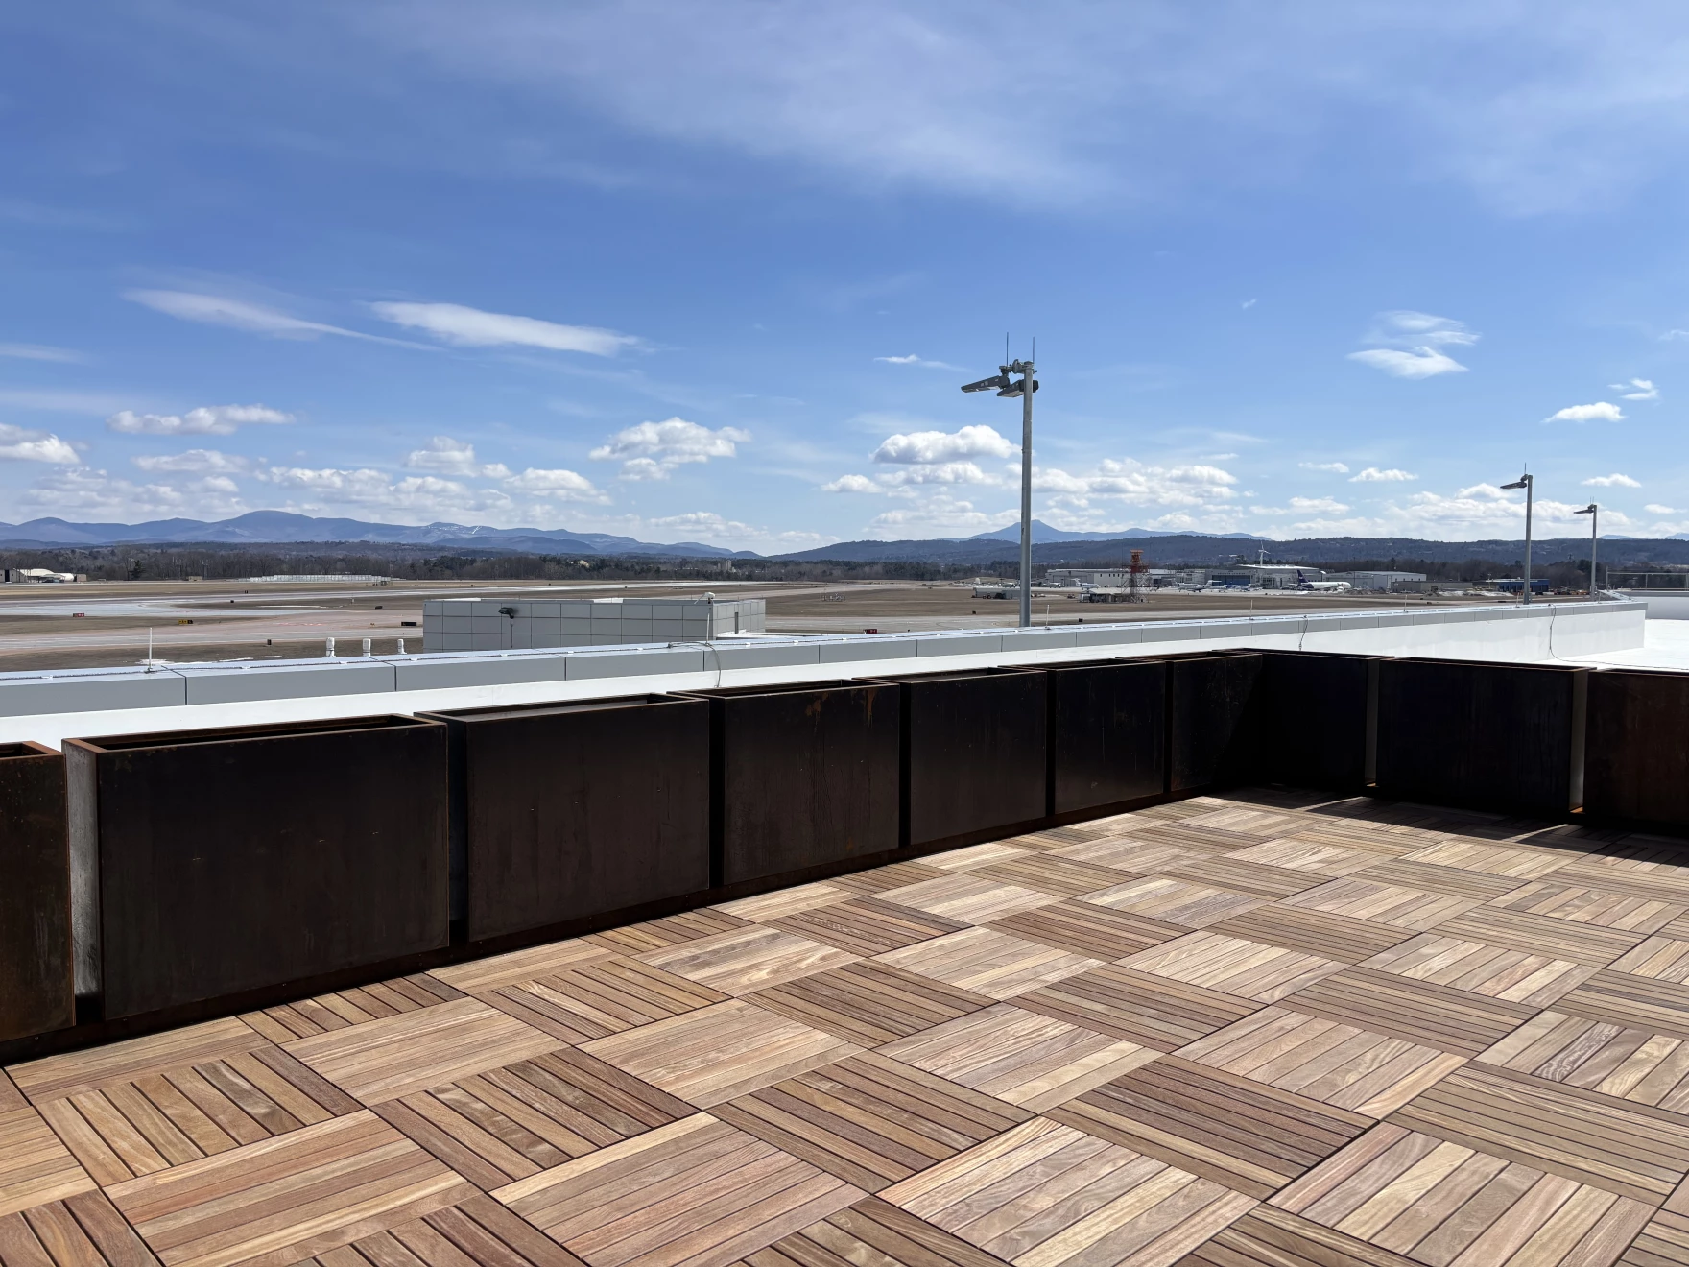

Slide 17

THANK YOU!
Sarah – NBRC (swaring@nbrc.gov)
Elisabeth – State of Vermont (Elisabeth.Nance@vermont.gov)
Agency of Commerce and Community Development/NBRC: https://accd.vermont.gov/economic-development/northern-border-regional-commission
Northern Border Regional Commission: https://www.nbrc.gov/

